Slide 1
PPT playbook example
Insides Sales Playbook

Slide 2
Lead Generation RWS Medical Affairs Advertising LinkedIn Campaign
Generate new leads for the business
Campaign element | Description
Marketing Contacts | Insert Lead Marketer(s)
Campaign Type | Ex. LinkedIn Sponsored Advertising campaign, Google Ad, live event, etc
Campaign Code | Insert Campaign Code
Campaign Start Date | Ex. June 19 2023
Campaign End Date | TBC
Target Audience | Ex. Primary Group Diana, Medical Affairs; Edward, HEOR; Sara, RWE; Isaac, CEO Emerging; Philippe, Head of Regulatory Ex. Secondary Group Paul, Market Access; Nick, Therapeutic Lead Commercial, Kelly, Brand Director Launch; Richard, Brand Leader/Lifecycle
Solutions Promoted | Ex. IQVIA Medical Affairs
Campaign Countries | USA, Canada, Europe
Call to actions | Let’s Talk

Slide 3
Inside Sales Actions – Examples below
MQLs will come through from the registration page.
Assigns to below Inside Sales contacts in SFDC
        US – initial outreach by Tyler Fleming (East Coast) or Jennifer Page (West Coast)
        EU – initial outreach by Arabella Chalmers
      Loop in Tim Spence in outreach
      Monitor and track for responses
      Reach out with the email message (see next slide). If it is a personal email:
        Search for Company email
        If you cannot find the Company email use personal email received
Add detailed Close status notes in SFDC.

Slide 4
Example Sample email if needed
Subject line: Your IQVIA Medical Affairs follow-up request from LinkedIn
Dear <NAME>,
Thank you for recently indicating on LinkedIn that you would like to connect and talk about how we can help you plan, generate and disseminate trustworthy medical evidence.
Please provide some details on your needs. We are happy to talk to you about a whole range of Medical Affairs topics including:
    Medical Affairs Strategy
    Evidence Generation
    KOL Identification and Engagement
    Medical Communications
    Field Medical
    Medical Information
I’d like to introduce you to my colleague Tim Spence copied here. Tim is part of our Medical Affairs leadership team and is happy to discuss further on your specific questions.
We look forward to hearing from you soon and are at your disposal for any immediate questions.
Thank you,
<NAME>

Slide 5
Inside Sales outreach instructions
If business units want to utilize their own outreach cadence, examples below
For every MQL please proceed with 3 outreach as follows:
  Outreach 1 - starts with using the email provided by the contact from the campaign
  Outreach 2 – starts 5 business days after 1st email outreach
  Outreach 3 – starts at least 1 business day after outreach 2 using LinkedIn
We want outreach to span 2 business weeks to account for contact being out of office.

Slide 6
Audience and Advertisements ex. marketing material

Slide 7
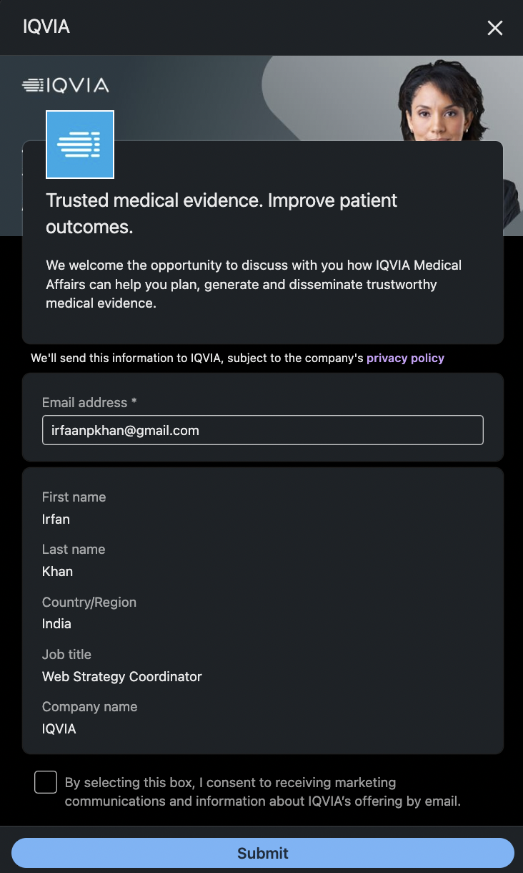
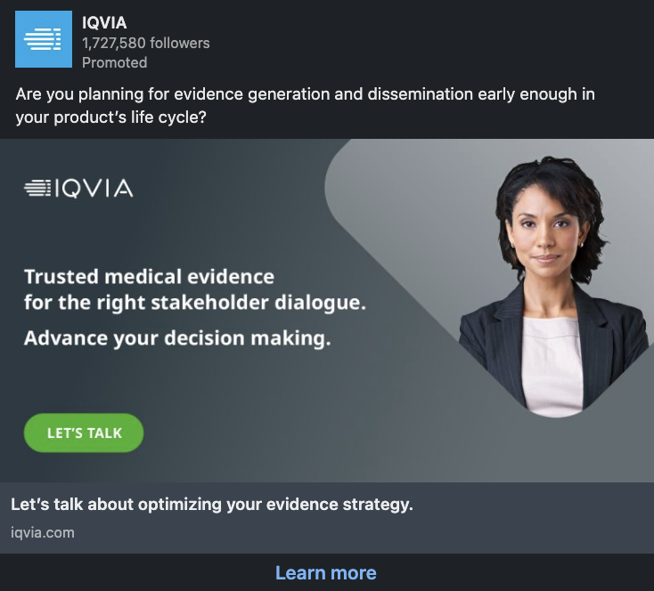
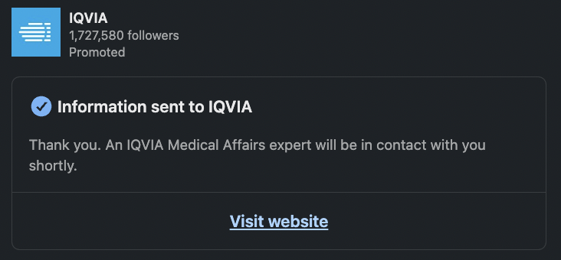
Medical Affairs Ad 1A
URL: https://www.iqvia.com

