Slide 1
Marketing Automation & Operations
Email Frequency Management

Slide 2
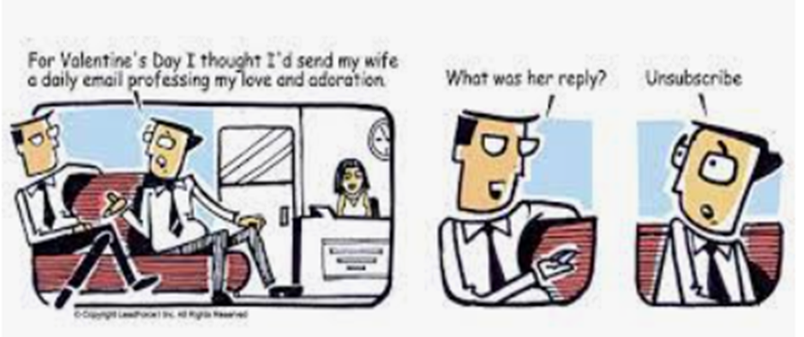
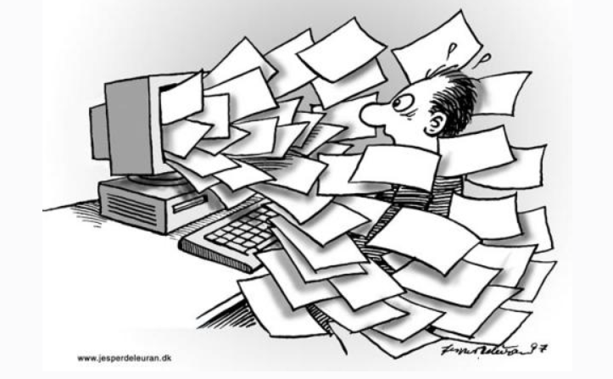
Email Frequency Management
The line between helpful and annoying, timely and spammy, converting and unsubscribed……
The #1 reason that subscribers flag emails as spam is “They emailed too often”
Per Campaign Monitor

Slide 3
Email Frequency Management
A complex challenge for a large, global and multi-product enterprise like IQVIA
What Marketing Automation you as a Marketer can do
Provide tools to assist marketers
What you as a Marketer can do
Planning with and across BUs
24 Hour Check Filter for Webinar/Event
Date check steps to prevent post-event mailing
48 Hour Check Filter for all other campaigns

Slide 4
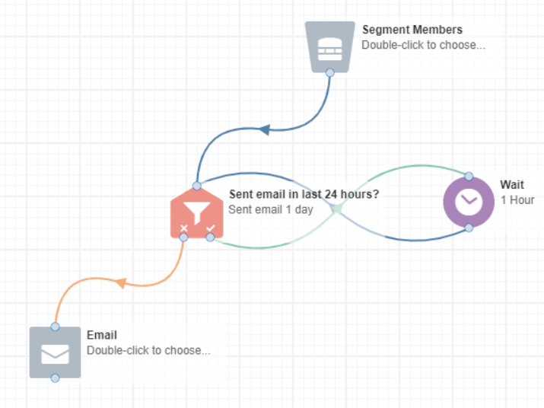
24hr Check Shared Filter
Fail safe to limit contacts to 1 email in 24 hours
Filter name is 'Sent email 1 day'
This shared filter reduces the chances of someone receiving more than 1 email in the same day
How does it work?
It looks at whether the contact has been sent an email in the last 24 hours.
If yes, then they fall to the wait step which refreshes every hour.
If no, they will then proceed to the email step
When should it be applied?
Apply to all webinar and event communications, except those being sent 1-2 days before the actual event.
Can also be applied to other mailings in conjunction with the stoplight program if required.

Slide 5
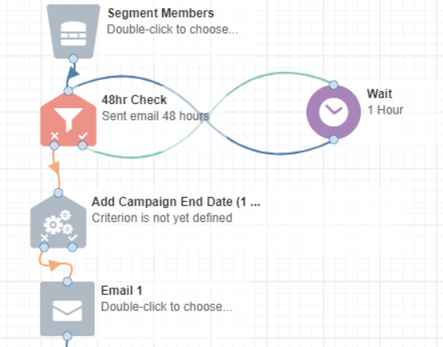
48hr Check Shared Filter
Fail safe to limit contacts to 1 email in 48 hours
Filter name is 'Sent email 48 hours'
This shared filter reduces the chances of someone receiving more than 1 email in a 48 hour period
How does it work?
It looks at whether the contact has been sent an email in the last 48 hours.
If yes, then they fall to the wait step which refreshes every hour.
If no, they will then proceed to the email step
When should it be applied?
Apply to all campaigns excluding webinar/events/time sensitive.

Slide 6
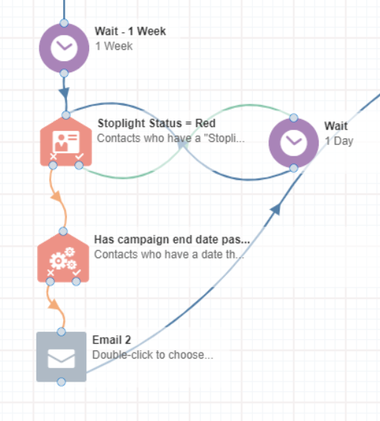
Date checks
Prevent emails being sent after an event
We can now add date check steps to a campaign before each email send to prevent contacts that have been held in stoplight/wait steps receiving emails that are no longer relevant
How it Works
We would need an agreed campaign ‘end date’ which we can add to the check step
When contacts arrive at this step the system will check if the date has passed. If it hasn’t then the contact will continue to flow through the campaign. If it has then the contact will be held at that step and won’t be sent any further mailings
When does this apply
Although probably more relevant for events/webinars this should be applied to all campaigns, especially where the stoplight is in place

Slide 7
Process map of filters on campaign canvas
24 hr filter
Contact sent email in last 24 hours?
Contact enters step
Yes
Email sent
No
Wait 1 hour
48 hr filter
Contact sent email in last 48 hours?
Contact enters step
Yes
Email sent
No
Wait 1 hour

Slide 8
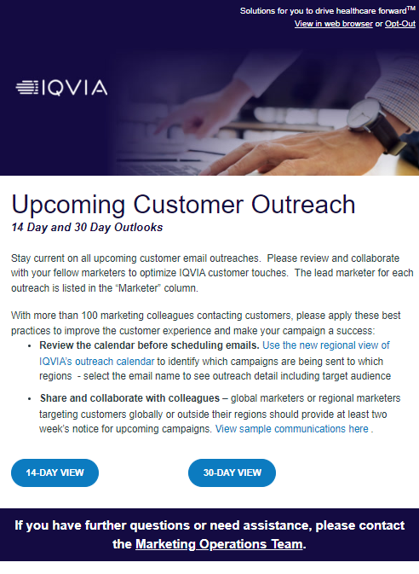
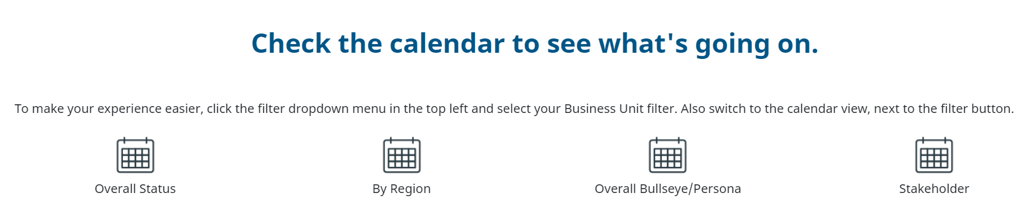
Marketing & Email Planning
Upfront planning and coordination with colleagues messaging similar Personas
Tools available to assist in that planning
Outreach calendar
Upcoming outreach notification email

Slide 9
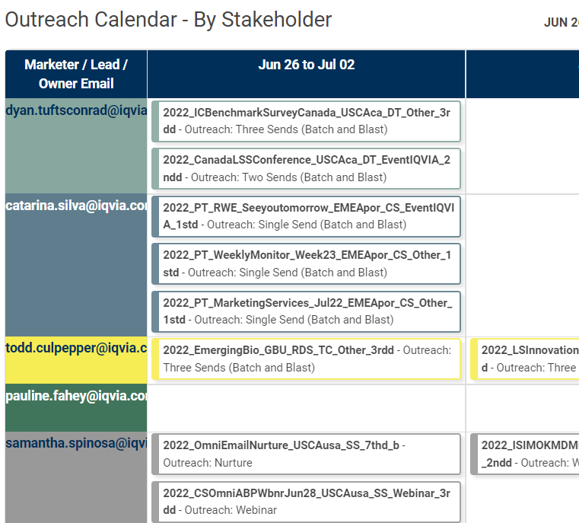
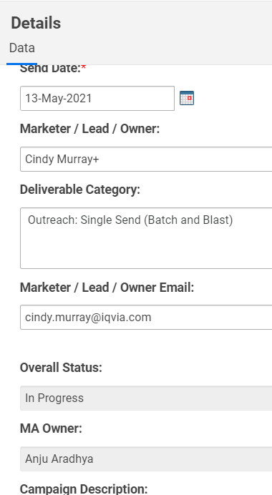
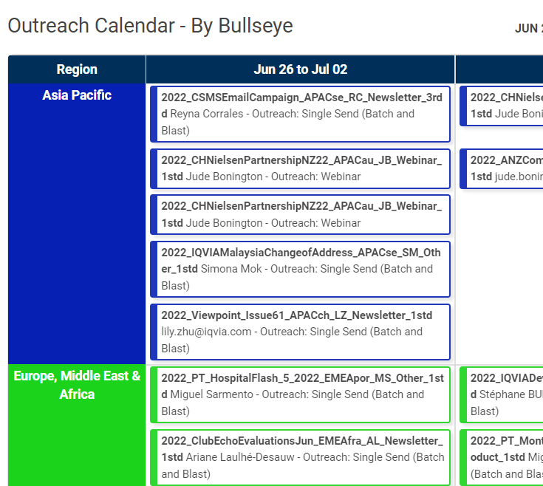
Smartsheet Outreach Calendars
Planning tools for GBU and RBU marketers
Calendars are available through the Resources section and the Help pages of the Marketing Operations Toolbox
Calendar supports:
Planning
Customer Experience
Collaboration
Decision-making (outreach conflicts)
Click on the Outreach to view:
Send Date
Type of Campaign
MA owner
Campaign Description
Region
Target Industry/Target Audience
Notes:
When you plan your customer experience we have four calendars available through the Resources section and the Help Pages. The four calendar views available are:
By Status – which shows you where your campaign is within production, for example, if the status is Request Received, that means you know it has been submitted, if it is marked as In Progress then you know we are working on it in and if it is Completed then you know we are done with it.
By Region – this shows you the campaigns that are planned out by region
By Bullseye – this will show you the Bullseyes listed within each campaign
By Campaign Owner or Stakeholder – This will show you the campaigns broken out by marketing owner
Keep in mind, this is where you can view details about any campaign on the calendar by clicking on it. This is a great way to find out who the MA owner is if you are unsure.
You are also able to see what campaigns are being delivered when and identify opportunities to collaborate with your colleagues before you schedule. An example of this would be is here you can identify if you are sending out an email that is targeting the same business persona that another colleague may be mailing. This would not be an ideal scenario so you would want to collaborate with that colleague to try and send out your emails on different days if you are targeting the same business persona.
NEXT SLIDE

Slide 10
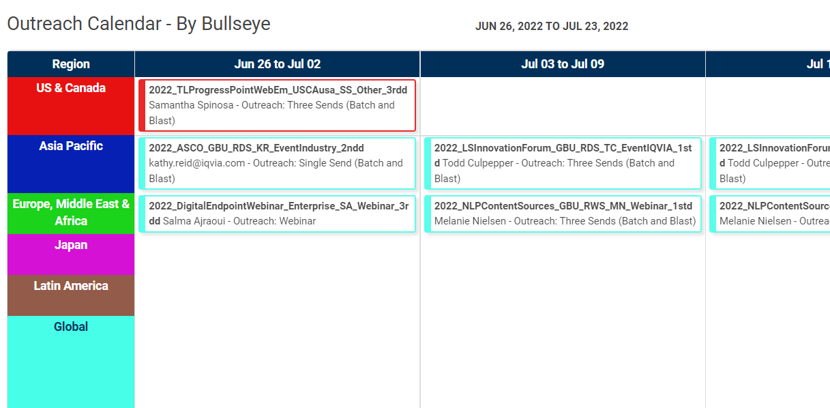
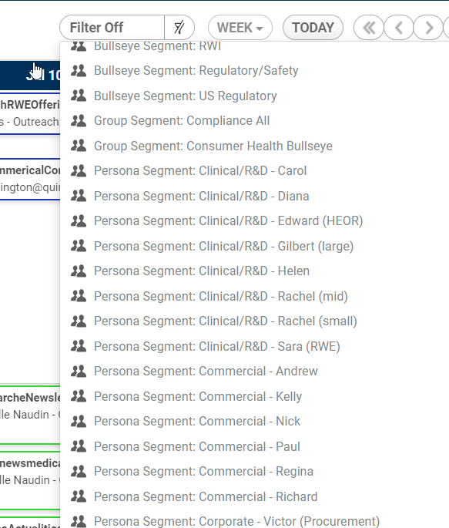
Outreach Calendar – By Bullseye
Primary planning calendar
Key calendar for planning in terms of understanding bullseye/persona use

Slide 11
Email Frequency Management
Key Takeaways
In-Campaign date checks
Planning is very important to minimizing over-contact and maximizing the chance of reaching and engaging your audience
Leverage the Outreach calendars to view overlap in Persona usage and enable collaboration with other BUs and marketers
Marketing Automation will apply the shared filters to regulate customer contact as a failsafe
Customer
Experience
Planning
Shared Filters

Slide 12
Thank You

Slide 13
Email Frequency Management
The line between helpful and annoying, timely and spammy, converting and unsubscribed……
The #1 reason that subscribers flag emails as spam is "They emailed too often“
Per Campaign Monitor
For B2B companies the sending frequencies with the highest median click rates are 16-30 & 6-15 per month
Per Hubspot

