Slide 1
Campaign Name: Marketing Campaign Template Example
Business Unit
Sales Playbook
Marketer Name, Date

Slide 2
Template Instructions
Make a copy of the template
This template is meant as a guide only, you can delete any slides you do not need or add any slides you may need
Once you receive the confirmation from marketing automation that your campaign is live in CRM, you can go into the campaign and upload your playbook under ‘Files’ for inside sales BDs, and you may add in triaging details for Anna Bernal and her team (assign MQLs to Inside Sales, assign MQLs to Inside Sales and note who the RW Acct Director is, etc.). See examples from previous marketing automation office hour call for differences in playbooks vs triaging instructions.
Forward your playbook over to Anna Bernal for awareness with launch date
If needed, plan a meeting with Anna Bernal to communicate high level message and awareness for the campaign to inside sales

Slide 3
Campaign Name
Campaign Goal Summary
Campaign Details | Description
Marketing Contacts | Marketers Names
Primary GTM Contact | Primary GTM Contact Name, or N/A
Marketing contact Sales should loop in regarding leads | Marketing Contact’s Name
Campaign Channels | Ex. Marketing Automation, LinkedIn, Paid Ads etc.
Campaign Code(s) | Campaign Code(s) by Channel
Campaign Start Date | Launch Date
Campaign End Date | End Date
Campaign Channels | Ex. Marketing Automation, LinkedIn, Paid Ads etc.
Target Audience | Business Personas/Segment Description
Solutions Promoted | Provide Solution being promoted ex. Real World Solutions
Message Being Promoted | Any special message or overall point to hit home
Countries Being Targeted | List Countries being targeted
Campaign Content Send Dates | Outline when content goes live *for Non-US campaigns, please provide a European friendly date format* Ex. Email 1: Launches X Date Email 2: Launches X Date Email 3: Launches X Date
Triage Instructions | What should be done with MQLs by the Sales Team
Call to actions | What is the CTA of the Creative Content Ex. Let’s Talk or Download an asset.

Slide 4
Inside Sales Actions
What do you want the Sales team to do once MQLs come through from the campaign. (Example Below)
MQLs will come through for the advertisements
You have our latest RWE Account Director List
Follow-up with leads and reach out to them via Eloqua Engage
      Customer outreach message is set-up in Eloqua Engage
      Search for subject line: Your RWE follow-up request from LinkedIn
      Enter customer email address and send message
      If for any reason Eloqua Engage does not work, use an Outlook email.
      Initial Outreach by Inside Sales and upon response loop in Account Director
      Monitor and track for responses
If there is no Account Director assigned reach out to X and copy X and X.
Add detailed Close status notes
Reporting on the Eloqua Engage Campaign
Template provided by marketing team for the sales team: example below
Subject line: Your RWE follow-up request from LinkedIn
Dear <NAME>,
Thank you for recently indicating on LinkedIn that you would like to connect and talk about how you can leverage Real World Evidence for your business.
Please provide some details on your needs. We are happy to talk to you about a whole range of RWE topics including:
  Leveraging RWE earlier in the lifecycle to help you more effectively plan for payer requirements?
  Generating research-grade RWE to meet your regulatory requirements with confidence?
  Sourcing and selecting the right RWD to meet your study needs?
  Something else? Let us know.
We look forward to hearing from you soon and are at your disposal for any immediate question.
Thank you,
<NAME>

Slide 5
Outreach
Creative Examples

Slide 6
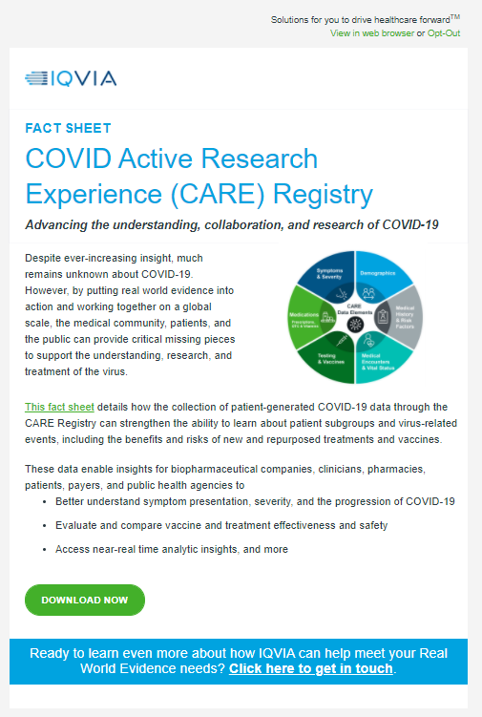
Email Assets
Email 1: Send Date 1/11/1111
Goal: Download Fact Sheet
Second CTA: Click here to get in touch: links here
Email 2: Send Date 1/11/1111
Goal: Download Fact Sheet
Second CTA: Click here to get in touch: links here
Email 3: Send Date 1/11/1111
Goal: Download Fact Sheet
Second CTA: Click here to get in touch: links here

Slide 7
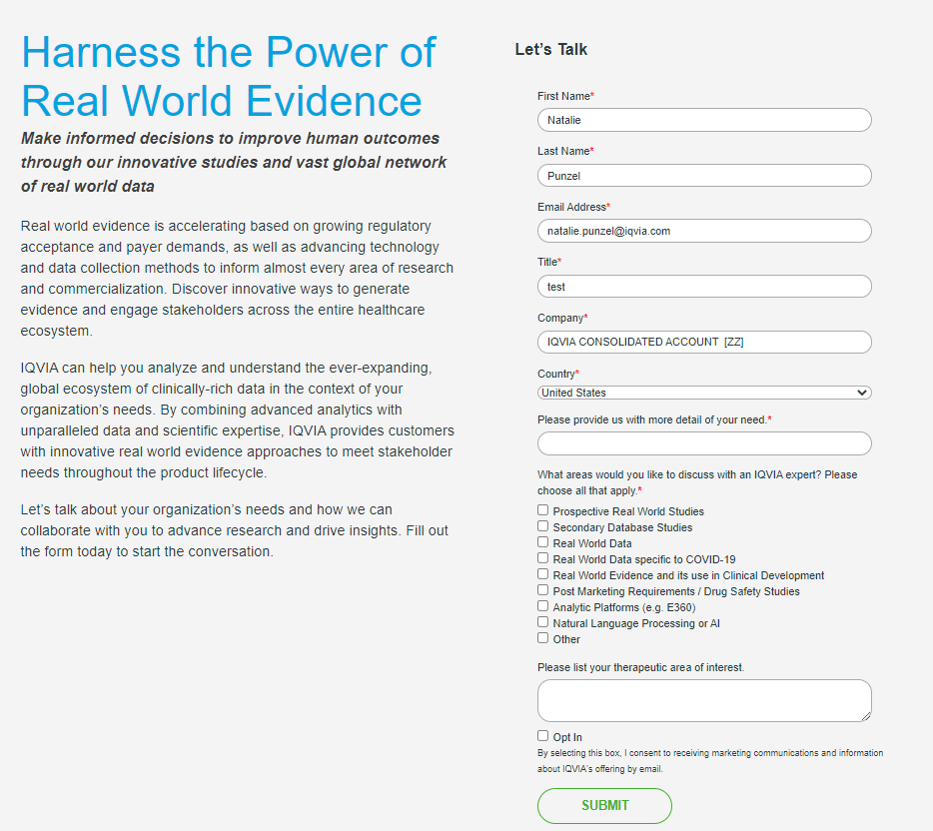

Email: What the MQLs have filled out to get to you

Slide 8
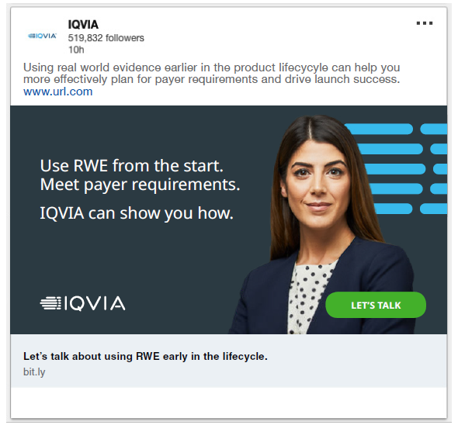
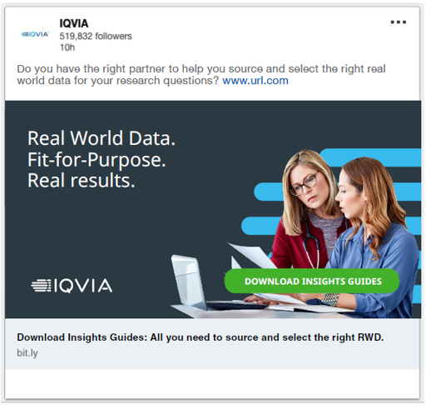
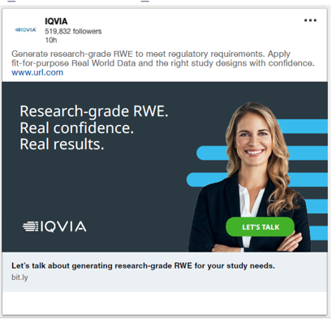
LinkedIn Assets
LinkedIn Ad 1: Launch Date 1/11/1111
Goal: CTA Let’s Talk
LinkedIn Ad 2: Launch Date 1/11/1111
Goal: Download Insights Guide
LinkedIn Ad 3: Launch Date 1/11/1111
Goal: CTA Let’s Talk

Slide 9
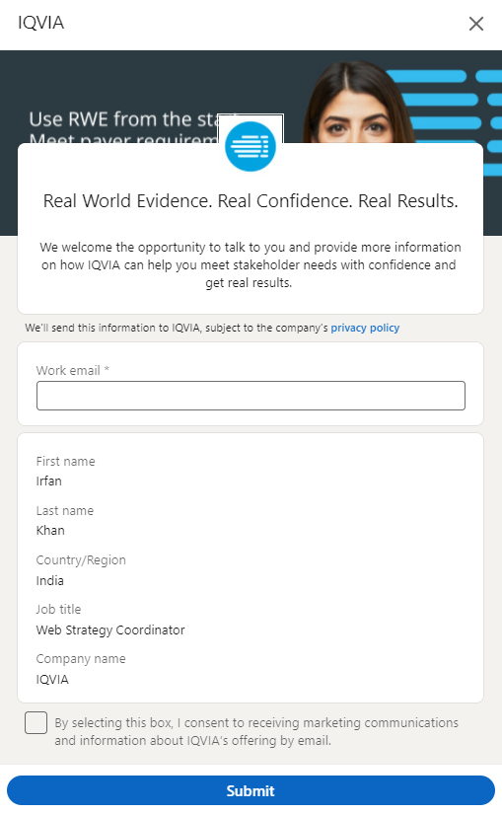
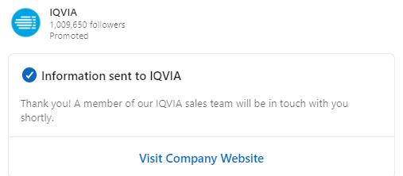
LinkedIn: What the MQLs have filled out to get to you

Slide 10
Social Assets
Social Ad 1: Launch Date 1/11/1111
Goal: CTA Let’s Talk
Social Ad 2: Launch Date 1/11/1111
Goal: Download Insights Guide
Social Ad 3: Launch Date 1/11/1111
Goal: CTA Let’s Talk

Slide 11
Social: What the MQLs have filled out to get to you

Slide 12
Paid Ad Assets
Paid Ad 1: Launch Date 1/11/1111
Goal: CTA Let’s Talk
Paid Ad 2: Launch Date 1/11/1111
Goal: Download Insights Guide
Paid Ad 3: Launch Date 1/11/1111
Goal: CTA Let’s Talk

Slide 13
Paid Ads: What the MQLs have filled out to get to you

Slide 14
Other Assets
Include any whitepapers, pdfs, landing pages etc.

Slide 15
Other: What the MQLs have filled out to get to you

Slide 16
Additional Information
Include any additional information necessary

