Slide 1
Marketing Operations
Recommended KPIs
Kristen Powell
10/5/2022

Slide 2
Agenda
Welcome
Best Practice: Recommended KPIs
Open Q&A/Discussion

Slide 3

Marketing Operations Open Office Hours
Get your questions answered by the marketing operations team. Open Office Hours are held monthly with the following agenda:
  Learn about a tip or best practice
  Ask a question – Pre-submit your questions here or ask during the office hours
  Learn how to leverage IQVIA’s marketing systems and processes most effectively
Action: Sign up here, if you need to be added to the outlook invite
Reminder: Save your questions for the end or enter in the chat. We will address as many as we can!

Slide 4
KPIs are key performance indicators, not just metrics
KPIs are a quantifiable measure of performance over time used to evaluate the success of a marketing plan, campaign, tactic etc for a specific objective
Use language like “increase” or “improve” or “decrease”
Notes:
What are KPIs and where do they fit in the big picture?
KPIs are a target for teams to shoot for, milestones to gauge progress and help generate insights that guide you into make better decisions

Slide 5
Where KPIs fit in the big picture
Measurement framework example with KPIs
Objective
Drive awareness, consideration and purchase/conversion of IQVIA Products + Services. Right customer, right message, right time
Customer Journey Phase
Awareness
Interest/Consideration
Conversion / Lead Gen
Audience
Persona/ Potential Customer
Returning Visitor/Engager
Hand Raiser
Message
General
Specific
Personal
Channel
Email
Organic/Direct
Organic Social
Events / Webinars
Paid Search
Paid Social
Display
KPIs
Increase
NNCs YoY
Increase
Engagement Rate YoY
Increase
Conversion Rate YoY
Notes:
Measurement framework - Measurement frameworks are a way of structuring metrics and those all-important key performance indicators (KPIs) around the strategy, goals, and objectives of the business. The key thing about a measurement framework is that it’s coherent and helps the business to understand the relationship between the metrics as well as the objectives themselves.
Goal/objective - Awareness, interest, consideration, lead gen, effectiveness and loyalty

Slide 6




Tips on defining your metrics of success
Actionable – give you guidance on how to fix a problem
Keep # of KPIs small. Too many show you don’t have a clear understanding of the goal and how the campaign works
Easy to understand, but have enough data to give context
Know your audience and get agreement. Set clear expectations to avoid misunderstanding when reporting on performance
Notes:
KPIs the specific things you’re measuring to reach your goal
Keep it simple. What am I trying to convey? Can I do it in 3 sentences or less.
Are all the data points necessary?
Keep it to the most essential info

Slide 7
Use these KPIs based the goal/objective of your campaign
Example KPIs by objective
Awareness
Increase NNCs
Interest/Consideration
Increase # of Clicks
Lead Gen
Increase # of MQLs
Increase # of SQLs
Increase SQL Amount
Increase # of Pipeline SQLs
Increase Pipeline SQL Amount
Increase conversion rate
Increase CTOR
Increase CTR
Increase # of Engagements
Increase Engagement Rate
Increase # of Leads
Increase Attendance Rate
Increase # of Opens
Increase Open Rate
Increase # of Registrations
Increase # of Views
Increase # of Impressions
Notes:
Awareness: Not always an indication of success to revenue, underperforming awareness KPIs don’t always mean it is less effective in driving business decisions. Typically, when we see lower performing awareness KPIs the topic is more relevant, more narrow
Rate KPIs add more context vs hard numbers

Slide 8
Example measurement framework for email
Objective
Drive awareness, consideration and purchase/conversion of IQVIA Products + Services. Right customer, right message, right time
Simplified Customer Journey Phase
Awareness
Consideration
Purchase + Conversion
KPI
Improved Open Rate
Increased Click to Open Rate
Increased Clickthrough Rate
Increased Conversion Rate
Leading Metrics
# Opens / # Delivered
# Unique Clicks / # Unique Opens
# Clicks / # Delivered
# of SQLs / # of MQLs
Supporting Metrics
Opens
Delivered
Unique Clicks
Unique Opens
Clicks
Delivered
MQLs
SQLs
Data Source
Eloqua
CRM
Notes:
Leading indicators are activities that should be trended as they predict the outcomes

Slide 9
Example Organic Social KPIs
Objective
Drive awareness, consideration and purchase/conversion of IQVIA Products + Services. Right customer, right message, right time
Simplified Customer Journey Phase
Awareness
Consideration
Purchase + Conversion
KPI
Increased Impressions
Increased Engagement Rate
Increase Conversion Rate
Leading Metrics
# of Impressions
# of Engagements / # of Impressions
# of SQLs / # of MQLs
Supporting Metrics
Engagements
Impressions
MQLs
SQLs
Data Source
Khoros
CRM
Notes:
Leading indicators are activities that should be trended as they predict the outcomes
Save and see more

Slide 10
Example measurement framework for an EMEA campaign
Objective
Gain traction through social media announcements
Share the webinar with existing contacts for conversions
Simplified Customer Journey Phase
Awareness
Consideration
Purchase + Conversion
KPIs
Increase Registrations from Social Media
Increase NNC from Social Media
Increase Attendance Rate from Social Media
Increase Conversion Rate from Social Media
Increase Registrations from existing contacts
Increase Attendance Rate from existing contacts
Increase Conversion Rate from existing contacts

Slide 11
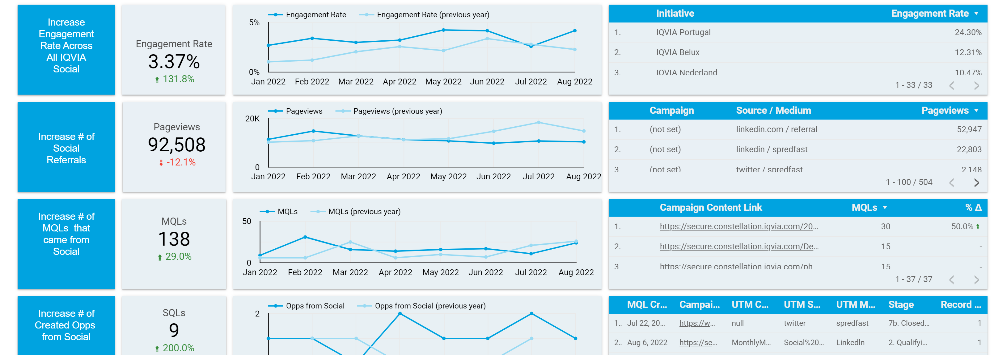
Example YoY and MoM Organic Social KPIs

Slide 12
Thank You
Notes:
Identifying your KPIs only scratches the surface. You can utilize dimensions to provide more context like channels or personas, use trends YoY to provide more context use indicators, show multiple data points to tell as story
Like Jen discussed on M3, give context
Test your assumptions! Use your KPIs as a baseline

Slide 13
Appendix
Notes:
Identifying your KPIs only scratches the surface. You can utilize dimensions to provide more context like channels or personas, use trends YoY to provide more context use indicators, show multiple data points to tell as story
Like Jen discussed on M3, give context
Test your assumptions! Use your KPIs as a baseline

Slide 14
Example Organic Web KPIs
Objective
Drive awareness, consideration and purchase/conversion of IQVIA Products + Services. Right customer, right message, right time
Simplified Customer Journey Phase
Awareness
Consideration
Purchase + Conversion
KPI
Increased # of pageviews
Increased Engagements
Increase Conversion Rate
Leading Metrics
# of Pageviews
# of Engagements
# of SQLs / # of MQLs
Supporting Metrics
MQLs
SQLs
Notes:
Leading indicators are activities that should be trended as they predict the outcomes

Slide 15
Example Paid Search KPIs
Objective
Drive awareness, consideration and purchase/conversion of IQVIA Products + Services. Right customer, right message, right time
Simplified Customer Journey Phase
Awareness
Consideration
Purchase + Conversion
KPI
Increased Impressions
Increased CTR
Increase Conversion Rate
Leading Metrics
Impressions
# of Clicks / # of Impressions
# of SQLs / # of MQLs
Supporting Metrics
Clicks
Impressions
MQLs
SQLs
Notes:
Leading indicators are activities that should be trended as they predict the outcomes
Potentially conversion rate

Slide 16
Example Paid Social KPIs
Objective
Drive awareness, consideration and purchase/conversion of IQVIA Products + Services. Right customer, right message, right time
Simplified Customer Journey Phase
Awareness
Consideration
Purchase + Conversion
KPI
Increase Impressions
Increased CTR
Increase Conversion Rate
Leading Metrics
Impressions
# of Clicks / # of Impressions
# of SQLs / # of MQLs
Supporting Metrics
Clicks
Impressions
MQLs
SQLs
Notes:
Leading indicators are activities that should be trended as they predict the outcomes

Slide 17
Example Display Advertising KPIs
Objective
Drive awareness, consideration and purchase/conversion of IQVIA Products + Services. Right customer, right message, right time
Simplified Customer Journey Phase
Awareness
Consideration
Purchase + Conversion
KPI
Increased # Impressions
Increased CTR
Increase Conversion Rate
Leading Metrics
# of Impressions
# Clicks / Impressions
# of SQLs / # of MQLs
Supporting Metrics
Clicks
Impressions
MQLs
SQLs
Notes:
Leading indicators are activities that should be trended as they predict the outcomes

Slide 18
Example Webinar / Virtual Events KPIs
Objective
Drive awareness, consideration and purchase/conversion of IQVIA Products + Services. Right customer, right message, right time
Simplified Customer Journey Phase
Awareness
Consideration
Purchase + Conversion
KPI
Increase Registrations
Increase NNC
Increase Attendance Rate
Increase Conversion Rate
Leading Metrics
Registrations
Net New Contacts
Attendees / Registrants
# of SQLs / # of MQLs
Supporting Metrics
Attendees
Registrants
MQLs
SQLs
Notes:
Leading indicators are activities that should be trended as they predict the outcomes

Slide 19
Example Event KPIs
Objective
Drive awareness, consideration and purchase/conversion of IQVIA Products + Services. Right customer, right message, right time
Simplified Customer Journey Phase
Awareness
Consideration
Purchase + Conversion
KPI
Increase Registrations
Increase NNC
Increase Attendance Rate
Increase Conversion Rate
Leading Metrics
Registrations
Net New Contacts
Attendees / Registrants
# of SQLs / # of MQLs
Supporting Metrics
Attendees
Registrants
MQLs
SQLs
Notes:
Leading indicators are activities that should be trended as they predict the outcomes

