Slide 1

Marketing Operations
The Art and Science of Segmentation
Srujana Pavuluri | Abhijith Joseph
October 9th 2024

Slide 2
Agenda
Welcome
The Importance of Segmentation
Elements in Segmentation
Contact Journey
Types of Segments
Recent Segment Exclusions
Segmentation Tools and Resources
Open Q&A/Discussion

Slide 3

Marketing Operations Open Office Hours
Get your questions answered by the marketing operations team. Open Office Hours are held monthly with the following agenda:
Learn about a tip or best practice
Ask a question – Pre-submit your questions here or ask during the office hours
Learn how to leverage IQVIA’s marketing systems and processes most effectively
Action: Sign up here, if you need to be added to the outlook invite
Reminder: Save your questions for the end or enter in the chat. We will address as many as we can!

Slide 4



The importance of segmentation
Organize your way to better email performance
Divide contacts into smaller, more specific groups based on certain criteria vs. mass sends
Dynamic segments vs stagnant lists
Segmented emails work better
Customer Centric
Improved relevance
Send messages based on customer needs and preferences
Send content that is more relevant and personalized to each contact making your email more likely to be open, clicked through and read
Guide customers through the funnel
Welcome and share
Brand awareness to new customers, boosts brand image
Intentionality and sharing right message at the right time
Notes:
On average segmented campaigns get 23% more opens and 49% more clickthroughs than unsegmented campaigns

Slide 5
Using customer data to create more targeted and personalized messaging
1
2
3
4
5
6
Entry Point
If they found you via a webinar, they might be interested in deep, educational content.
If they entered through a blog post, they might enjoy more of your thought leadership pieces.
Geographics
Is your email about an event in a certain area? Try targeting based on Country and/or City of the event
Behavioral
Target individuals visiting certain IQVIA.com pages
Send emails so people attending certain webinars or registering for certain events
IQVIA Segmentation
Are there certain industries or types of companies you are needing to target? Consider using this field to narrow down the industry/category
Mapped Functional Area
Segment by job function or department of the contact
Mapped Job Level
Does your segment only need to cover decision makers at a certain level? Use this field to drill down on specific job levels of contacts in the database
Notes:
Knowing their entry points is like understanding their journey to you, allowing you to guide them further effectively.

Slide 6
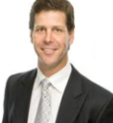
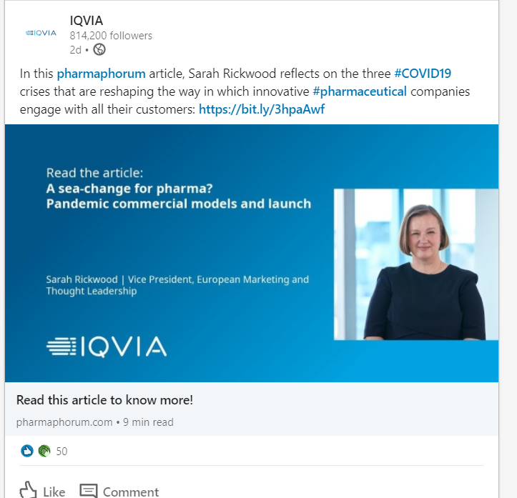
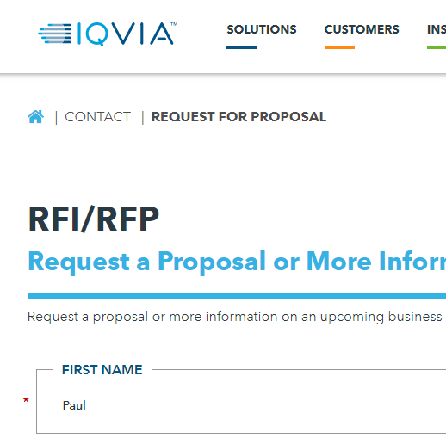
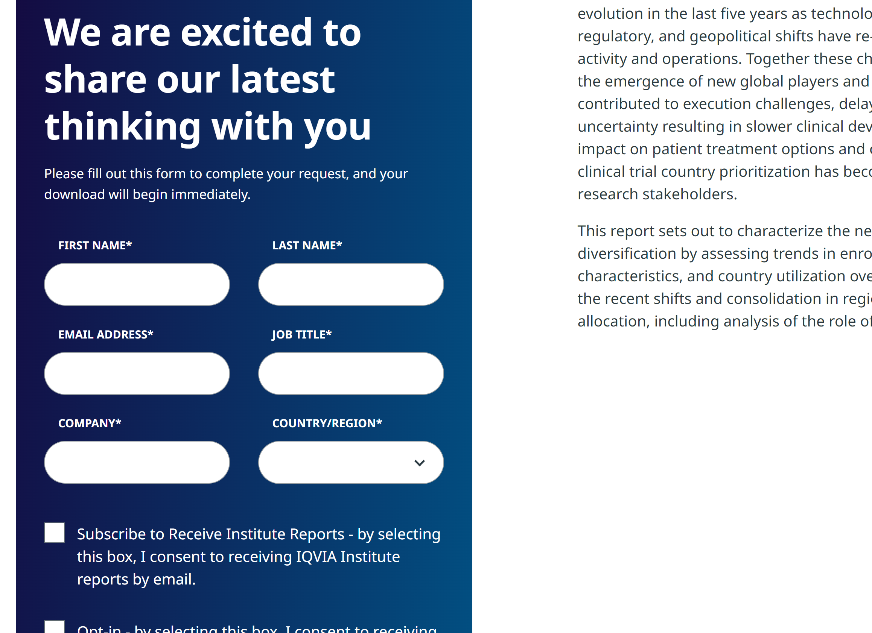
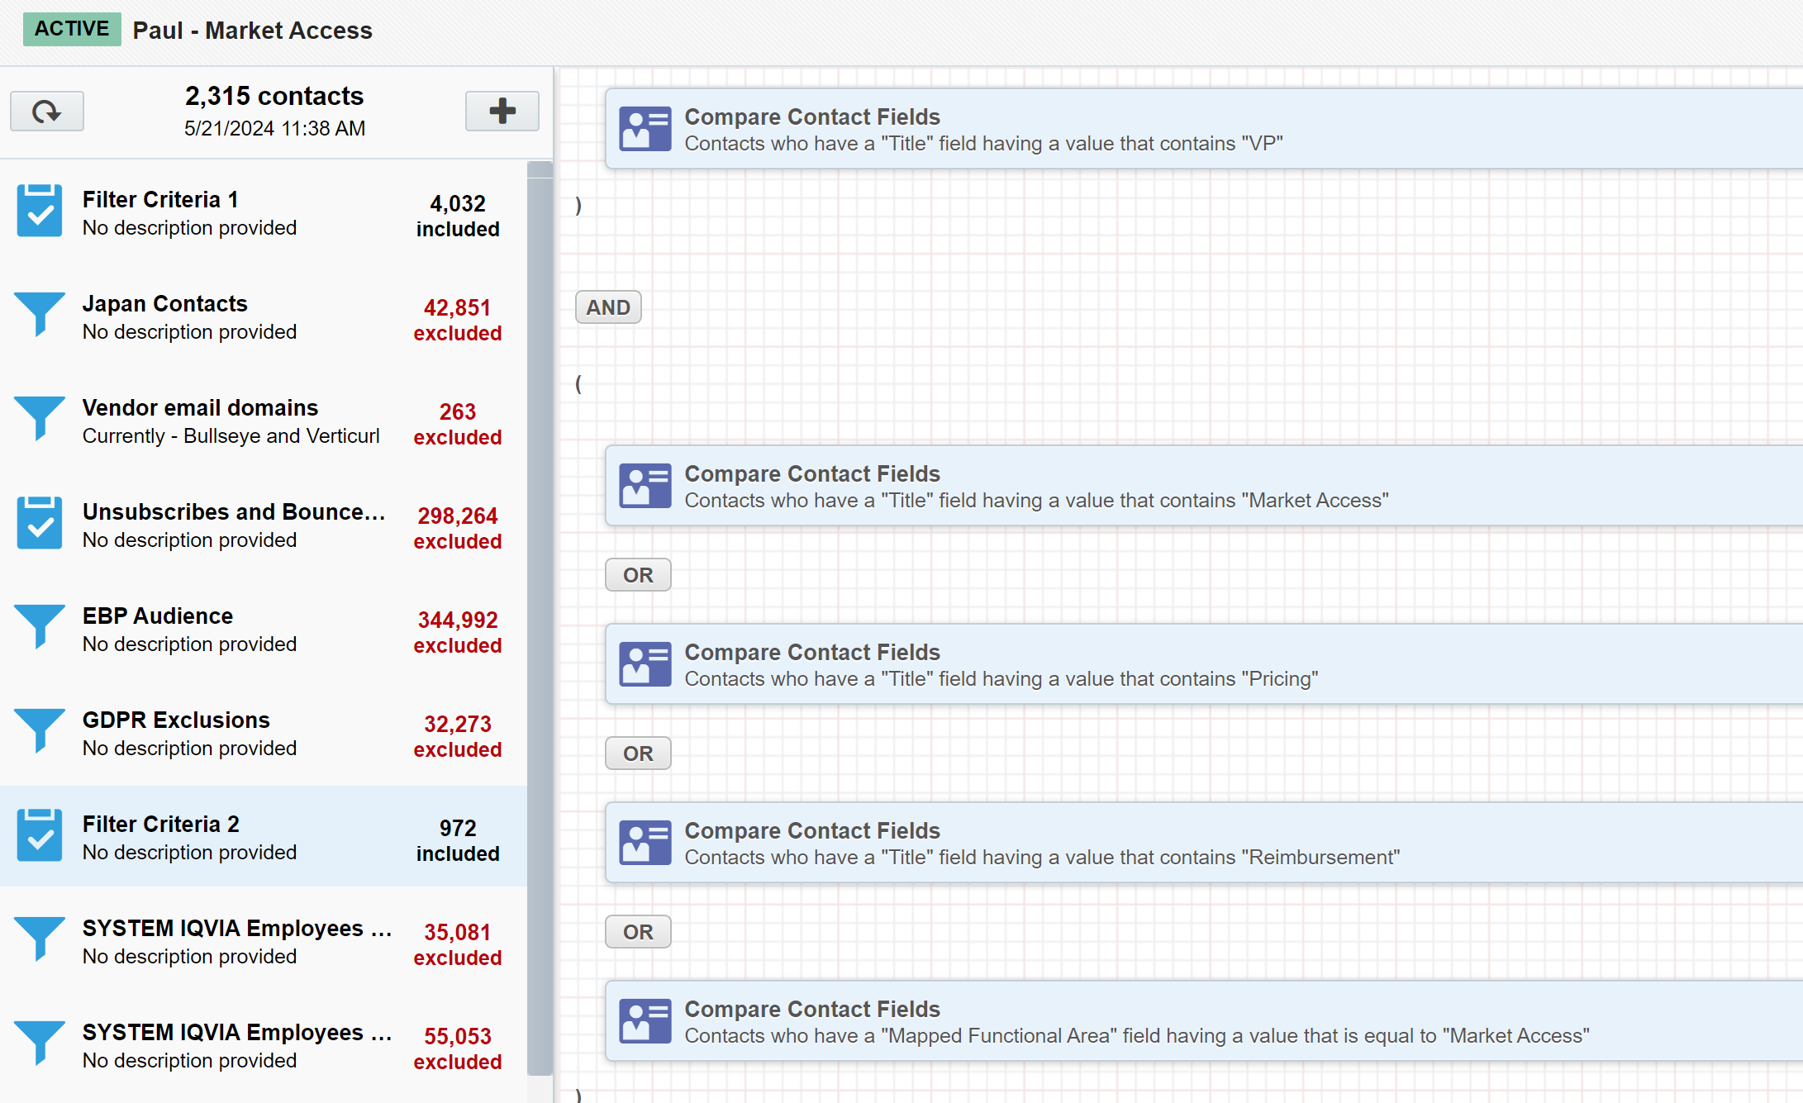

Contact journey: from database entry to segmentation
Segmentation based on title criteria example
Paul is a potential customer
- Paul decides to learn more and fill out a form
- Paul’s contact record enters the database
- Paul entered his title (VP, Market Access).
This automatically matches him to the Paul – Market Access persona segment. Now whenever an email goes out to this segment, Paul will receive the email
Paul clicks on a link on an organic IQVIA LinkedIn posts that takes him to IQVIA.com
VP, Market Access
Notes:
Urchin Tracking Module

Slide 7
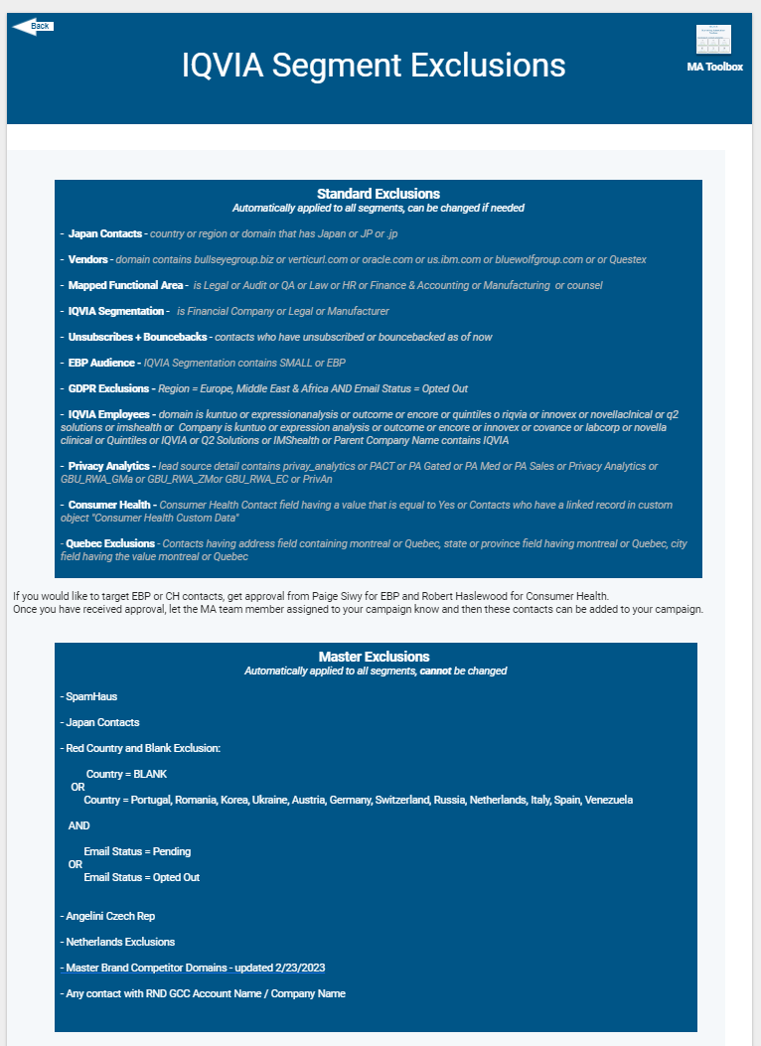

Slide 8
Recent Segment Exclusions
- Privacy Analytics - lead source detail contains privay_analytics or PACT or PA Gated or PA Med or PA Sales or Privacy Analytics or GBU_RWA_GMa or GBU_RWA_ZMor GBU_RWA_EC or PrivAn
- Consumer Health - Consumer Health Contact field having a value that is equal to Yes or Contacts who have a linked record in custom object "Consumer Health Custom Data"
- Quebec Exclusions - contacts having address field containing montreal or Quebec, state or province field having montreal or Quebec, city field having the value montreal or Quebec

Slide 9



3 types of segments
Standard Segment
Standard
Criteria defined by marketer
One time segment or reused segment
Bullseye Segment
Bullseye
More specific category of customers
Must be reused
Planned to be used > 5 times this year in 5 different campaigns
Actively refines bullseye based off performance
Will be templatized
Will be added to the coverage report
Will be added to intake form drop down
Will be added Bullseye Segment Membership field and program
Persona Segment
Persona
Detailed representation of a hypothetical customer that is created using market research, customer data and other sources.
Has a name and backstory
Created by Charlie

Slide 10
Michael – Head of Patient Support Services
New persona segment available
Criteria
Mapped Job level contains “Executive”
AND
Title contains:
Patient Solutions and Services OR
Patient Access OR
Patient Experience & Customer Solutions
AND
Standard and Master Exclusions
338
Promotable Contacts as of 10/8/2024

Slide 11
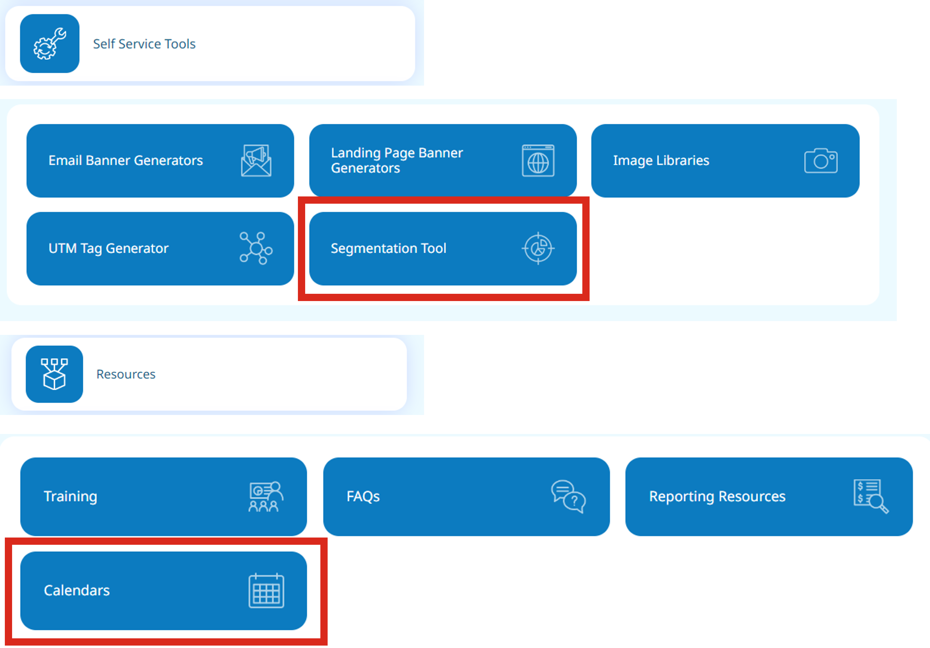
Segmentation tools and resources

Slide 12
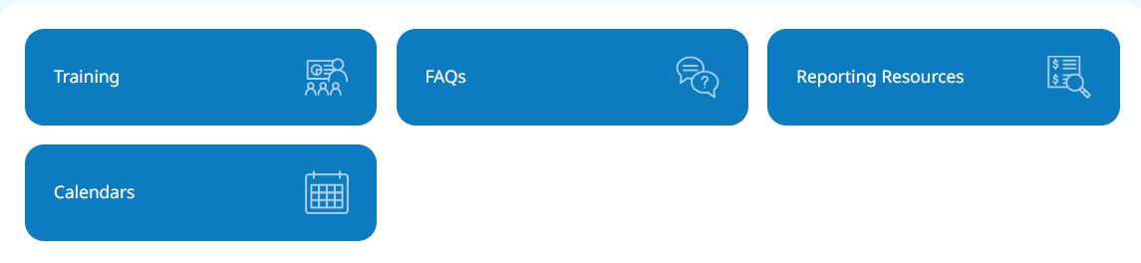
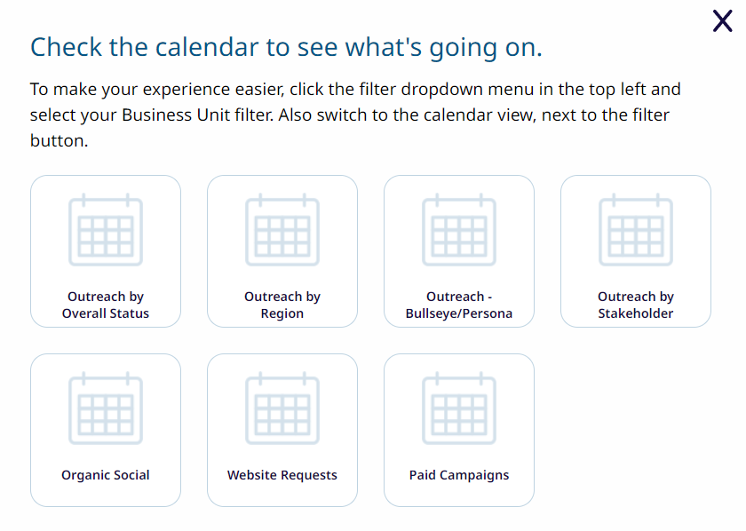
View campaigns going out by status, region, bullseye, stakeholder, Organic Social, Website Requests, Paid Campaigns

Slide 13
Thank You

