Slide 1
Marketing Operations
Toolbox Updates
Phil Cuff
7-Sep-2022

Slide 2
Agenda
Welcome
Marketing Operations Toolbox updates
Open Q&A/Discussion

Slide 3

Marketing Operations Open Office Hours
Get your questions answered by the marketing operations team. Open Office Hours are held monthly with the following agenda:
  Learn about a tip or best practice
  Ask a question – Pre-submit your questions here or ask during the office hours
  Learn how to leverage IQVIA’s marketing systems and processes most effectively
Action: Sign up here, if you need to be added to the outlook invite

Slide 4
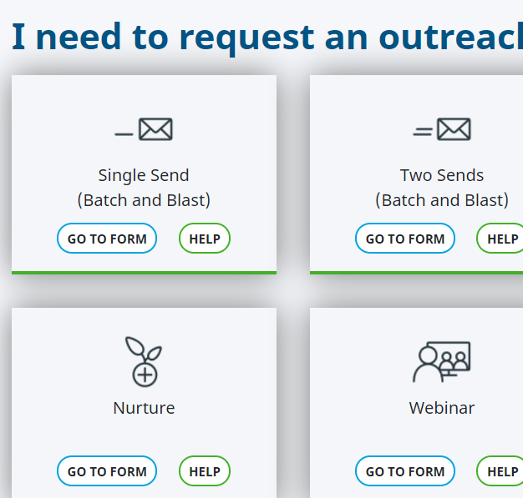
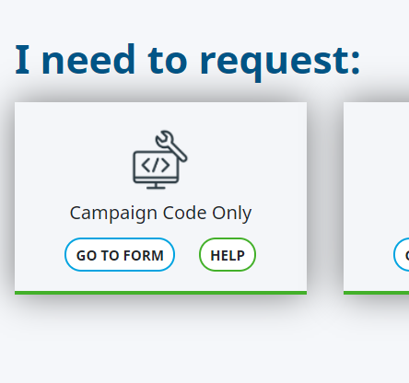
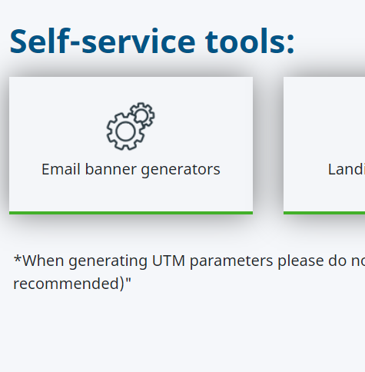
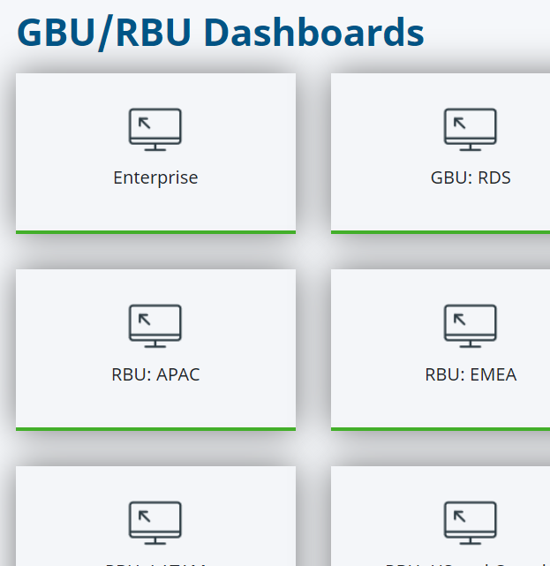
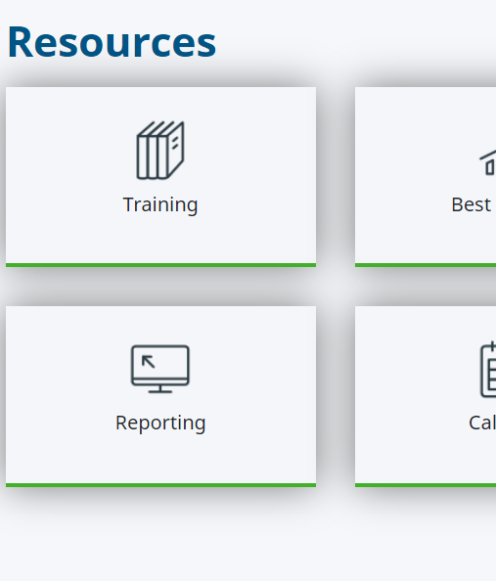
Your Central Resource: The Marketing Operations ToolBox
https://secure.constellation.iqvia.com/MarketingAutomationToolbox
Outreach Requests
Campaign code/engage/LP
Self Service tools
Dashboards
Resources
Highlights
Highlights
Highlights
Highlights
Highlights
Email Batch and Blast
Webinar/Event
Nurture
Campaign codes for events
Engage only
Landing page only
Email banner generator
Landing page banner generator
Image libraries
UTM Tag Generator
Regional and Global Business Unit dashboards
Training
Best Practice
Calendars
Reporting
Contact uploads
Notes:
So we’re going to start at the Marketing Automation Toolbox
This will become a recurring theme for the remainder of the presentation since it should be your first stop for all things ‘MA’’
You will see here an overview of what is available on the toolbox
Speak to each section – most popular reason is outreach request or campaign code request
You can request outreach in advance

Slide 5
Why the changes?
Listening to our users
Customer survey in Q1 2022
  Reviewed results and feedback
  Implemented suggested improvements where possible
Ongoing improvements
  Reviewed engagement metrics
  Always looking at how to improve the features and functionality
  Welcome any feedback from users

Slide 6
Toolbox changes

Slide 7

Name change
To align with changes from recent re-org
Is Now

Slide 8
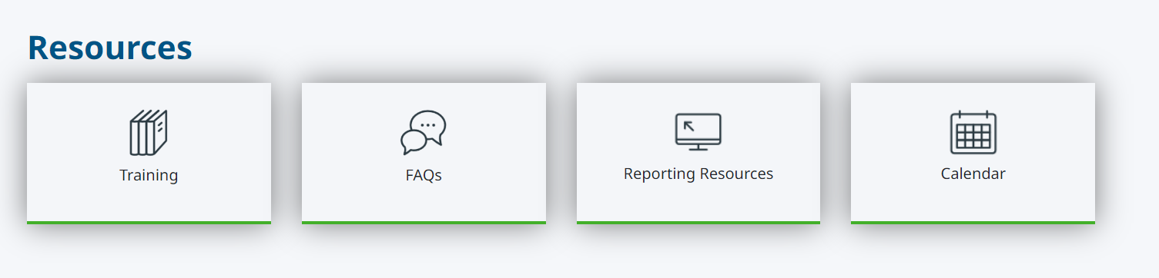
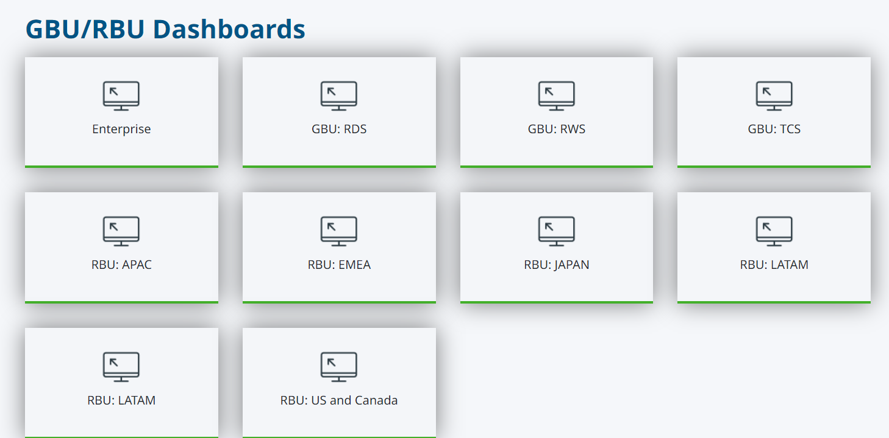
Layout
We’ve moved some things around
Resources section has been condensed
Training and Best Practices section combined into 1
Metrics definitions are now within the Reporting Resources section
Dashboards have been moved to the bottom of the page
Notes:
Simplified user interface

Slide 9
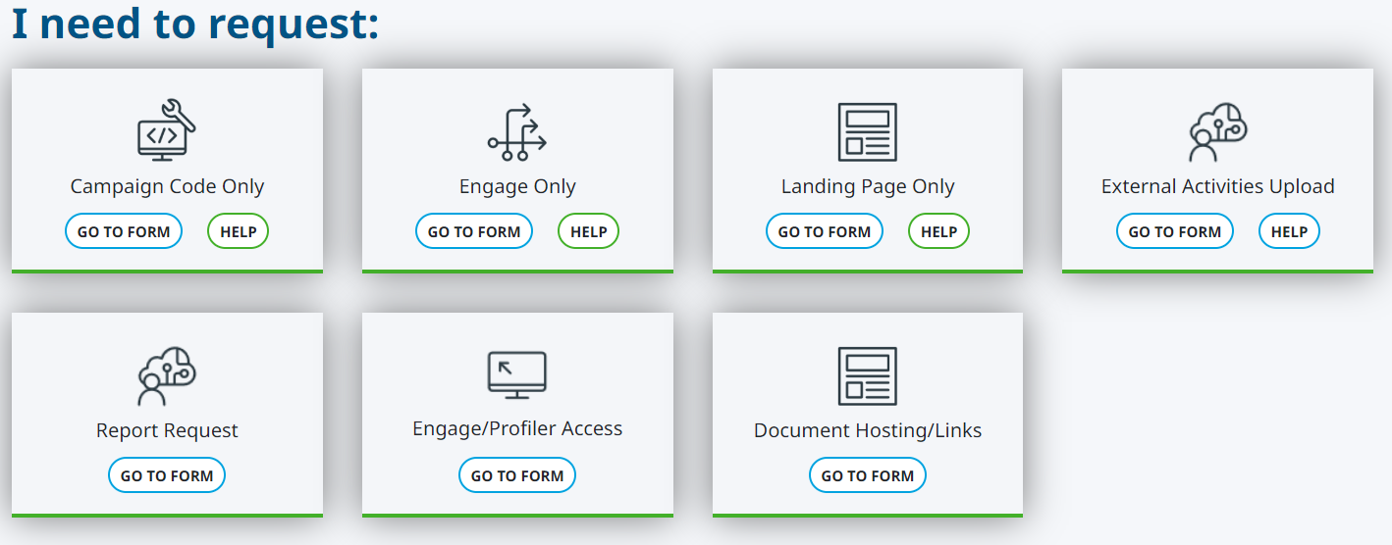
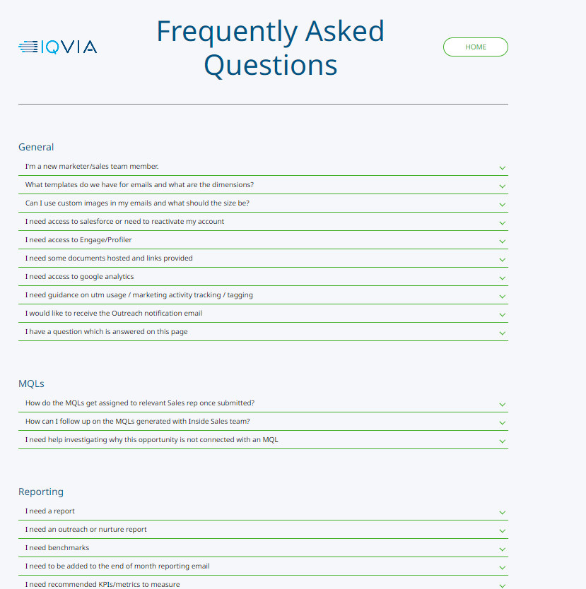
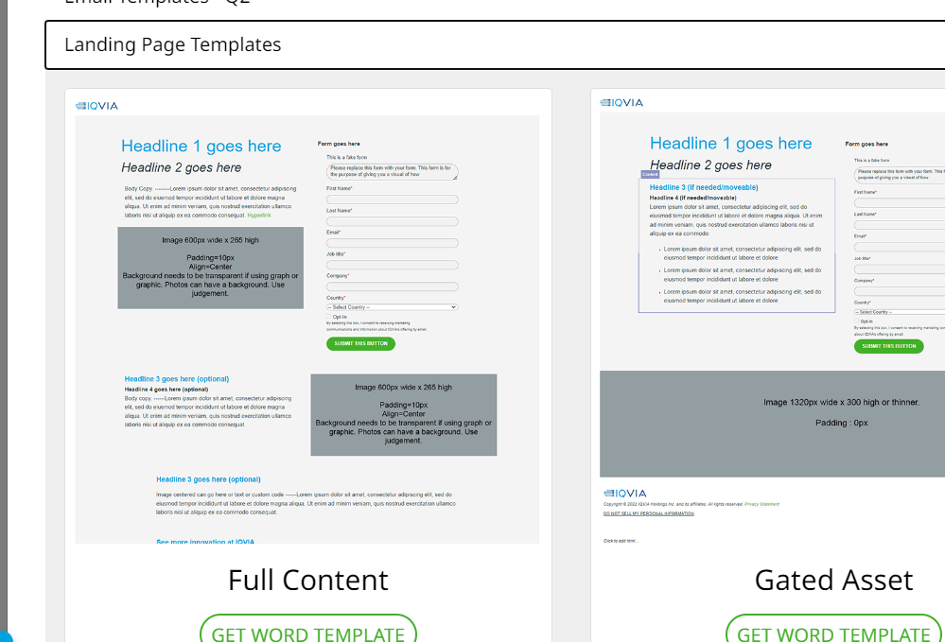
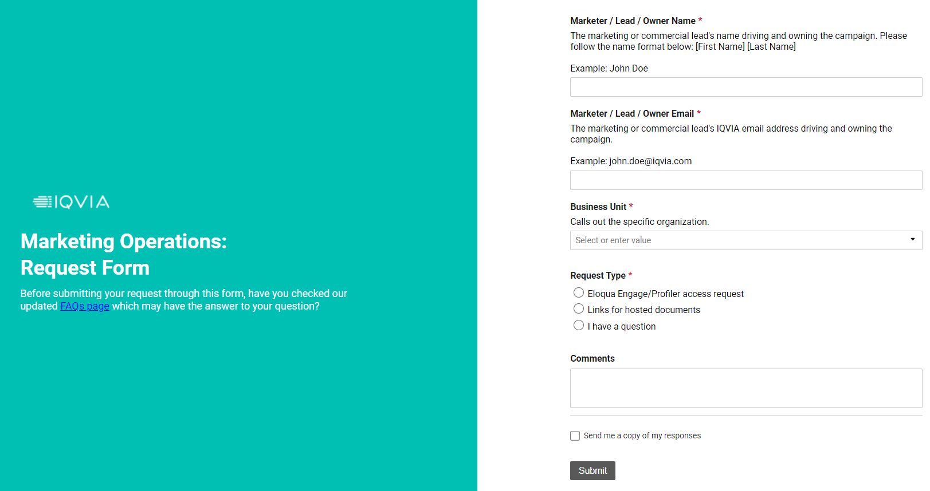
Updated Content & New functions
Updates made in several areas
Additional options in the request section
  Report Request (previously part of reporting resources)
  Engage/Profiler Access request
  Document Hosting/Links request
Updated FAQs page
Updated Help section
Notes:
Contact us form – centralised location for all enquiries and requests, triaged and assigned so shouldn’t get missed
Updated FAQs – more comprehensive FAQs section to hopefully allow you to find answers to more of your questions

Slide 10
Key Takeaways
Key updates made:-
  Layout change
  Updated/More comprehensive FAQs guide
  New contact us form
  Consolidation of some sections
Marketing Operations Toolbox should be the first stop for any information relating to our services
Please review the FAQs before contacting us in case the answer is already there
If there are any questions you would like to see added to the FAQs then please let us know
When contacting us please use the form

Slide 11
Thank You

