Slide 1
Marketing Automation & Operations
External Marketing Activity Uploads
Srujana Pavuluri
April 6, 2022

Slide 2
Agenda
Welcome
Best Practice: External Marketing Activity Uploads
Open Q&A/Discussion

Slide 3

Marketing Automation Open Office Hours
Get your questions answered by the marketing automation team. MA Open Office Hours are held monthly with the following agenda:
Learn about a tip or best practice
Ask a question – Pre-submit your questions here or ask during the office hours
Learn how to leverage IQVIA’s marketing systems and processes most effectively
Action: Sign up here, if you need to be added to the outlook invite
Reminder: Save your questions for the end or enter in the chat. We will address as many as we can!

Slide 4
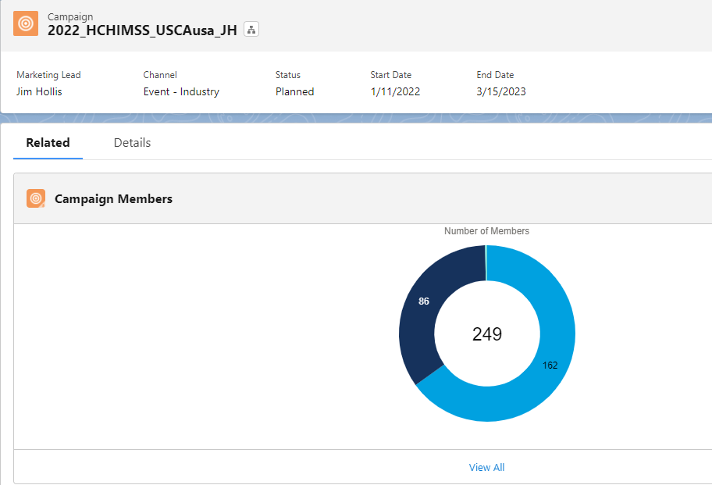
What is an External Marketing Activity Upload?
Process of capturing Campaign Members in Eloqua & Salesforce
Registered
Attended
Booth Visit
Downloaded
Filled out form
Requested Follow-up
Requested More Info
and more…

Slide 5
Why are they important?
Uploads feed all these marketing and sales categories
Engagement
Net New Contacts
MQL Tracking
Segmentation
Eloqua Profiler

Slide 6
When?
Within 4 business days post webinar/event
- The sooner the better
Target completion within 48 business hours
Physical Events
Webinars hosted outside ON24
Events/Webinars/Landing Pages hosted/collaborated by/with Third Party
MA Team uploads file and emails you the results

Slide 7

Improvements for External Marketing Activity Uploads
Bolder Smarter Leaner
Complex Excel Template
36 Required Fields
Simplified Excel Template
Only 12 Required Fields
Email Request Process
Non-standard email request process, not tracked or reported
Standard Request Process
Submit request form on MA Toolbox, now consistent, tracked and reported
Data Picklists
Legacy picklists selections are outdated and don’t reflect current business
Updated Data Picklists
Updated picklist selections better meet current business requirements
Complicated Process
Execution process outside usual practices, difficult to manage
Simplified Process
Simplified standard execution process aligned to best practices for managing

Slide 8
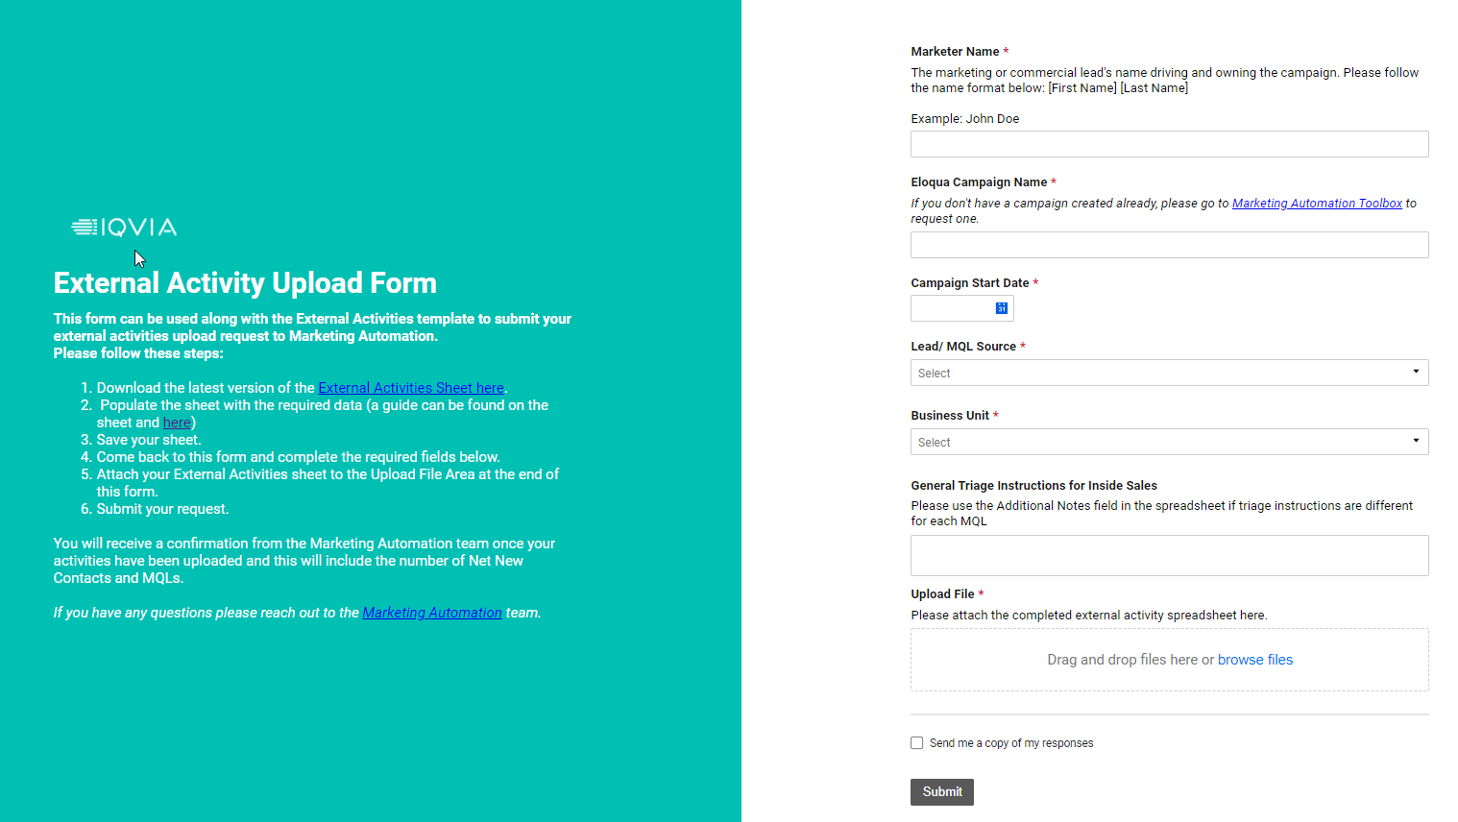
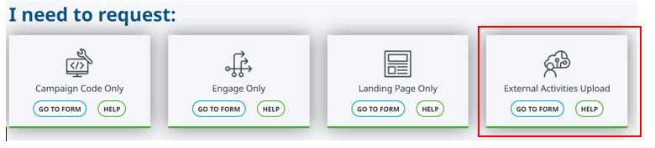
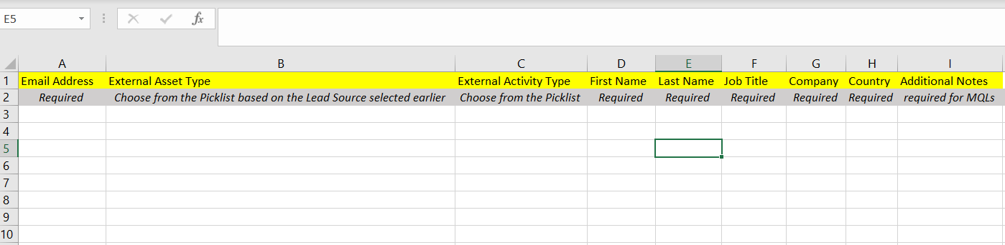
How to request an External Marketing Activity Upload?
Start at MA Toolbox: https://secure.constellation.iqvia.com/MarketingAutomationToolbox
New Improved Template
New Simple Request Form

Slide 9
Thank You

