Slide 1
Oracle Eloqua Engage Training
Stakeholder Onboarding/Training
Natalie Punzel – Marketing Automation Manager
September 2021

Slide 2
Agenda
Benefits of Eloqua Engage and Eloqua Profiler
Eloqua Engage
Eloqua Profiler Web Alerts
QA
Resources
Archive

Slide 3
Benefits of Eloqua Engage and Eloqua Profiler

Slide 4
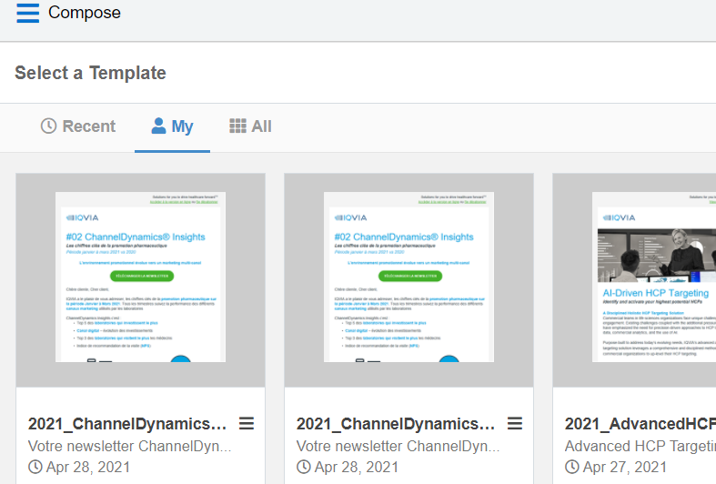
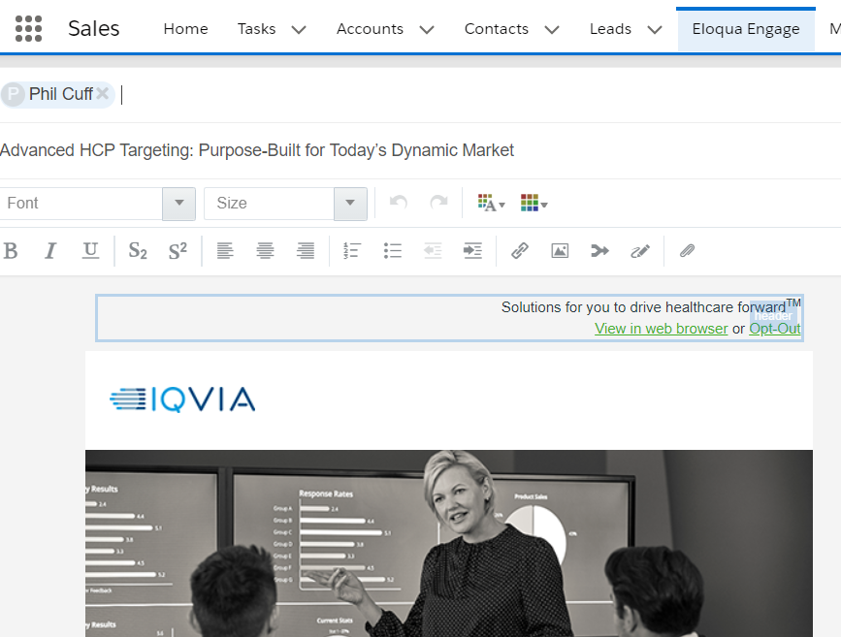
Eloqua Engage (embedded within Salesforce)
Sales can easily engage customers with consistent messaging and content
Provides Pre-built marketing templates that sales can easily customize to send personalized email
Use with sales teams to support campaign messaging and sales follow-up
Appropriate for a one send campaign i.e. follow up to an event, one-off notification
Tracks open and click-throughs in real time
Notes:
Eloqua Sales Tools consists mainly of Eloqua Engage and Eloqua Profiler. Eloqua Engage lives
within Salesforce and provides sales and marketing teams access to all of our marketing emails.
It is typically best used for sales prospecting and for email sends to under 50 contacts. Within
Eloqua Engage you are able to customize and send personalized emails through prebuilt
templates that already exist within Eloqua Engage. Emails that are sent out through Eloqua
Engage have the ability to track open and click-throughs in real time.
You can best use Eloqua Engage by making sales communications for your campaign to be used
as follow-up emails by Inside Sales or your sales teams.
For those of you who may already be familiar with engage I would like to note – Currently, a
new Outlook Plugin is being piloted by the Inside Sales group that makes it even easier to leverage Engage. And so far, the team is having good success engaging with these customers.

Slide 5
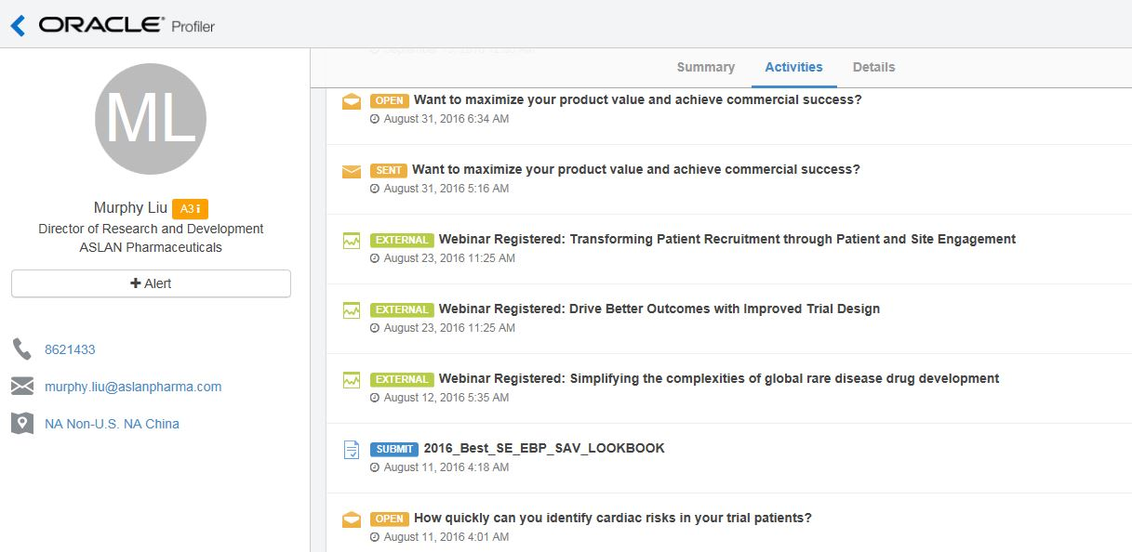
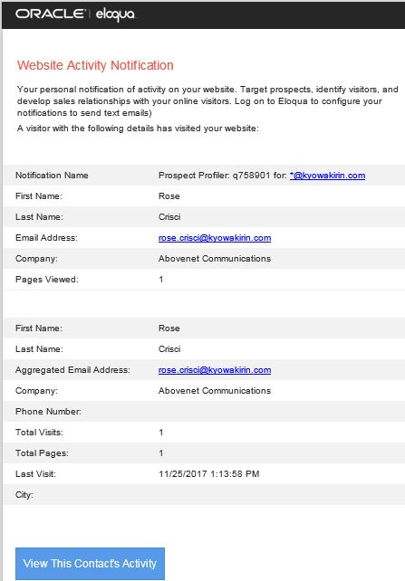
Eloqua Profiler (embedded within Salesforce)
Customer 360 View provided to the Sales Team
View customer activity profiles in one place
Shows summary and details of customer online activities & behaviors
    Website activity
    Event and tradeshow activity
    Email Open & Click activity
    Form fill activity
Provide real-time email alerts to sales of prospect visits to IQVIA.com
Customer Insight provided to the sales team for each contact and lead
EXAMPLE NOTIFICATION
Notes:
The second tool is Eloqua Profiler, which also lives within Salesforce. Eloqua Profiler can be
used to provide visibility into prospect activity data and to send alerts on return prospect visits
to IQVIA.com or other IQVIA web properties. This is specifically helpful to the Sales team to
view customer activity data and to see previews of what emails and web pages contacts are
engaging with.
You are also able to gain visibility into contacts’ engagement with marketing tactics, some
examples of those are, event and webinar activity, open and click activity, and form fill out
activity.
So those are the main Eloqua Sales Tools that exist for you to utilize whenever needed. As a
reminder you will need an active user account in both Salesforce and Eloqua to use the tools.
You can find more details and trainings on the tool available in the resource section of our
marketing automation toolbox.
Now over to Garrett to finish up…

Slide 6
Eloqua Engage

Slide 7
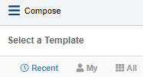
Eloqua Engage: Selecting a Template
ELOQUA ENGAGE: SELECTING A TEMPLATE
Log into Salesforce
Navigate to Eloqua Engage
Click on “Compose”
Choose a template
  Recent | My | All
Navigate to All – Filter to find a specific template saved in a particular location
If you know the template name you can type it in. It may be helpful to provide the Sales team with your campaign code so that they can search the templates available to them for that campaign
  2021_CSMSDynDplyWbnrEmNur_USCAusa_SS
  Natalie Demo Email Template

Slide 8
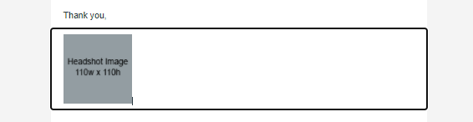
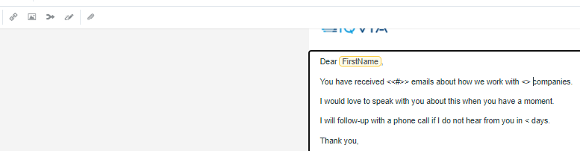

Eloqua Engage: Editing the Email
ELOQUA ENGAGE: EDITING THE EMAIL
Once you have selected your template, you can make edits to it
To delete a content block that you don’t want, simply highlight it and delete
To insert field content into the email, select Field Merge from the top ribbon banner
Here you can select, FirstName or Company if you desired that information to be pulled into the email
Here, you can preview your email to see what it would look like to the recipient

Slide 9

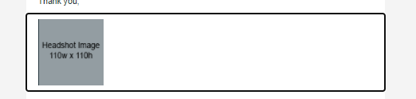
Eloqua Engage: Adding an Image
ELOQUA ENGAGE: ADDING AN IMAGE
If you would like to upload an image, put your cursor where you would like the image and select "Upload Image"
Select Upload in the right hand corner and upload the image you want to use
You will want to upload the image with the size dimensions desired, as you cannot alter the image size within Engage
The maximum size for an upload in Images is 50 MB

Slide 10

Eloqua Engage: Adding a file to your email
ELOQUA ENGAGE: ADDING A FILE TO YOUR EMAIL
We typically recommend sending a link to document vs having it attached in the email for tracking purposes.
In order to add a file to your email, Select the attachment icon in the editing banner
Select the attachment if it is already uploaded or select the upload button to upload your attachment
Insert the file as a tracked link
The maximum size for an upload in File Storage is 10 MB

Slide 11
Eloqua Engage: Adding New Contact Records
ELOQUA ENGAGE: AUDIENCE UPLOAD GUIDELINES
New contacts records can be created directly in Engage or Salesforce.
Salesforce and Eloqua Synch daily.
If a new contact is needed immediately for a delivery, enter the contact in Engage.
All new contacts need the following minimum information
  First Name
  Last Name
  Email Address
  Job Title
  Company
  Country
In the rare situation that you have a large number of contacts that need uploading, follow the process outlined here and send your file to marketing.automation@iqvia.com

Slide 12
Eloqua Engage: Create Email Audience Lists in Salesforce
ELOQUA ENGAGE: Creating Email Audience Lists
If you want to build an audience within Engage, utilized the below Salesforce reports in order to build your audience:
  SFDC Contacts Report for Eloqua Engage
  SFDC Lead Report for Eloqua Engage
Utilize the filters in order to get the desired audience, run the report, export the report, and copy and paste those email addresses into your Eloqua Engage email.
These reports remove all bounce-backs and opt-outs.

Slide 13
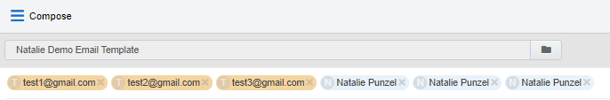
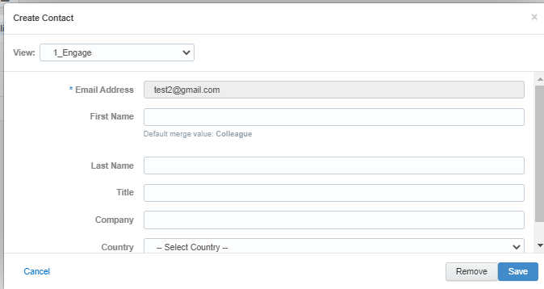
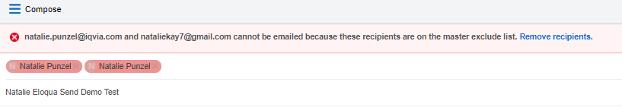
Eloqua Engage: Select the Audience
ELOQUA ENGAGE: SELECT THE AUDIENCE
To enter email addresses into the email, you can manually enter your recipients' email addresses or copy and paste contacts from Microsoft Outlook, as well as XLS and CSV files
As you enter an email recipient's name or email address, Engage searches your Oracle Eloqua contacts. If you enter an existing Oracle Eloqua contact, the name is displayed in blue. New email addresses that do not match Oracle Eloqua contacts, or ones missing a field merge value, display in orange. You are prompted to save these recipients as contacts before sending the email.
Engage displays warning messages if contacts are globally unsubscribed or if the email addresses are flagged as bouncebacks. These contacts are displayed in red. After clicking Send, Engage provides a list of any recipients who will not receive the email because they are either on the master exclude list or unsubscribed from the email group

Slide 14

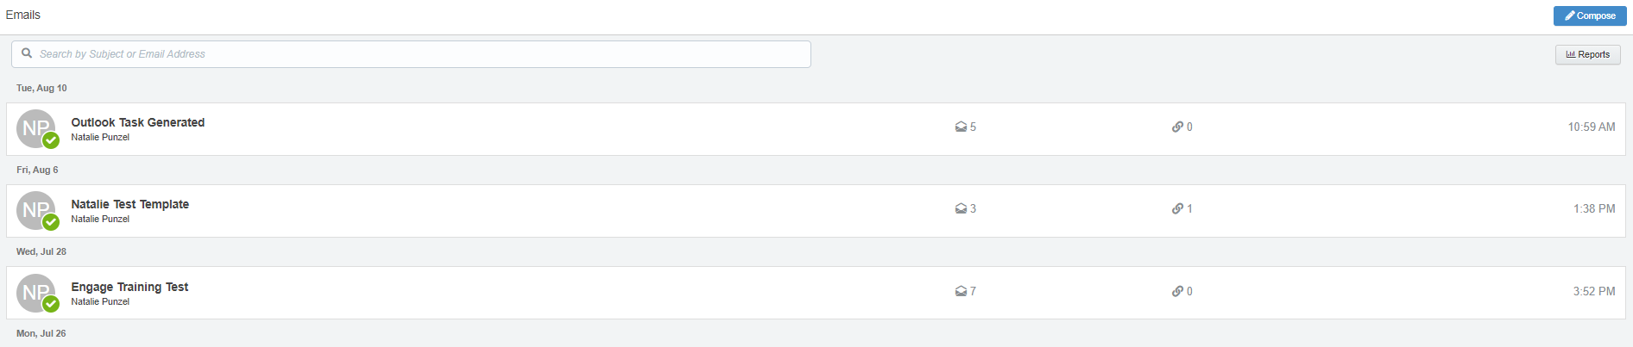
Eloqua Engage: Sending the email
ELOQUA ENGAGE: SENDING THE EMAIL
Once you have your audience selected, you can then go ahead and send your email
Once the email is sent, it will display on your Eloqua Engage homepage
On your Eloqua Engage homepage, you will be able to see engagement come in from your email in real time

Slide 15
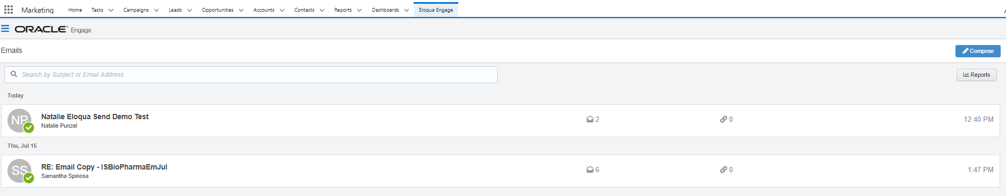
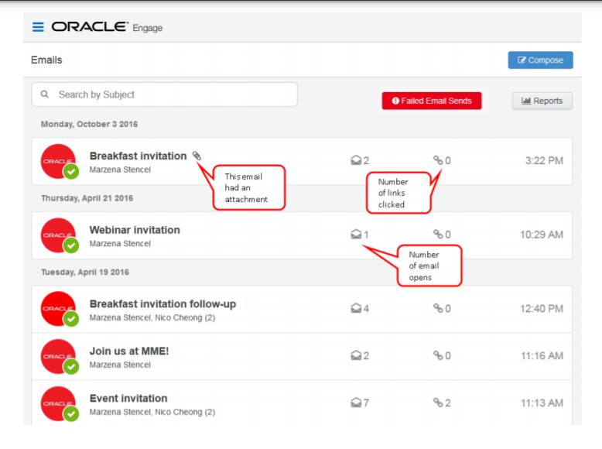
Eloqua Engage: Reporting
Once the email is sent, Engage displays your Recent Emails Sent history and send status.
To view email sent history:
  Navigate to the Engage home page by logging into Salesforce and clicking the Engage icon:
  Engage displays a list of successfully sent emails along with their sent status, date, and number of email opens and clicks.
    A green icon indicates the email was sent successfully to all recipients.
    An orange icon indicates the email was sent successfully to some recipients.
    A red icon indicates the email was not sent successfully to any recipients.

Slide 16
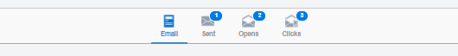
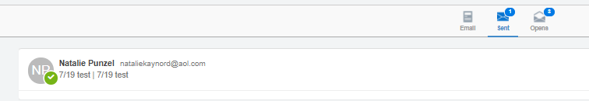
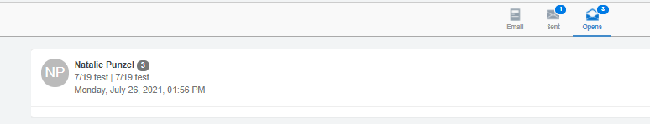
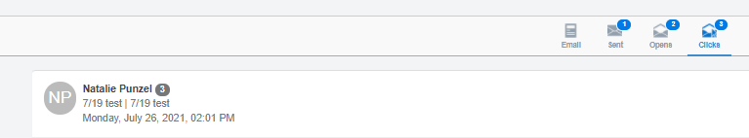
Eloqua Engage: Reporting
Select an email to view additional details. Explore the different tabs to learn more about your sent email.
Emails tab: Displays a thumbnail image of your email
Sent tab: Displays the recipients of the email. Here, you can click a recipient’s name to view additional details.
Opens tab: Displays the recipients who opened the email and
Clicks tab: Displays the recipients who clicked a link in the email

Slide 17
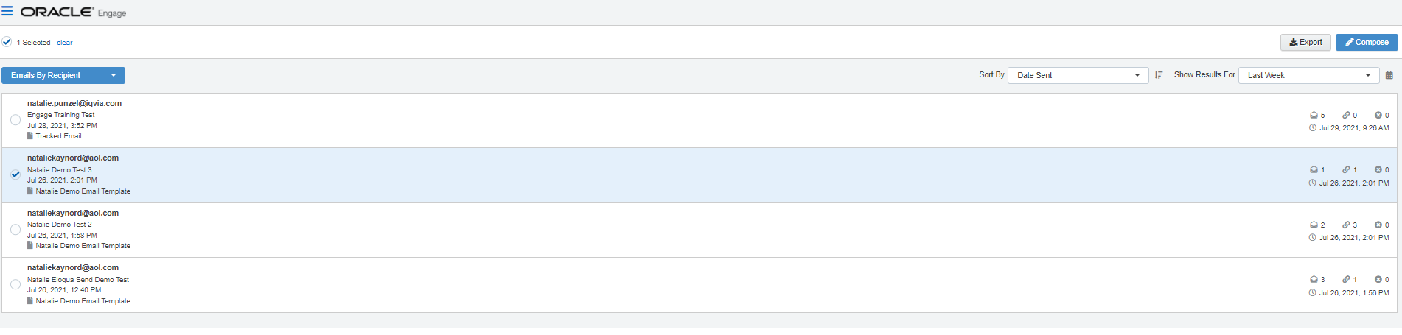
Eloqua Engage: Reports
Engage reports provide insight about the performance of your sent emails. Access reports by opening Engage and clicking Reports on the sent emails page
  Tip: You can send an email using one of the templates in your report results.
There are two Engage report types available:
  Engage top templates report
    The Engage top templates report provides information about the performance of your templates over a given period.
    You can utilize this report to gain an understanding of your top performing templates. You are than able to reuse the templates that have the best performance for future emails
  Engage emails by recipient report
    The report displays a list of recipients for your sent emails. Emails sent to multiple recipients are listed individually.
    You can utilize this report to view who has engaged with your email and follow up with them easily if desired. You can click on the recipient's name and select "Compose" to follow up directly with any recipient within this report.

Slide 18
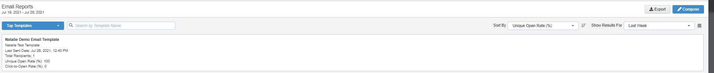
Eloqua Engage: Top Templates Report
The Top Templates report displays emails sent by the logged-in user
Use the search and date picker to limit the number of templates displayed:
  Search by template name.
  Filter results by date sent. Use the standard time frames from the drop-down list or enter a custom date by clicking the calendar icon. The default time frame is the Last Week.
Results are sorted by highest unique open rate by default. Use the Sort By drop-down list to sort by a different metric.
This report captures the following metrics.
  Unique Open Rate
    The unique opens divided by the total number of times an email was delivered. (Unique Opens / Total Delivered) A unique open is the number of recipients (original recipients or email forwards) that opened an email at least once. This does not count all the times that the same recipient opened the email.
  Click-to-open rate
    Clicked sends / opened sends. Both clicked sends and opened sends ignore possible forwards. Clicked sends: The first clickthrough by the original recipient. This metric ignores possible forwards. Opened sends: The number of first opens for the email.

Slide 19
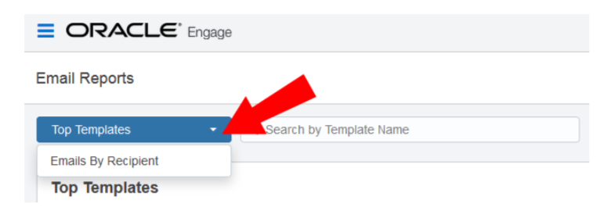
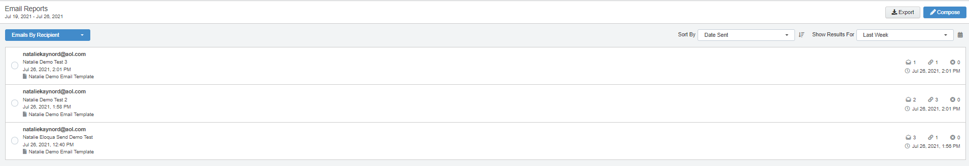
Eloqua Engage: Follow-up Using Top Recipient Report
The Top Recipient Report can be found in the Top Templates drop-down
Use the date picker to limit the number of email recipients displayed. Use the list’s standard time frames or enter a custom date by clicking the calendar icon. The default time frame is Last Week.
Results are sorted starting with the most recently sent email by default. Use the Sort By drop-down to sort by a different metric.
This report captures the following metrics.
  Total opens
    The number of times an email was opened. This includes multiple opens by the original recipient or forwarded recipient.
  Total clicks
    The total click-throughs. This includes multiple clicks by the same recipient. System Action links are not tracked.
  Hard bouncebacks
    The total emails that returned a hard bounceback.
    A hard bounce is an email that permanently could not be delivered. Some common reasons for hard bounces include an invalid email address or domain name.

Slide 20
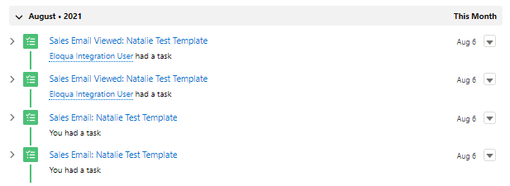
Eloqua Engage: Tasks Generated in Salesforce
When you do send your emails out of engage, the action counts as a “task.” Once the email is sent, a task will be created and marked as complete.
If the contact opens the email, another task will be created on the record that opened the email

Slide 21
Eloqua Profiler
Web Alerts

Slide 22
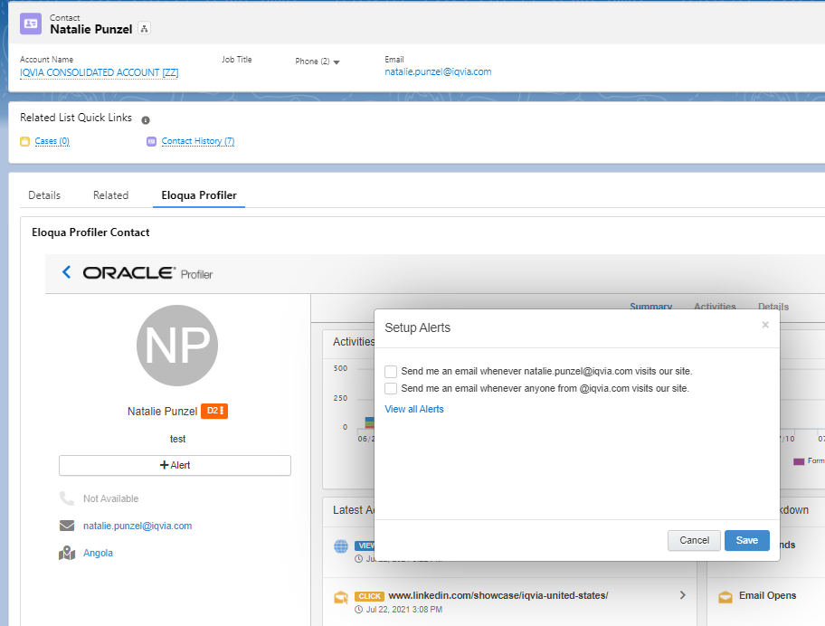
Eloqua Profiler Web Alerts
ELOQUA PROFILER WEB ALERTS FUNCTIONALITY
Eloqua Profiler allows you to view activity around specific contacts
Allows you to view customer activity profiles in one place
Shows summary and details of customer online activities & behaviors
  Website activity
  Event and tradeshow activity
  Email Open & Click activity
  Form fill activity
Provides real-time email alerts to sales of prospect visits to IQVIA.com
Email will arrive in your inbox from:

Slide 23
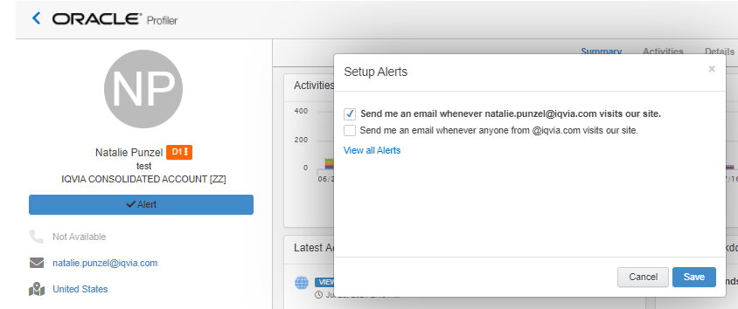
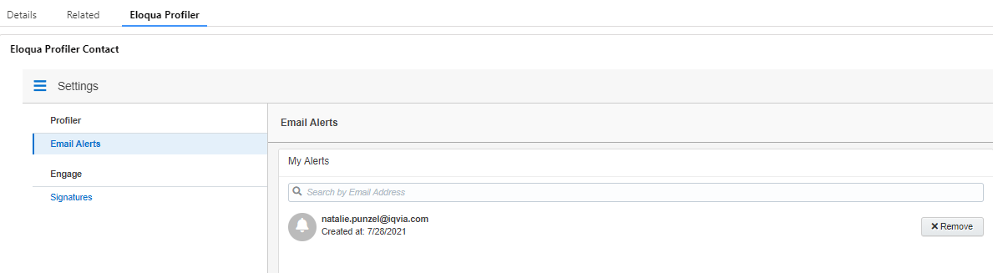
Eloqua Profiler Web Alerts
REMOVE ELOQUA PROFILER
WEB ALERTS
Search the contact you would like to remove as a web alert
Click on their name and select "Eloqua Profiler"
Click the blue "Alert" box
In the pop-up window select "View all Alerts"
Here all your web alerts will be listed, remove the alerts you no longer want to receive

Slide 24
RESOURCES
Eloqua Training Materials and Documentation
  Oracle Eloqua Engage User Guide
  Oracle Eloqua Sales Tools User Guide
  Profiler Training Resources
  Engage Training Resources
Training Videos
  Getting Started Video on Profiler (5 minutes)
  Eloqua Profiler Overview (3 minutes)
  Getting Started Video - Engage (3 minutes)
Eloqua Engage Outlook Plug-In
  Request the Oracle Outlook Plug-In in VIA
Eloqua Salesforce Reports
SFDC Contacts Report for Eloqua Engage
SFDC Lead Report for Eloqua Engage
Engage Task Report
For any support needs for Engage or the Outlook Plug-in please submit a VIA ticket.

Slide 25
Q&A

Slide 26
Archive

Slide 27
ARCHIVE
Eloqua Engage Outlook Plug-In
Audience upload resources
Salesforce Audience and Task Reports

Slide 28
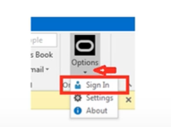
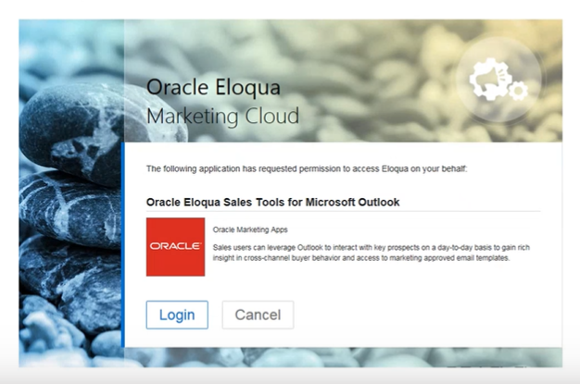
Eloqua Engage Plug In: First Steps
1. Download the Oracle Eloqua Sales Tools for Microsoft Outlook
  - Instructions can be found here on page 10
  - It will give you instructions for 32 bit or 64 bit. 32 bit is what worked for me
  - You may need to request the Outlook App in Via here.
2. Documentation can also be found in the Eloqua help center here
3. Once installed, you will have a new icon within your Outlook, you will need to sign into your Eloqua account
4. To sign into your Eloqua account, click on “Options” on the icon and “Sign In”
  - Login using your Eloqua Credentials
  - Users need to have access to Eloqua Engage and Eloqua Profiler to avoid login-issues
  - For any support needs for Engage or the Outlook Plug-in please submit a VIA ticket.
  - If you experience log-in issues, reach out to marketing.automation@iqvia.com

Slide 29
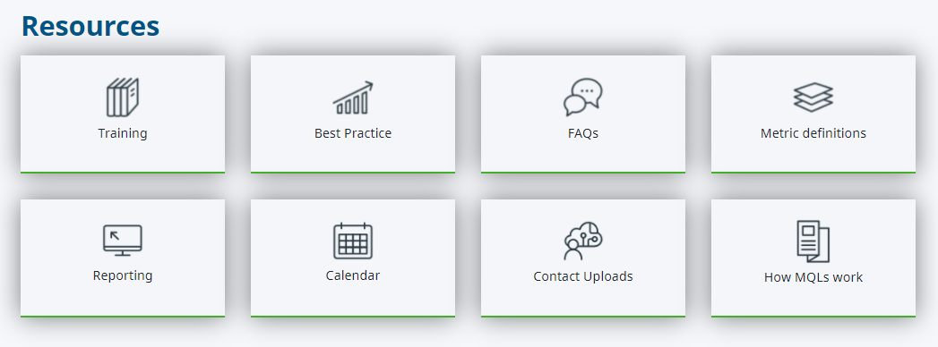
Audience Upload Resources
1. Marketing Automation Toolbox
2. Scroll down to Resources and select Contact Uploads
Format your excel spreadsheet to the specifications outlined here
Once your file is ready, email your file to marketing.automation@iqvia.com

Slide 30
Salesforce Audience Reports
There are two reports available in Salesforce that allows you to curate your desired audience
  Contacts Report for Eloqua Engage
  Lead Report for Eloqua Engage
Below is an example of a Task report. A task is created and associated to the recipient’s contact or lead record in Salesforce when the email is sent and when the email is opened. You can see how the difference in the sent and opened task within the report.
    - Engage Task Report

Slide 31
Eloqua Engage Outlook Plug-In

Slide 32
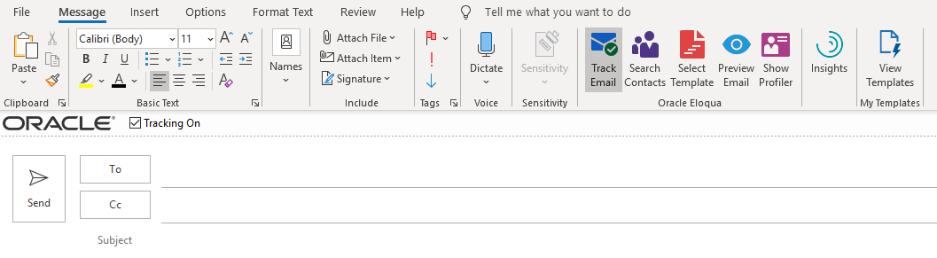
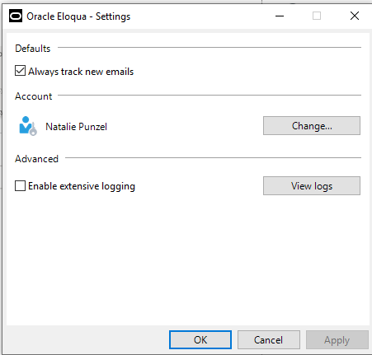
Outlook Eloqua Engage Plug-In
OUTLOOK ELOQUA ENGAGE PLUG-IN OVERVIEW
Download Outlook plug-in app to view new ribbon options.
By default, tracking will be enabled. Tracking is enabled when the tracking box is checked.
Once this box is checked and an email is sent, this email will be tracked by Eloqua.
When the “Tracking On” box is not checked, the message is sent as a personal email and is not tracked.
Uncheck the tracking box if you would like to remove tracking. You can also logout of the Oracle App if you do want the new options to appear.
You can also change the default so that the “Tracking On” box is unselected by default therefore having to check it when you want the email to tracked. To do that, go to the Oracle App and select “Settings” and uncheck “Always track new emails.”

Slide 33
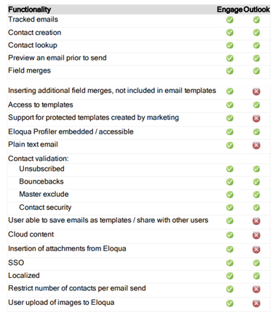
Outlook Eloqua Engage Plug-In
OUTLOOK PLUG-IN VS. ENGAGE
Within the Outlook Plug-In you will not be able to:
  Insert additional fields merges
  Have support for protected templates created by marketing
  Have a plain text email
  User will be unable to save emails as templates and share with others
  Cloud content will not be available
  Cannot insert attachments from Eloqua
  Restricts the number of contacts per email send
  Cannot upload images from Eloqua

Slide 34
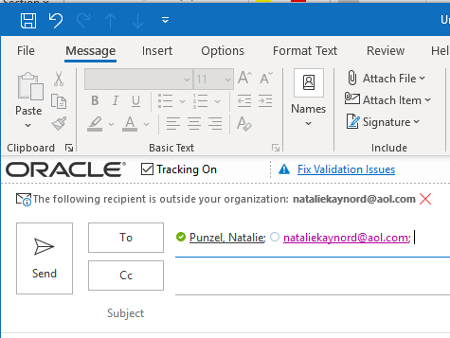
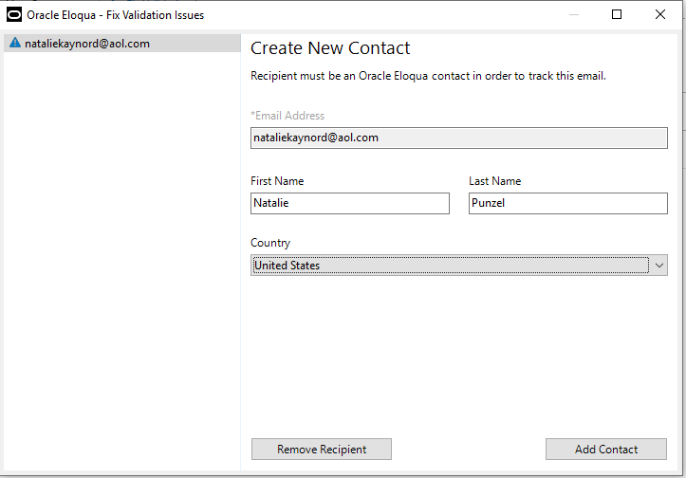
Outlook Eloqua Engage Plug-In
ADD CONTACTS WITH OUTLOOK PLUG-IN
Either type a single contact's name into the address bar or copy and paste a list into the address bar
Once you enter in the contact’s information, if the contact is in the database, you will have no issues and you will be able to add them to your recipient list.
If the contact you try and enter is not in the database, you will get a “Fix Validation Issues” alert within your email address bar. You will need to click on that and add that contact to the database. If you don’t want to add that person, select “Remove Recipient.”

Slide 35
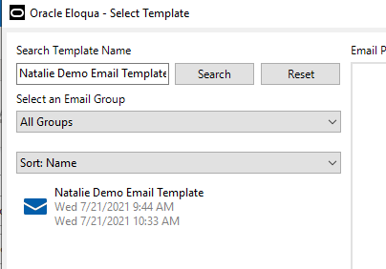
Outlook Eloqua Engage Plug-In
SELECT A TEMPLATE WITH OUTLOOK PLUG-IN
  You can create your own personalized email or select a template
  You can search templates by the template name. At least three characters must be specified to search.
  You can narrow the search by selecting specific email groups. You can sort templates by name, creation date, or modified date.
  There are pre-made templates created within Engage that you can choose if you would like:
    Starter Engage Template Names – search these templates in Engage. Do a “Save As” – to create a new email
      Blank Template without Signature field merge w/ IQVIA logo
      Inside-Sales-Blank-Template_2.0_Blank
      Blank Template with Signature field merge w/ IQVIA logo
      Inside-Sales-Blank-Template_2.0
      Blank Template looks like it is coming from Outlook
      2021_Inside_Sales_Blank_Template_Outlook_Version_2.0

Slide 36
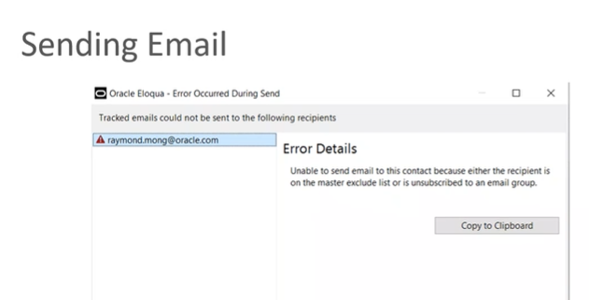
Outlook Eloqua Engage Plug-In
PREVIEW AND SENDING AN EMAIL WITH OUTLOOK PLUG-IN
  Once you have the email completed you can click on Preview to see how the email will look to the recipient
  When you are ready to send the email, you can click Send.
  Another validation will be ran at this time to see if there are any issues with the recipients
  If there are issues, you will get a prompt telling you why
  Any email address that does pass this validation will not receive the email

Slide 37
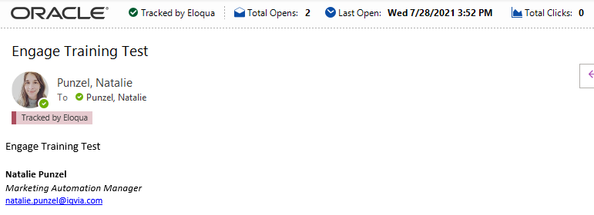
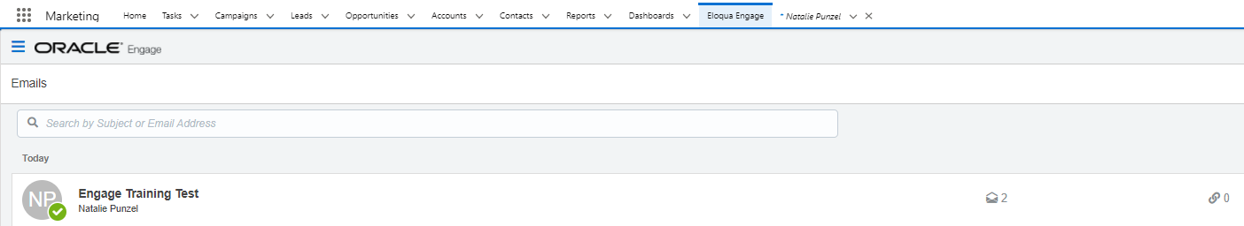
Outlook Eloqua Engage Plug-In
EMAIL SEND METRICS WITH OUTLOOK PLUG-IN
  You can check the email send metrics in Outlook by navigating to the Sent Email Folder and opening the email that was sent
  The correspondence will also show up within Salesforce Engage as well

