Slide 1
SEO Best Practices
The importance of Search Engine Optimization
Sathya N Senior Web Strategy Coord

Slide 2
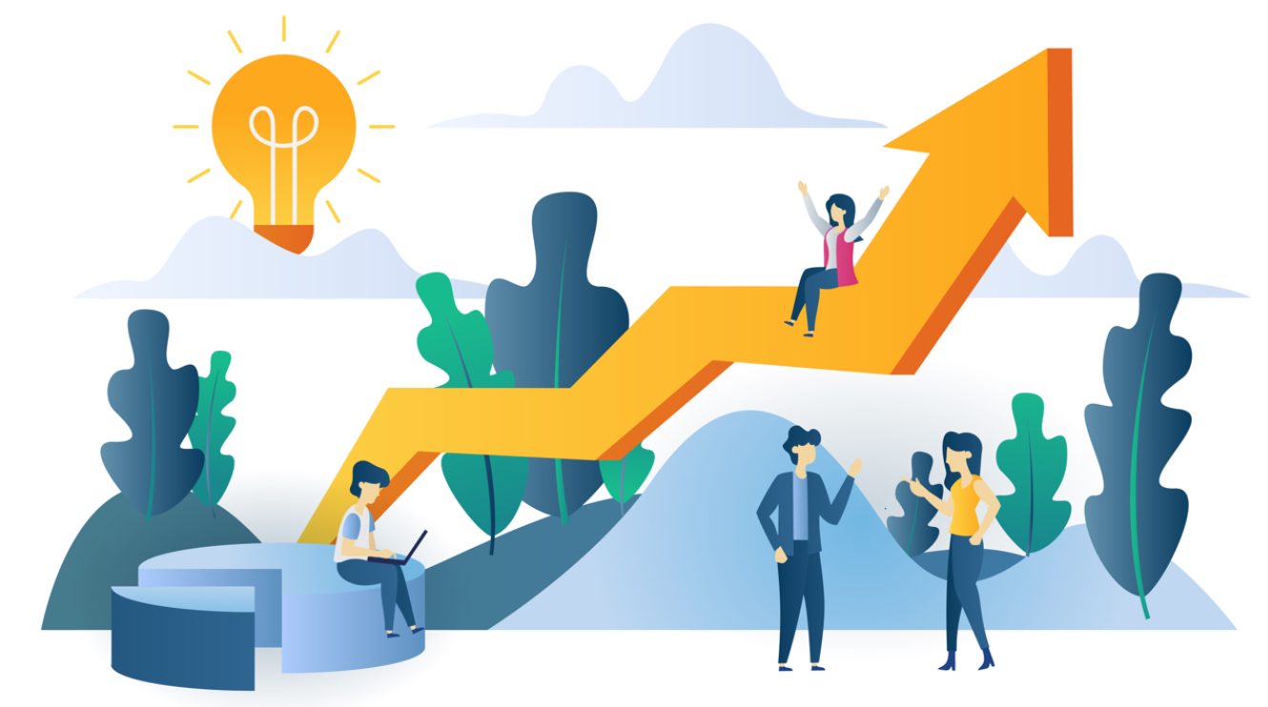
What is SEO?
Search Engine Optimization is the process of increasing traffic to a webpage through non-paid search engine results.

Slide 3
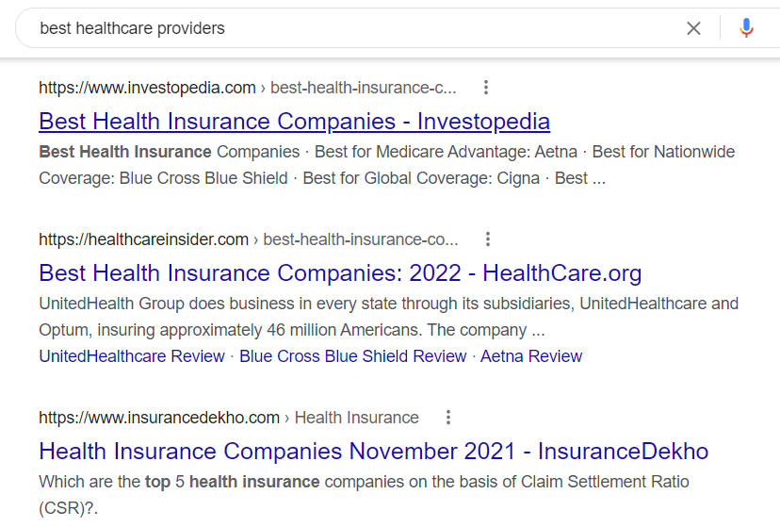
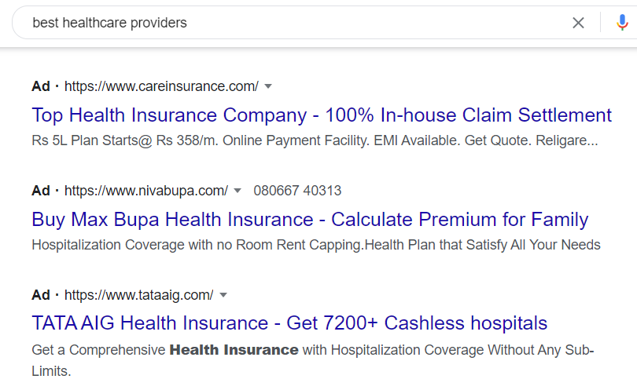
An example of Organic (non-paid) vs paid search results
Non- paid results are earned based on quality and quantity of the content at no cost
Paid results are through running Google Ad campaigns with an additional cost
Organic Search Results
Paid Search Results

Slide 4
Why is SEO important?
Visibility
and
Rankings
Trustworthy
and
Growth
Web Traffic

Slide 5
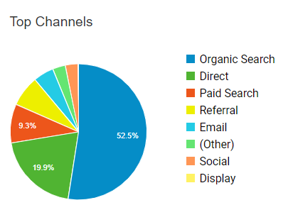
Organic Opportunity on IQVIA.com

Slide 6


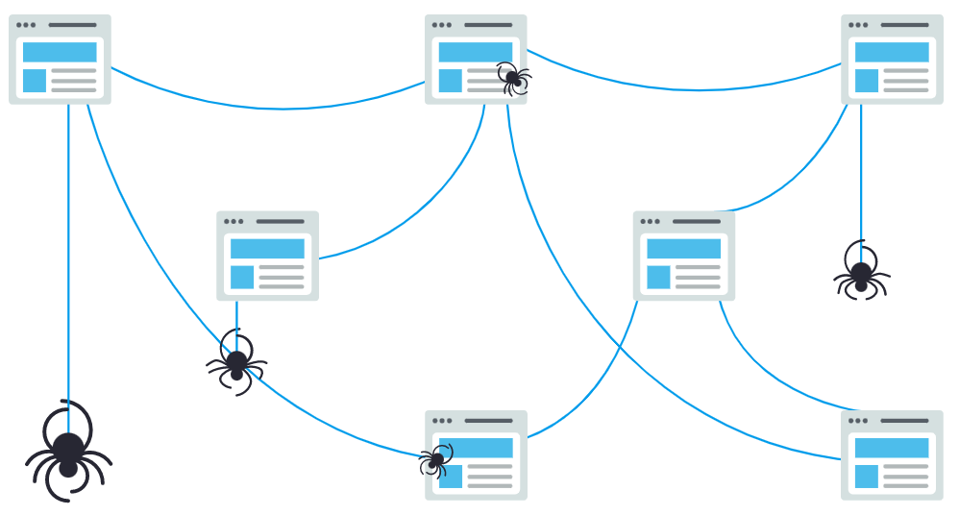
How does Google rank websites?
Search engines like Google follow 3 steps to rank:
Crawling
Indexing
Ranking

Slide 7




Elements of SEO
Internal Linking / Anchor Links
Backlinks
SEO Elements
Keyword Research
On-Page SEO

Slide 8
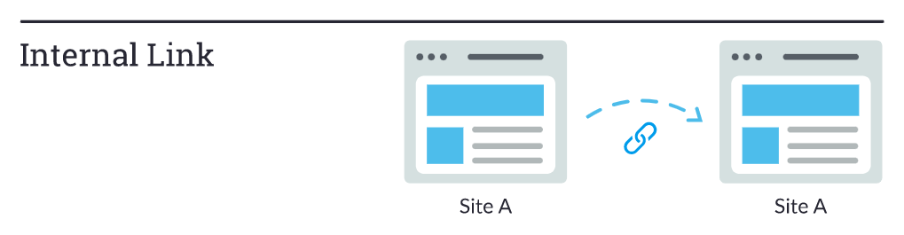
Internal Linking
Inter-link pages within the website
Example: https://www.iqvia.com/locations/united-states/library/white-papers/integrated-delivery-networks
https://www.iqvia.com/locations/united-states/solutions/life-sciences/commercial-solutions/market-access/idn-insights

Slide 9
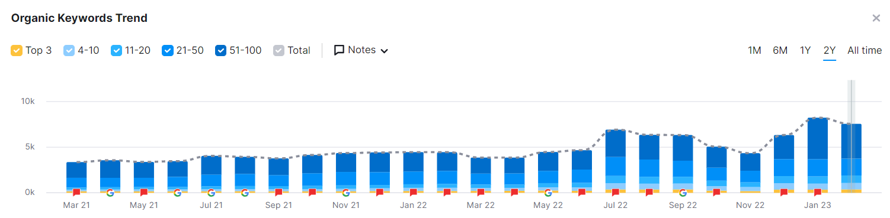
Result of interlinking TL pages and Related Solutions
Page 1 Keywords for GBU Solution pages increased by 79.36%.
Organic Traffic up 37% to GBU Solutions pages
1K+/mo more visits through non-branded keywords
Notes:
Note – early results and trends, will continue to analyze over time

Slide 10
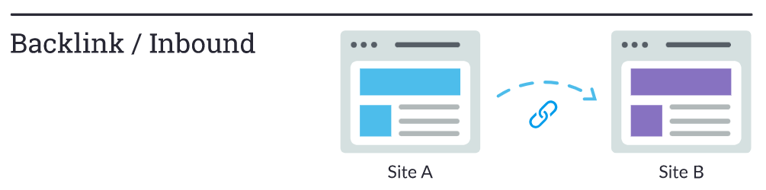
How Backlinks Work?
The more relevant, important, and trustworthy a web page is, the more links it will have earned.

Slide 11
Keyword Research: The foundation for a good SEO
Analyze and choose the best keyword
Identify a list of keywords that are relevant to your offerings
Check the keywords that your competitors are ranking for
Brainstorm your own ideas and find related keywords on Google

Slide 12
Keyword Types
Primary Keyword
Secondary Keyword
Healthy diet plan
Healthy diet for weight loss
Healthy diet food
Low carb diet
Healthy meal plans
Diet plan weight loss

Slide 13
Keyword Research
Websites with well-chosen keywords help to get more organic traffic
Short tail keywords
These keywords are not specific
They consist 1-2 words
They have high search volume and high competition
Since these keywords are broad match, they don't convert very well
Example: Analytics IGC Consulting, etc.
Long tail keywords
These keywords are very specific
They consist of more than 2 words
They have relatively low search volume and competition
This will bring in quality traffic leading to higher conversion rate
Example: Healthcare data transformation solutions Master data management in healthcare Clinical Research and Development solutions, etc.

Slide 14
Did you know?
Title tags with numbers result in higher CTR:
Poor example: Learn digital marketing
Good example: 5 easy ways to learn digital marketing
Having questions in your metatags can increase your CTR:
Poor example: Learn the importance of first page rankings
Good example: How to rank number 1 on Google?
According to Moz

Slide 15
Additional Tips for Optimizing Titles for SEO
Length: 512 pixels. (approx. 60 characters or less)
Write for Humans, not robots: Keep it natural.
Competition: What are our competitors calling their similar pages?
Keyword placement: Place most important keywords towards the front of the title tag, with least important semantics at the end.
Relevancy: It accurately describes the content (strong message match).
Unique Page Titles: Ensure title tags are unique to each page, and that only one page on the site is optimized for a given keyword.
No stuffing: Do NOT repeat the same word over and over.
Use action words: these terms help entice the user to take action (or click). Ex: Get, take, learn, go, download and boost.
Highlight differentiators: tell people what makes your content unique. i.e., depth,, speed, freshness, actionable, brand.
Add brackets/parenthesis: break up the text and highlight specific sections of the title, which can improve readability.
Goal #1
Help you rank for a keyword
If you aren’t ranking for your keyword that you target, your page won’t see much traffic.
Goal #2
Entice the User to Click
Google uses CTR to decide how relevant you are for a specific page. If you rank low but have a high CTR, Google will bump you up over time.

Slide 16
Optimizing Meta Descriptions
Once on Page 1, meta descriptions become important!
No longer than 155 characters. Keep it short but interesting enough. Usually, 120 -156 characters
Use active voice and make it actionable: Address the user directly to act. Motivate with your differentiation.
Include a Call to Action: Entice the Click! “Learn more, get it now, start your free trial, find out how”
Use your targeted primary keyword This will make the word bolded and it will stand out.
Show specification where possible Use a benefit or two when writing your meta description
Make sure it matches the page’s content Don’t mislead, it will cause users to bounce from your page.
Make it unique Avoid copy and pasting directly from your content
Goal #1
Entice the User to Click
The meta description affects click through rates. Don’t lose visits by forgetting this step.
Goal #2
Summarize your content
Set the user’s expectation at what they will arrive at. It will help conversion and time on page.

Slide 17
When creating Graphics for IQVIA.com
Limit amount of Text
Graphics on IQVIA.com
Consider Alternatives
Difficult to read
Hurt the mobile experience due to resizing
Are not crawled
Try presenting your content in modules
Consider a Ceros interactive graphic which is crawlable
Use alt image tags to provide context to search engines

Slide 18
Summary
Choose long tail keywords as a primary keyword and include it in the URL, Title, H1, First Sentence and Last Sentence
Add variations, synonyms or LSI keywords of your primary keyword into the copy and in the sub-headings
Find internal linking and backlink opportunities
Add ALT tags to images
Consider removing gate for older assets
Your page should be better than competitors, your content should address what people expect to see
To improve Readability:
Write in short sentences and short paragraphs
Avoid using big or complex words
Write as you speak
Ask yourself, can an 8th grader read and understand your content

Slide 19
Next Steps
Find ‘Keywords’ ranking on page 2 of Google
Consider to update the titles if not already optimized
Add key summary on asset landing pages
Inter-link related pages
Include keyword in the CTA button instead of ‘Learn more’
Check for duplicate titles/content within iqvia.com and fix it immediately

Slide 20



Measuring Success
Primary Keyword Ranking
Are we on Page 1?
Over time our rankings should increase, we can monitor this using tools such as MOZ and Google Search Console. This could take anywhere from a week to up to a few months. Continuous improvement is key.
Click Through Rate
Is our CTR high enough?
If we are on page 1, our CTR becomes vital to gaining traffic. Google Search Console can assist with capturing this KPI.
Organic Traffic
Are we gaining visitors?
We can use Google Analytics to see if we detect an increase of traffic to our page.

Slide 21
Resources
SEO FAQs
Video: SEO Basics Part 1
Video: SEO Basics Part 2
Introduction to Search Engine Optimization
SEO Keyword Tips
SEO Brand World Guidelines

Slide 22
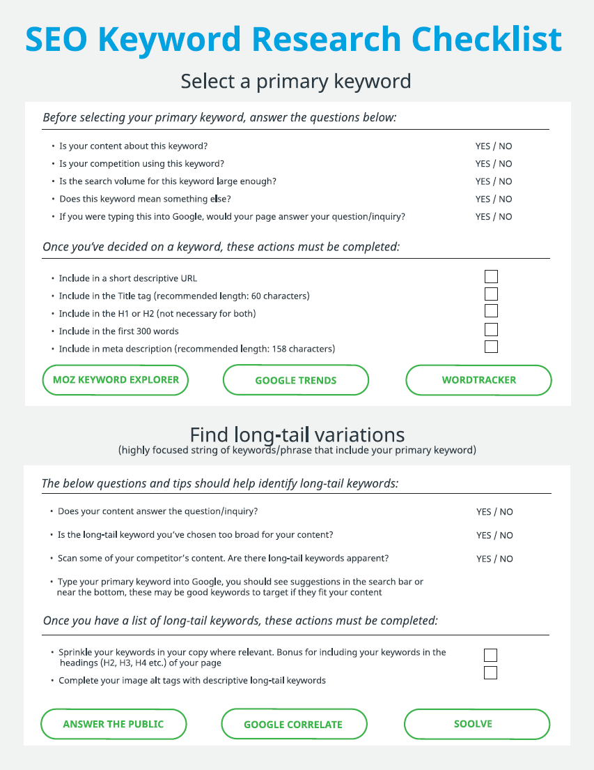
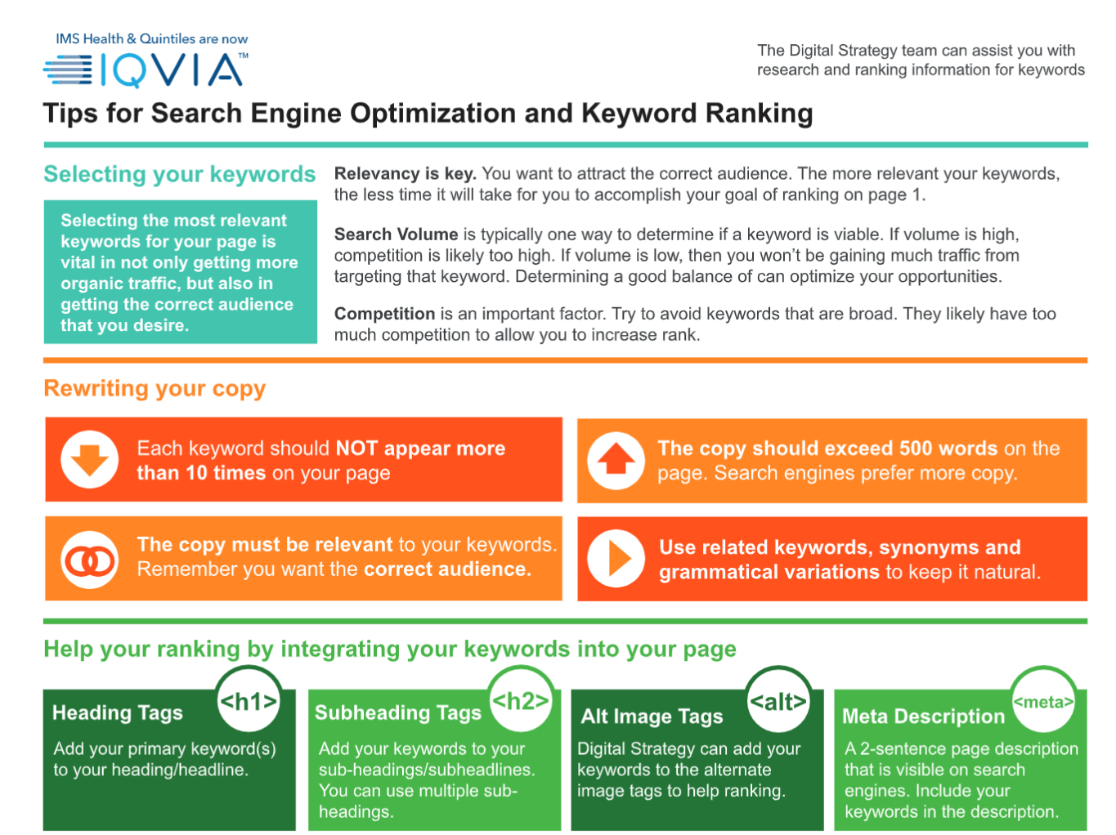
Additional Resources
Use the checklist as a guide to set up your SEO page strategy.
MOZ Keyword Explorer
Answer the Public
Wordtracker
Google Correlate
Google Trends
Soolve
SEO Keyword Research Checklist
SEO Keyword Tips Fact Sheet
Contact Web.Support@iqvia.com
for assistance

Slide 23
QA

