Slide 1
Marketing Automation & Operations
Effective Use of MQL Forms in Campaigns
Aaliyah Haarish
Aug 2, 2023

Slide 2
Agenda
Welcome
Best Practice: Effective Use of MQL Forms in Campaigns
Open Q&A/Discussion

Slide 3

Marketing Automation Open Office Hours
Get your questions answered by the marketing automation team. MA Open Office Hours are held monthly with the following agenda:
Learn about a tip or best practice
Ask a question – Pre-submit your questions here or ask during the office hours
Learn how to leverage IQVIA’s marketing systems and processes most effectively
Action: Sign up here, if you need to be added to the outlook invite
Reminder: Save your questions for the end or enter in the chat. We will address as many as we can!

Slide 4

What is a Marketing Qualified Lead (MQL)
A prospect/customer identified by marketing that fits a defined profile and level of engagement agreed to by both marketing and sales and is ready to be turned over for sales activity.
Most importantly, the prospect/customer is accepted by sales for further qualification.
We focus on hand-raisers.
If a prospect/customer is a “hand-raiser”
- they have explicitly asked up to follow-up on a specific business need and/or indicated an upcoming RFP

Slide 5
What is a Form?
Where forms can be used?
Request Demos/call back and Free trails
Newsletter Sign-up
Registrations for events and webinars
To host (gate) Whitepapers, Videos and Reports
Infographics and Blogs
Hybrid landing page (offering an asset and an MQL form in the same page)
Forms allows you to learn more about customers and prospects and it’s one of the most powerful and effective ways of collecting information about existing or potential customers.

Slide 6
Types of Forms
The 3 main types of forms are MQL, non-MQL and Hybrid.
The Non-MQL form is the more basic form and isn’t linked to Inside Sales. For example, this form can be used for gated content on a landing page
The MQL form creates an MQL task in Salesforce which goes to Inside Sales – sales follow up. This form has additional fields to the standard non-mql form including the required field asking for more information as well as a number of additional hidden fields.
In an MQL form there is an additional field of ‘Please provide us with more detail of your need’ which is required and is important for the Inside Sales triage process
A hybrid form will have both MQL & Non MQL functions. It contains a checkbox for requesting a follow-up and ONLY if the checkbox is checked, the form produces an MQL task

Slide 7
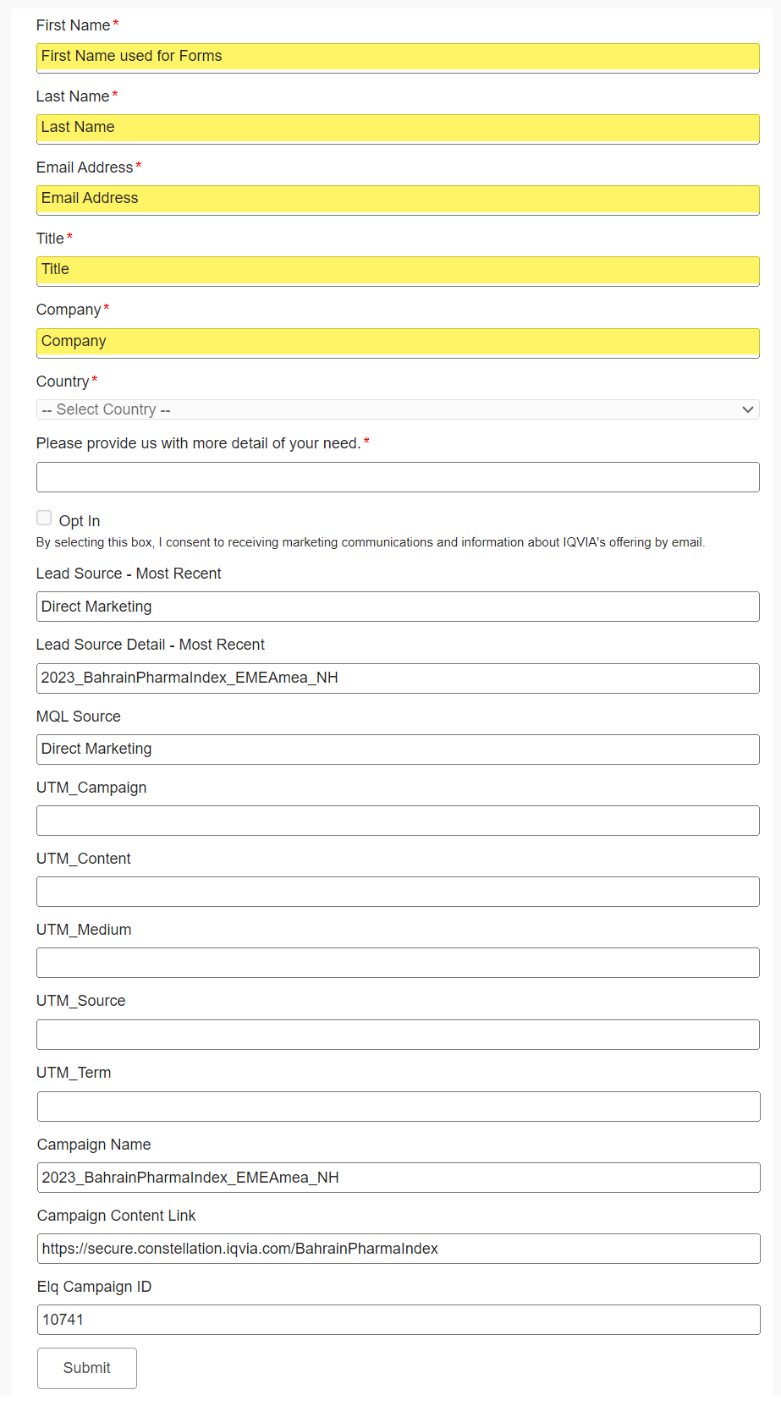
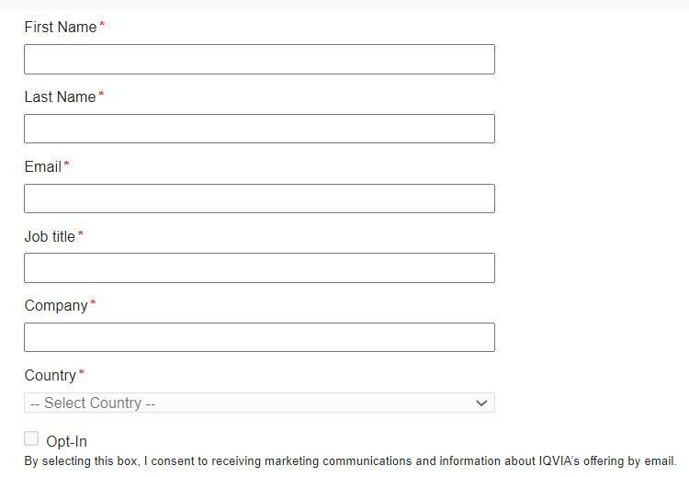
Types of Forms
MQL forms there is an additional field of ‘Please provide us with more detail of your need’ which is required and is important for the Inside Sales triage process
Generally, forms will have 7 required fields
MQL Form
Non MQL Form
Hidden Fields
Non-MQL form is the more basic form and isn’t linked to Inside Sales. This form would be used for gated content on a landing page.

Slide 8
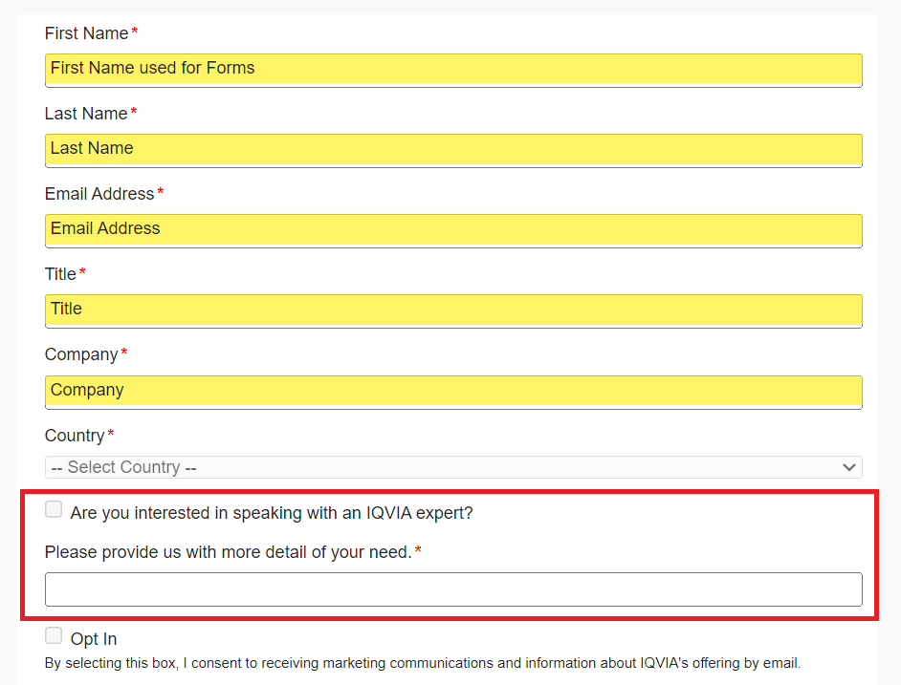
Types of Forms
Hybrid Form
Same as the MQL form except only the option to check or uncheck the field “Are you interested in speaking with an IQVIA expert?”

Slide 9
MQL Vs Non MQL
First Name
Last Name
Title
Company
Country
Email Address
Opt in checkbox (defaulted to unchecked)
First Name
Last Name
Title
Company
Country
Email Address
Please provide us with more detail of your need
Opt in checkbox (defaulted to unchecked)
ALL OF THESE FIELDS ARE REQUIRED except the opt In Field

Slide 10
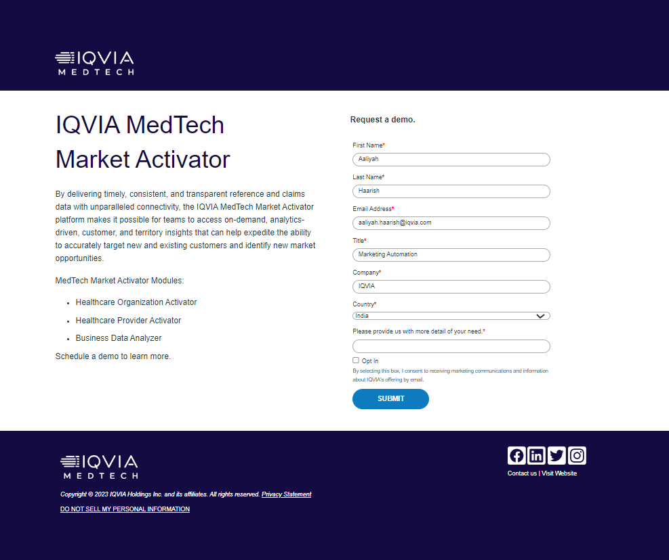
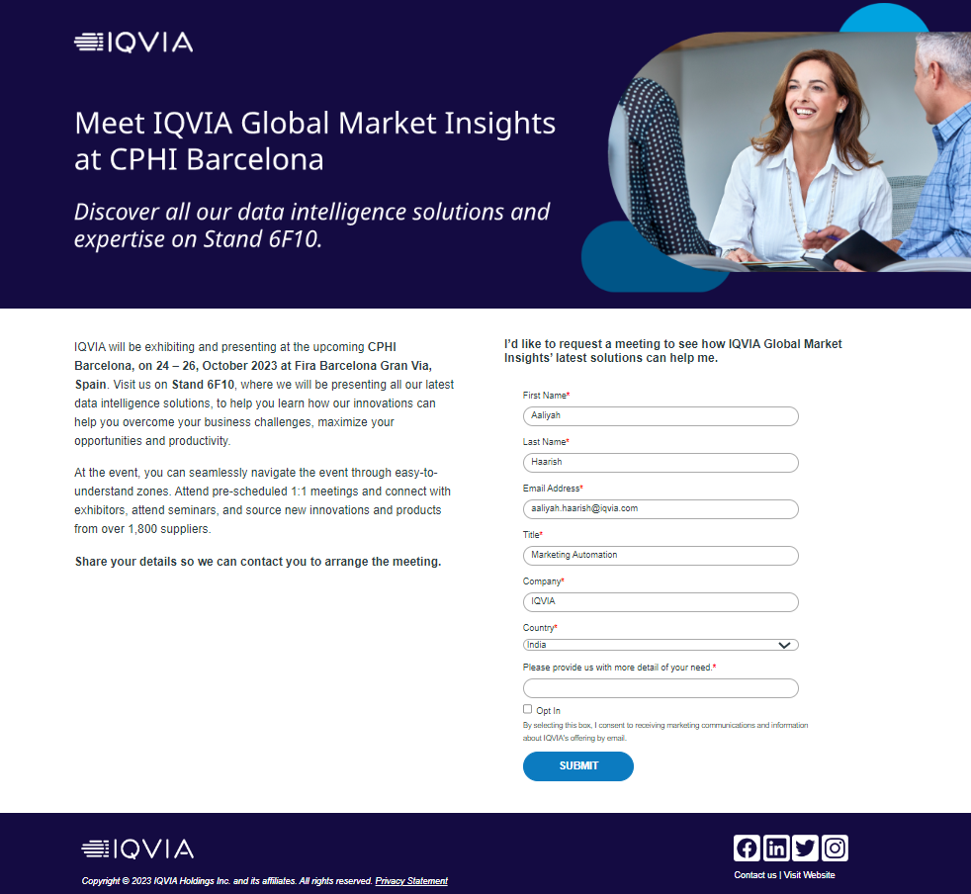
What is a Landing page?
Landing Pages are treated as part of an email campaign or standalone assets.
“The landing page provides the contact with more information and options related to the email or ad that brought them there. On the landing page, a visitor can be asked to participate in the campaign by reviewing detailed information, submitting a form, or clicking a button to receive additional information. The landing page moves prospects through your campaign and gives them a clearer idea about your product and your company”
“It is a payoff to the action that was taken to get the individual to the landing page.”
Examples

Slide 11
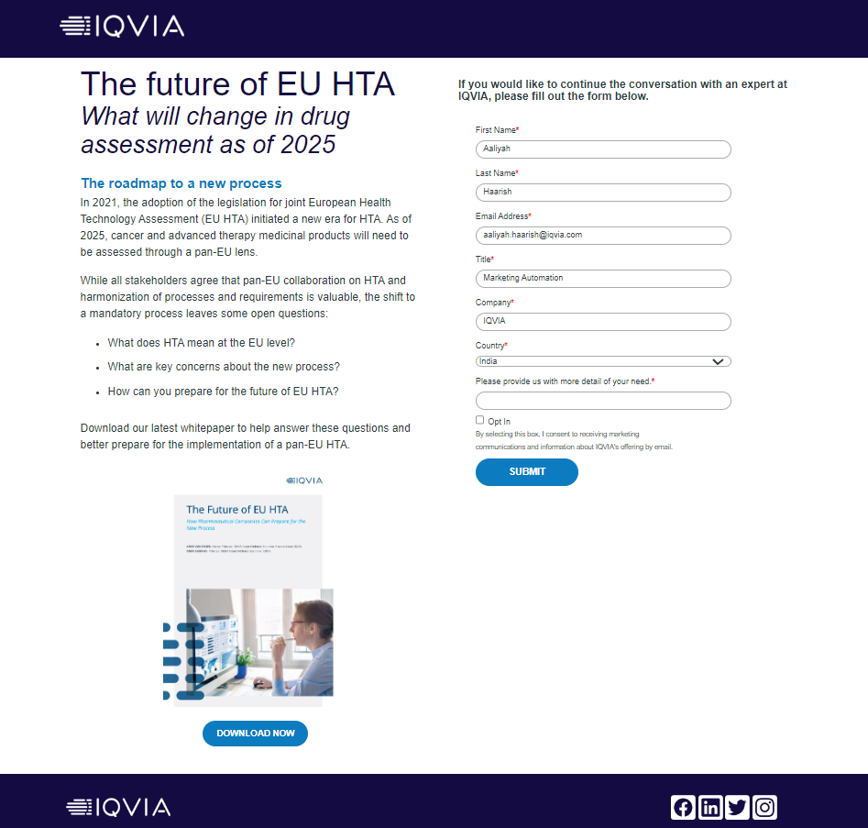
Hybrid Landing page
Hybrid landing page is a combination of offering access to any resources like, whitepapers, fact sheets etc along with a hybrid or an MQL form.
This can be used as an alternative for gated pages.
A Hybrid landing page can be created either with a hybrid form or a standard MQL form
Example

Slide 12
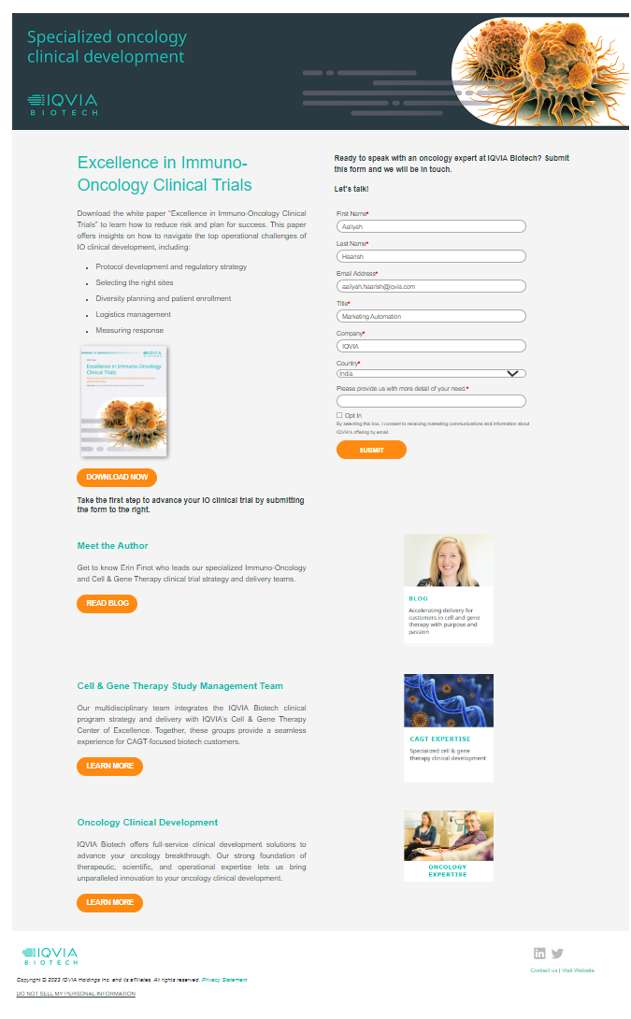
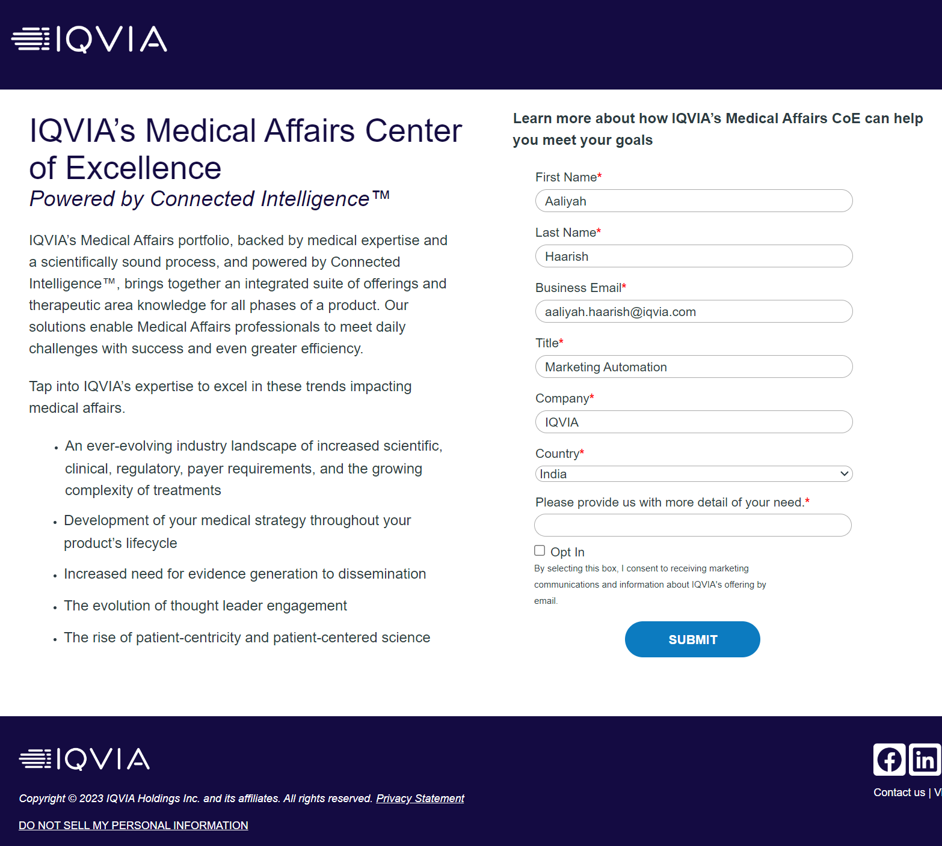
Top 3 Landing pages driving MQLs
2023_Virtual_Customer_Sum_US_GBU_RWS_AF
2023_FierceEmailJun_Biotech_PS
2023_MdAfrFierceEmMay_USCAusa_RL
105 MQLs
104 MQLs
102 MQLs
3
SQLs

Slide 13
Best practices for effective MQL pages
Always have ONE objective
Target more specific audience
Have a short & attention-grabbing titles/headlines
Have a relevant images
Make the content crisp, clear and compelling
Explaining what they will get by filling out the form
Minimizing the distractions on the page
Preference using hybrid landing page

Slide 14
Thank You

