Slide 1

Marketing Operations
Marketing Operations Toolbox and Marketer Dashboard
Phil Cuff
8th November 2023

Slide 2
Agenda
Welcome
Marketing Operations Toolbox and Marketer Dashboard
Open Q&A/Discussion

Slide 3

Marketing Operations Open Office Hours
Get your questions answered by the marketing operations team. Open Office Hours are held monthly with the following agenda:
  Learn about a tip or best practice
  Ask a question – Pre-submit your questions here or ask during the office hours
  Learn how to leverage IQVIA’s marketing systems and processes most effectively
Action: Sign up here, if you need to be added to the outlook invite
Reminder: Save your questions for the end or enter in the chat. We will address as many as we can!

Slide 4
Strategy – Mktg Ops Toolbox Redesign
Leaner processes & more productive workflow
1
For Marketers
Have the convenience of a single location to submit all their Marketing Operations requests
Easier and more intuitive navigation for marketers to find the right information and accomplish their tasks
2
For Marketing Operations
Benefit from a single platform and process to efficiently manage all execution and SLAs across channels
Much easier and quicker to manage form updates
3
For Reporting/Metrics
Updated and aligned fields across all request types to support the business’s reporting requirements
Single platform to report Activation metrics
4
LEAN
Focus on continuous improvement, single platform that we can more easily manage, maintain and enhance on a regular basis

Slide 5

Operational Plan – Mktg Ops Toolbox Redesign
Reporting Enhancements
Align fields and data across request types
Transition to Reporting Group (from BU)
1
Website Request Forms
Integrated into the Toolbox from VIA
4/5 forms condensed to 1
2
3
Paid Social Forms
Integrated into the Toolbox from email/excel
1 form for multiple types
Organic Social Forms
Integrated into the Toolbox from VIA
4
5
Site Redesign
Reflect current IQVIA Brand
Modernized & Updated UI
Enhanced Usability for Marketers
Lean Productivity Updates (Ongoing)
Continuous Improvement focused on productivity enhancements across intake/requests & Activation
Marketer Dashboard & Conversations
6

Slide 6
Toolbox Site Redesign Process
Step
Step
Input & Research
Google Analytics data review
Results from survey
Marketer input from survey/comments
Briefing & Design
Agency briefing – mid-July
Agency generated 3-4 design proposals
1
2
Step
Step
Evaluation & Decision
Review design options internally
Marketer focus group & Brand for feedback and advice
Provide direction back to Agency for final design
Build & Go Live
Agency builds site enhancements, Update Content
Testing
Go Live & Communicate
3
4

Slide 7
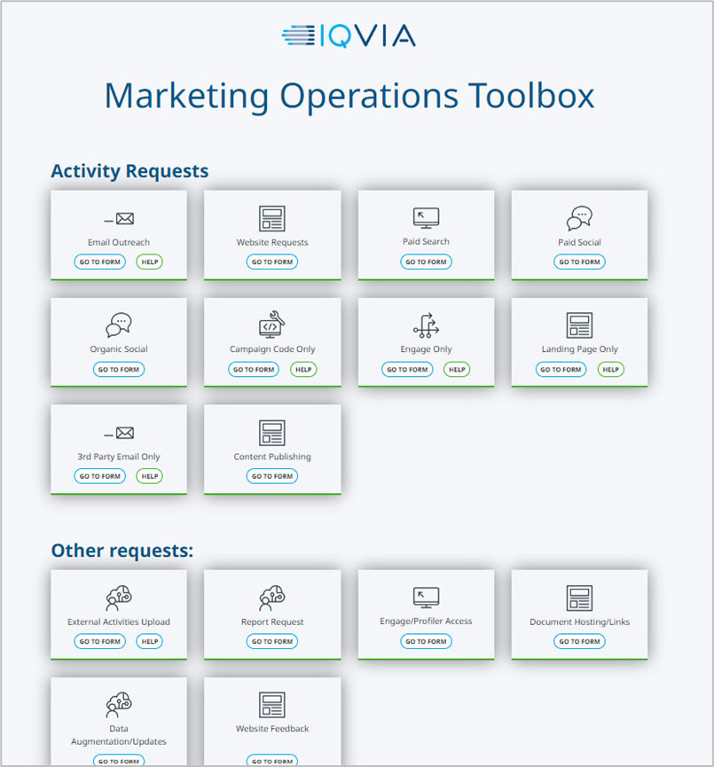
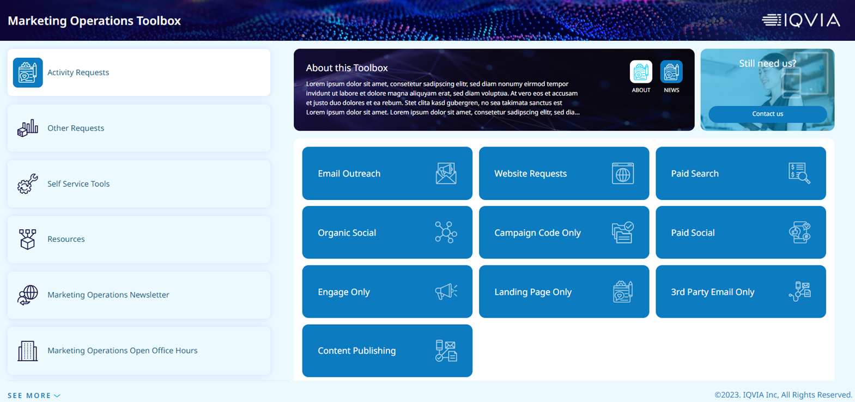
Mktg Ops Toolbox – Old to New

Slide 8
Marketer Dashboard

Slide 9
Marketer Dashboard introduced
Lean Productivity Enhancement
View Request Details
1
View and manage all your active requests in single location including details – Campaign ID, Segments etc.
Converse w/ Mktg Ops
Converse with Mktg Ops regarding a request – rather than emailing back and forth
2
Add Attachments
Add attachments directly to requests – content, lists etc.
3
Single Location
4
All work information and product for a request will now be in a single location

Slide 10
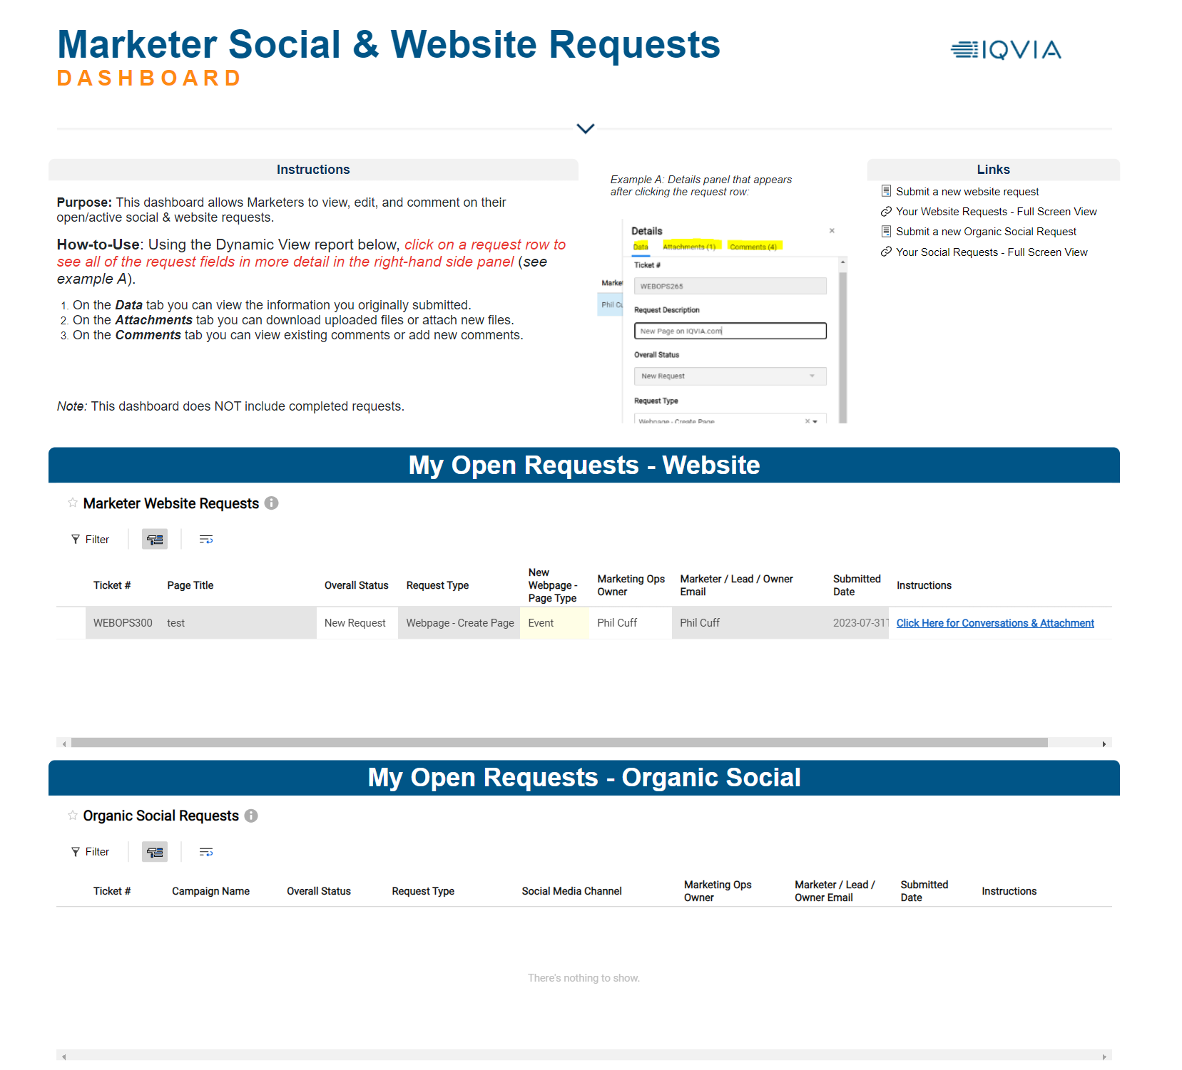
Marketer Dashboard

Slide 11
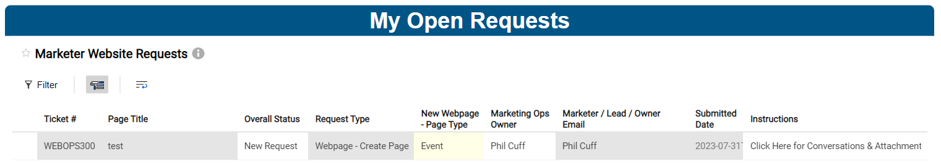

Marketer Dashboard introduced
View and manage all your active requests in single location
We have run a Proof of Concept (POC) with website requests over the last few month
  It has proven successful and marketer feedback has been positive:
    “I love the layout and functionality of the Marketer Dashboard. I can see everything in one spot...”
    “I like working with the new Dashboard. I find it more efficient…”
The Dashboard is on SmartSheet so marketers will need to sign in for access, but IQVIA uses SSO so you should not need to enter any credentials
All alerts that are sent from SmartSheet to the marketer will contain a link to their dynamic dashboard

Slide 12
Reminders and Next Steps
https://secure.constellation.iqvia.com/MarketingAutomationToolbox
Target Go Live – Week of Nov. 13
As always feel free to share feedback and suggestions
  Phil.Cuff@iqvia.com
  Garrett.Brennan@iqvia.com

Slide 13
Thank You

