Slide 1
RWS Global
Updates for MA Open Office
Clint Allen, Associate Director, Omnichannel Marketing, RWS

Slide 2
Top campaign by channel
Campaign | Channel | # of MQLs
2022_CSMALibrariesMadLog_USCAusa_RL | Display | 965
2022_CPhIWW_GBU_TCS_SD | Event | 322
2021_iqvia_brand | Paid Search | 319
2022_RWELeadGenAds_GBU_RWS_PF | Paid Social | 290
2022_RWHealthEconomicsWbnrMay_USCAusa_RL | Webinar | 203
2022_AIMLinfograpBioPharma_GBU_RWS_JM | Third Party Provider | 155
2022_Q1Nurture_GBU_RWS_CA | Email | 138

Slide 3
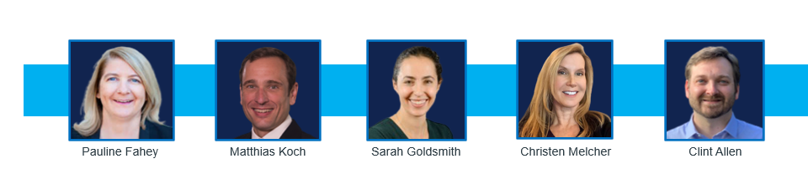
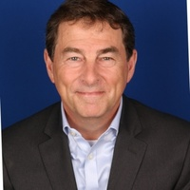
RWS Global Marketing | team effort
John Weyrauch
Pauline Fahey
Matthias Koch
Sarah Goldsmith
Christen Melcher
Clint Allen

Slide 4



Conference nurture campaign
3 emails to nurture conference audiences
Conference Session A recording
White Paper aligned to topic
Fact sheet, article, or insight brief aligned to topic
RWS Virtual Conference
(5+ sessions)
Conference Session B recording
White Paper aligned to topic
Fact sheet, article, or insight brief aligned to topic
Conference Session C recording
White Paper aligned to topic
Fact sheet, article, or insight brief aligned to topic

Slide 5
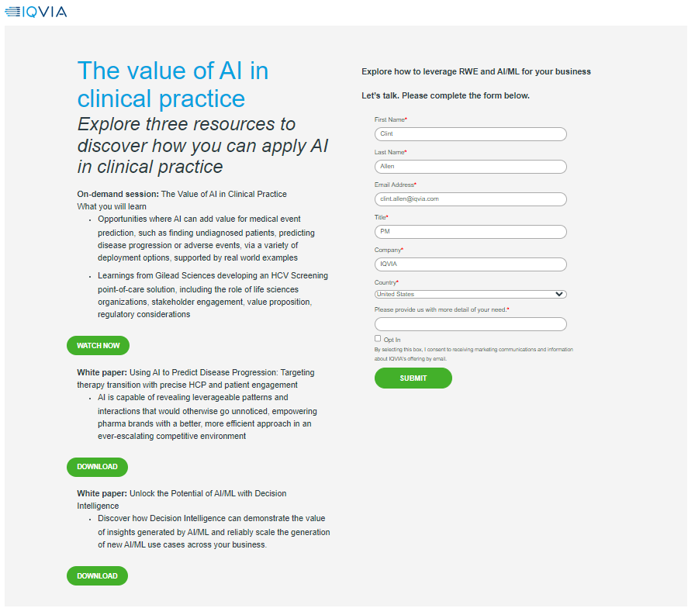
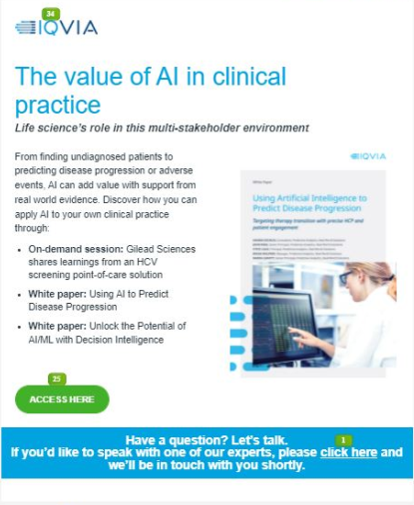
Email and landing page example

Slide 6
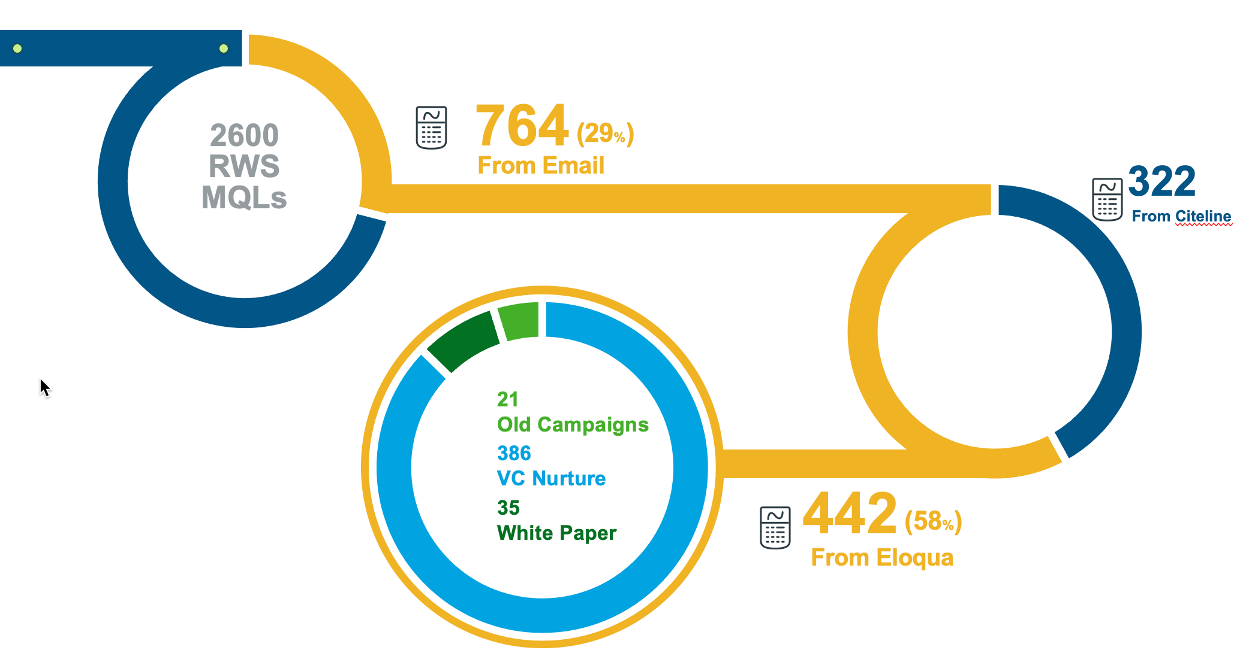
RWS 2022 email MQL flow and first impressions
At 29% of total, Email is a critical channel
Heavily reliant on Paid (42%)
Email campaigns live-on
VC content is valuable
  595 (VC) + 386 (Nur) = 981
  39% of total VC related MQLs
White papers (TL assets) are under-utilized
  All 35 came from 1 white paper

Slide 7
4 notes on increasing email MQLs in 2023
1
2
Focus Emails on MQL generation
Evidence shows… it works
Expand Eloqua efforts
Optimize VC content
Increase utilization of TL assets
3
4
Stay in market
More (quality) emails = more MQLs
Emails linger (look at 21 MQLs from pre-’22 campaigns)
Integrate with other channels
Support emails with social
Manage TL schedule around VC windows

Slide 8




Conference nurture campaigns
Amplifying value of VC content and sub-dividing audience segments
Webinar – Repackaged Session A
RWS Virtual Conference
(5+ sessions)
Email topic aligned TL asset
Webinar – Repackaged Session B
Email topic aligned TL asset
Email – Session C recording
White Paper aligned to topic
Email – Session D recording
White Paper aligned to topic

Slide 9
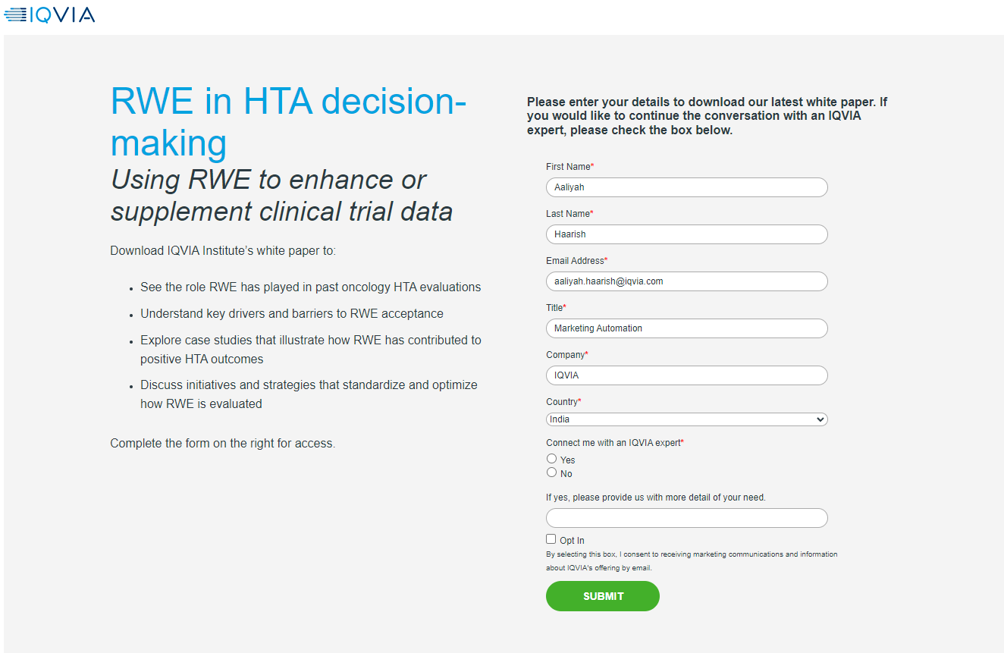
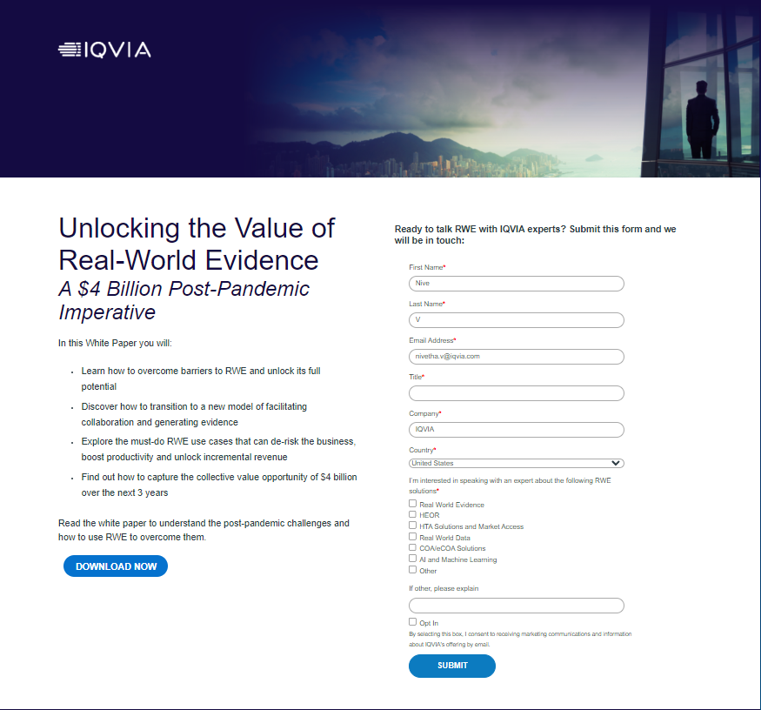
Landing page evolution
Balancing Engagement, Content Dissemination and MQLs
“Free” content & MQL form
Gated content & MQL box
“Free” content & MQL+ form
Good MQL performance paired with great asset dissemination.
Were we leaving leads on the table?
Great engagement
MQLs dropped

Slide 10
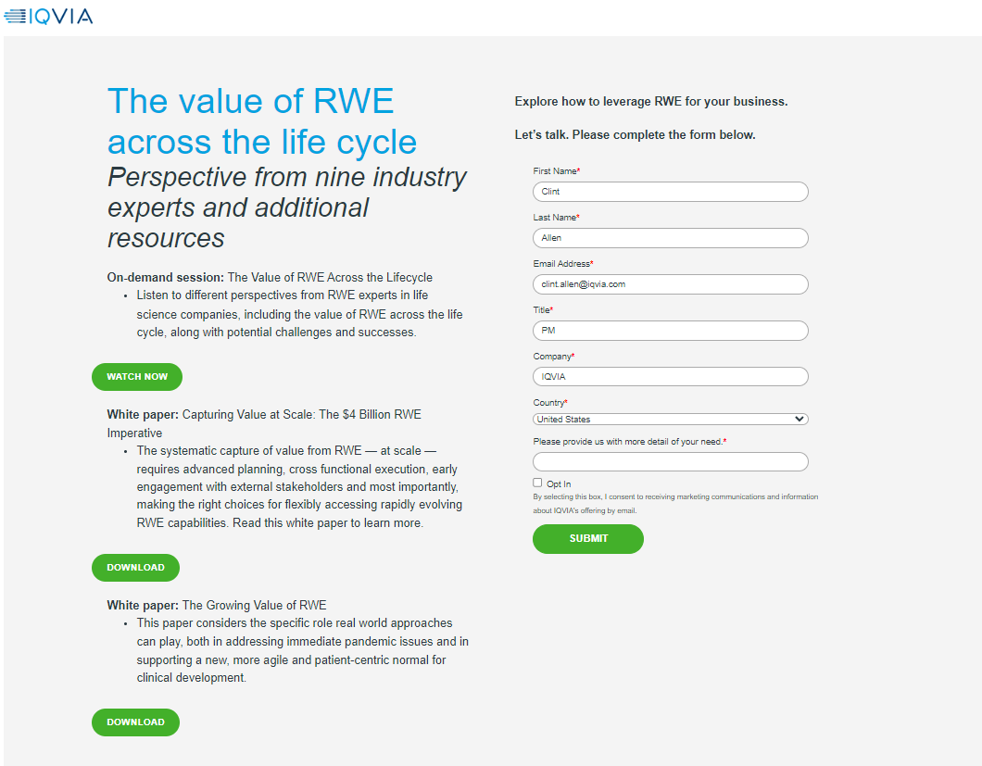
“Free” content & MQL form

Slide 11
Gated content & MQL box

Slide 12
“Free” content & MQL+ form

Slide 13
Save time and enhance your presentations
275+ predesigned, preapproved slides from our slide bank
Access the slide bank and elevate your slides with icons, graphics, agendas, graphs, charts, bios, timelines and more!
  On the ribbon, go to Home > New Slide > Reuse Slides (a box will appear on the right sidebar).
  Paste one of the links below into the Insert Slide From field, then click the arrow on the right.
    Primary Slide Bank (shapes, case studies, text boxes, timelines, charts, bios): https://brandworld.iqvia.com/share/A5C3B5D0-ED29-45E3-BB171402F4733AE6/
    Maps and Flags Slide Bank: https://brandworld.iqvia.com/share/C48B7E46-1C33-4088-9DD788D1DCB82983/
    Icon Slide Bank: https://brandworld.iqvia.com/share/ACB71044-401F-48FB-863068A891643D71/
  Click any slide you wish to insert – it will upload directly into your deck.
For offline use, download the slide banks from Brand World on to your computer.
  On the ribbon, go to Home > New Slide > Reuse Slides (a box will appear on the right sidebar).
  Click Browse > Browse File and find the location of the downloaded PPT. Click Open.
Learn how to use this template and convert old PPT decks by visiting the PowerPoint Resource Center on Brand World.

