Slide 1
Marketing Operations
2023 Email and Landing Page templates
Phil Cuff
5th April 2023

Slide 2
Agenda
Welcome
Best Practice: 2023 Email and Landing Page templates
Open Q&A/Discussion

Slide 3
Marketing Operations Open Office Hours
Get your questions answered by the marketing operations team. Open Office Hours are held monthly with the following agenda:
  Learn about a tip or best practice
  Ask a question – Pre-submit your questions here or ask during the office hours
  Learn how to leverage IQVIA’s marketing systems and processes most effectively
Action: Sign up here, if you need to be added to the outlook invite
Reminder: Save your questions for the end or enter in the chat. We will address as many as we can!

Slide 4
Overview
New email and landing page templates for master brand and sub-brands to align with Website design
Suite of 10 email templates and 3 landing page templates
Same templates as previously available but now only available with new color scheme
  Indigo background in some sections
  White text and logo on Indigo background for headers and footer areas
  Blue CTA
  New social icons
  New BYO banner options
  New BYO image options
All templates are available for use now
Old/Existing templates will be archived for master and sub-brands
  Active campaigns using the old templates will continue to do so, including nurture for now
  New campaigns should use the new templates
  If you wish to update your nurture campaign you will need to submit a new request through the Toolbox
No changes currently for Biotech, Q2 and Institute templates
Toolbox and Brandworld are in the process of being updated

Slide 5
Emails

Slide 6
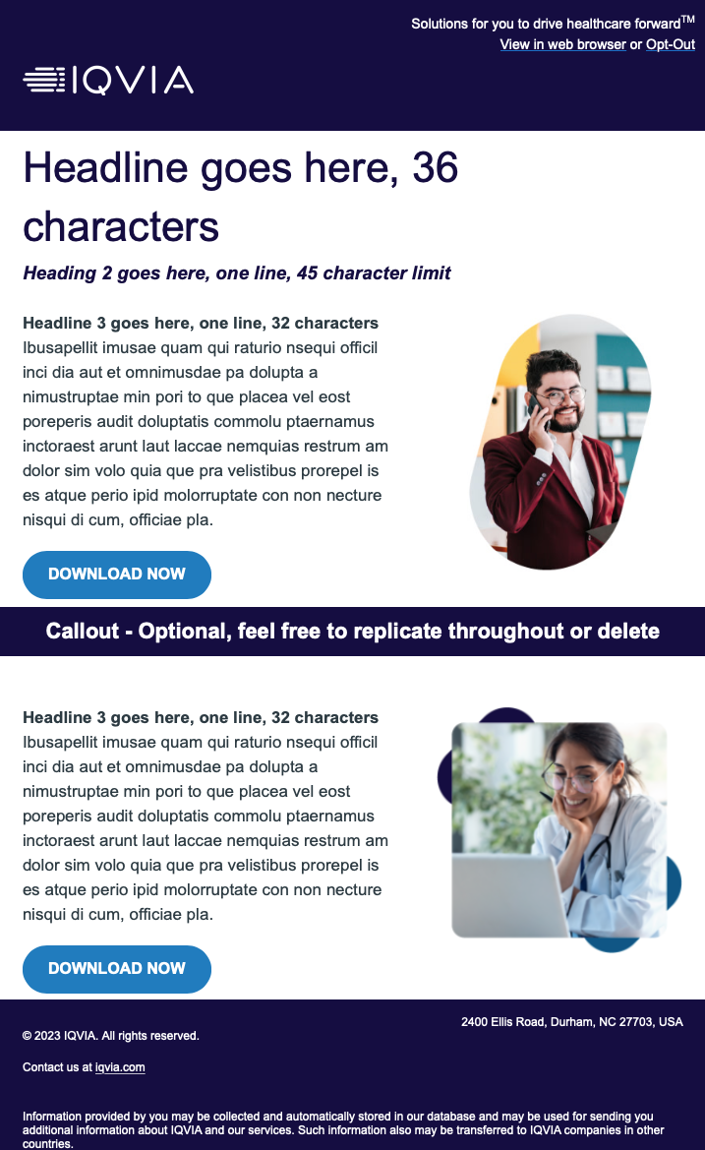
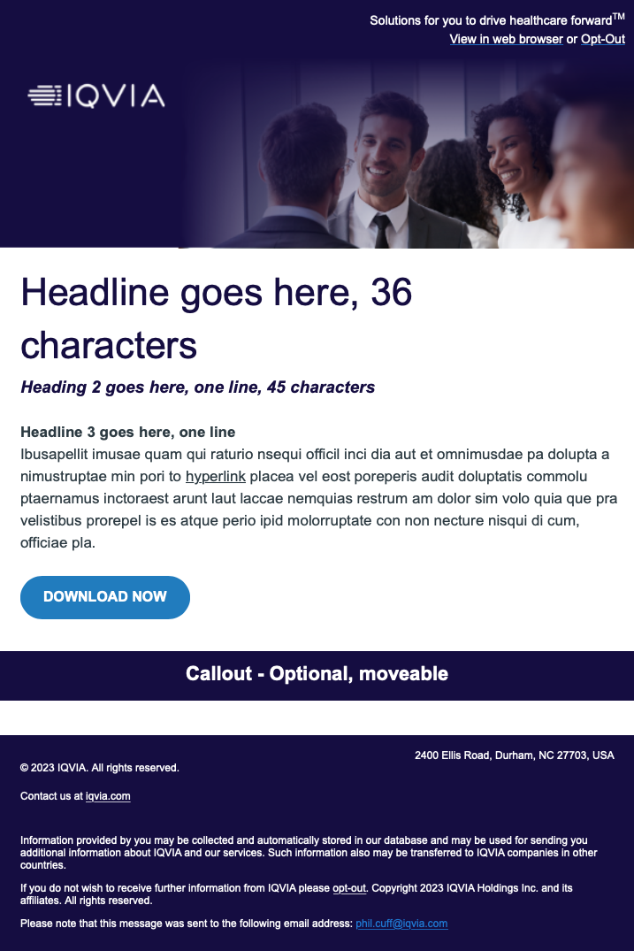



Updates to Eloqua email templates
Email layouts
New BYO hero banner
Logo and Image with blue tint
New BYO email body images

Slide 7
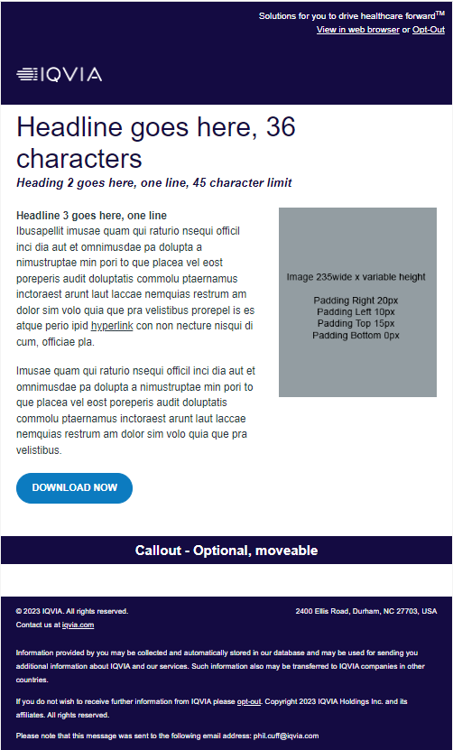
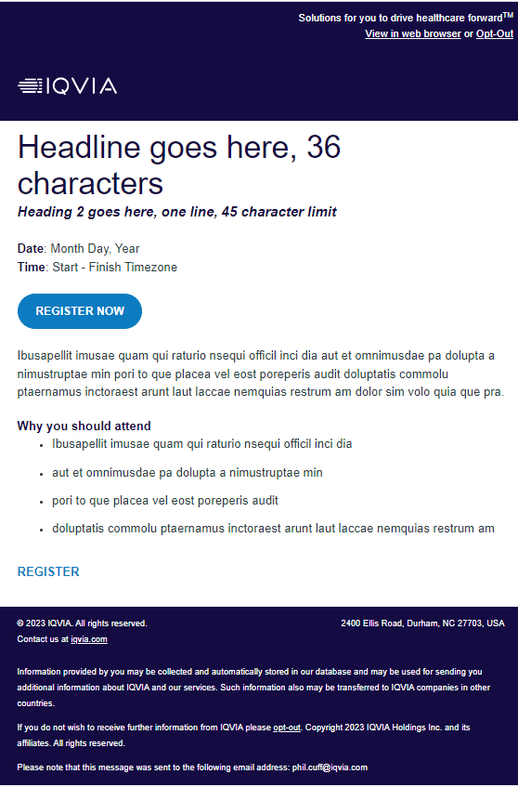
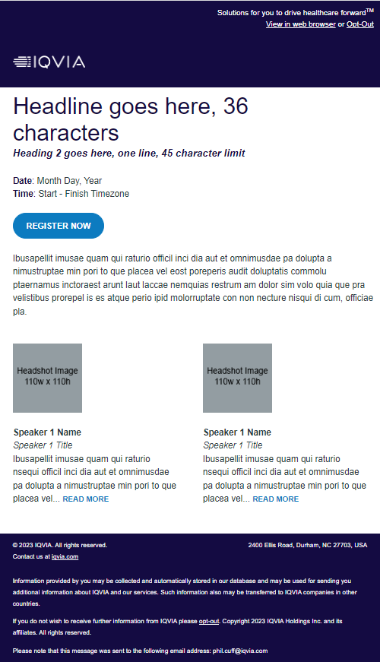
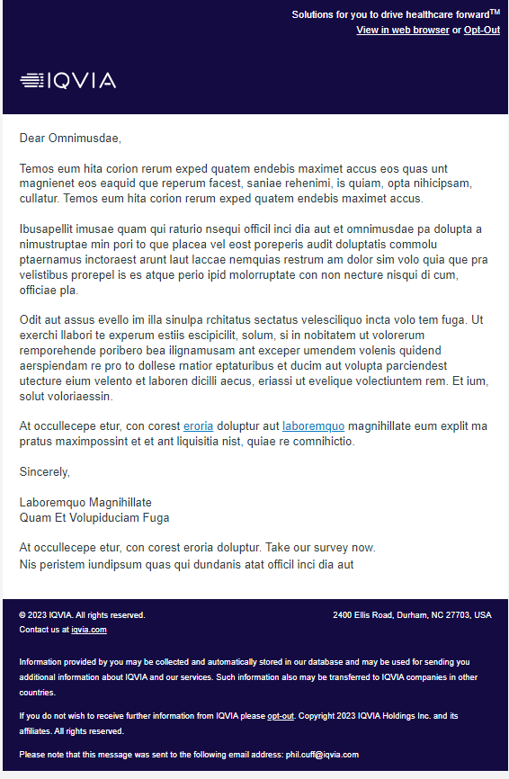
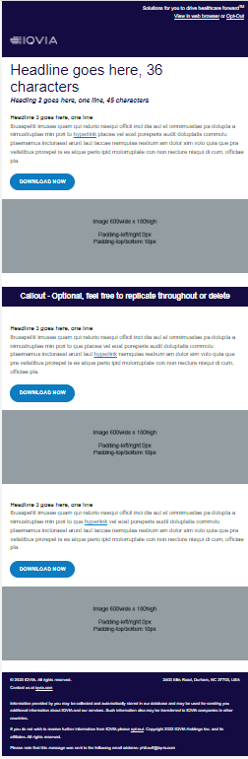
New Email Templates
Updated Email Templates
Modern Asset 2 Col
Webinar No Speakers
Webinar With Speakers
Announcement
Newsletter 1 Col

Slide 8
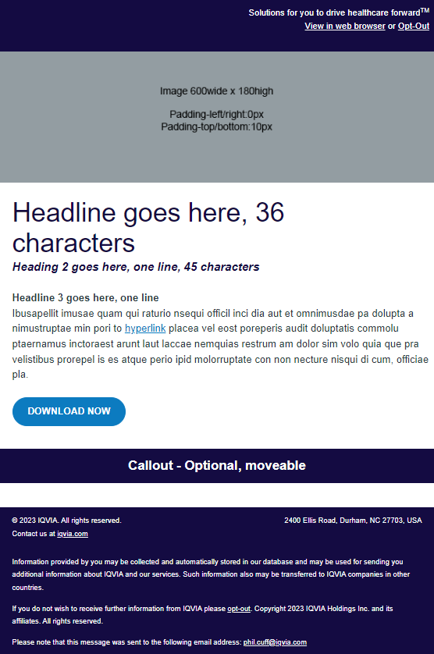
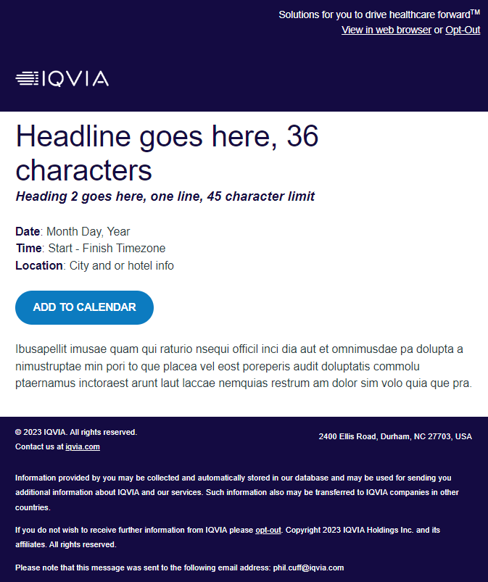
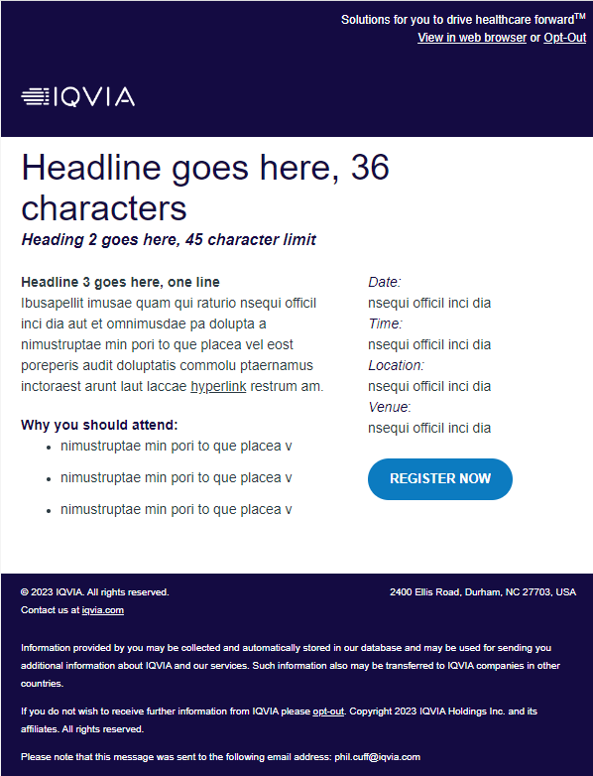
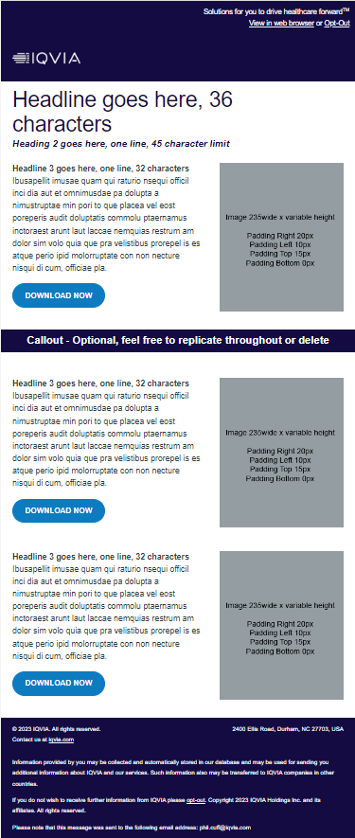
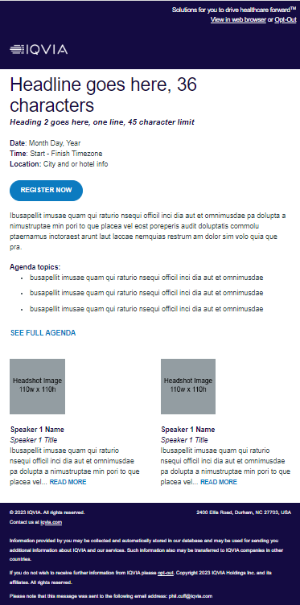
New Email Templates
Updated Email Templates
Modern Asset 1 Col
Event Save the Date
Event Register
Newsletter 2 Col
Event Agenda/Speaker

Slide 9
Landing Pages

Slide 10
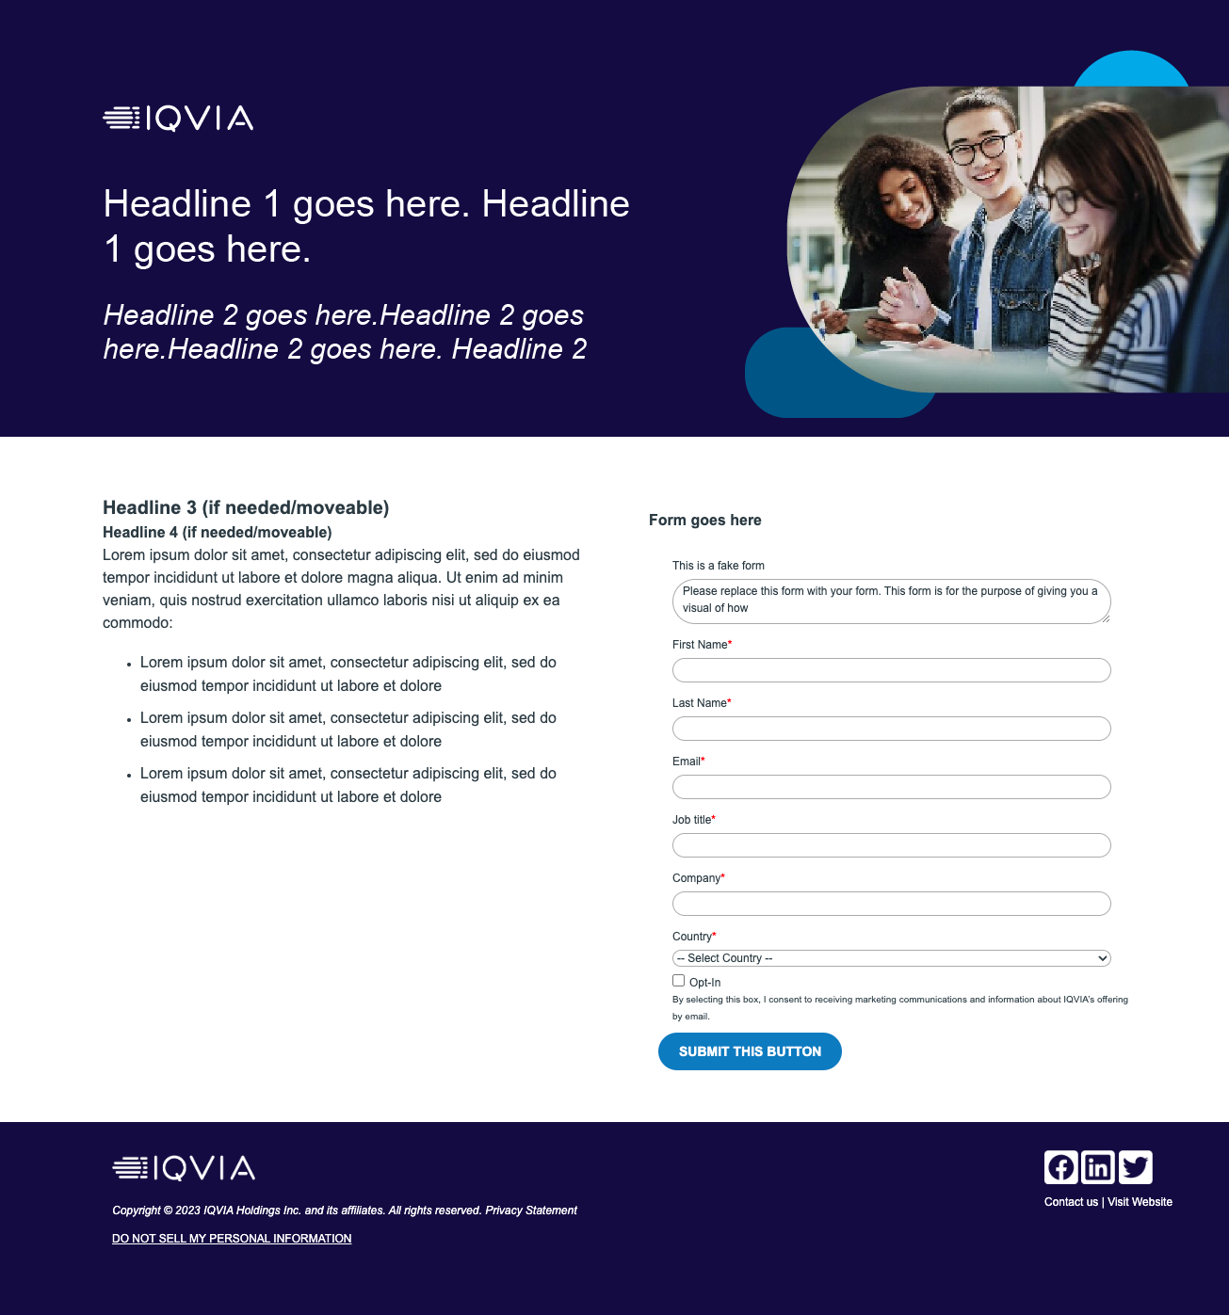
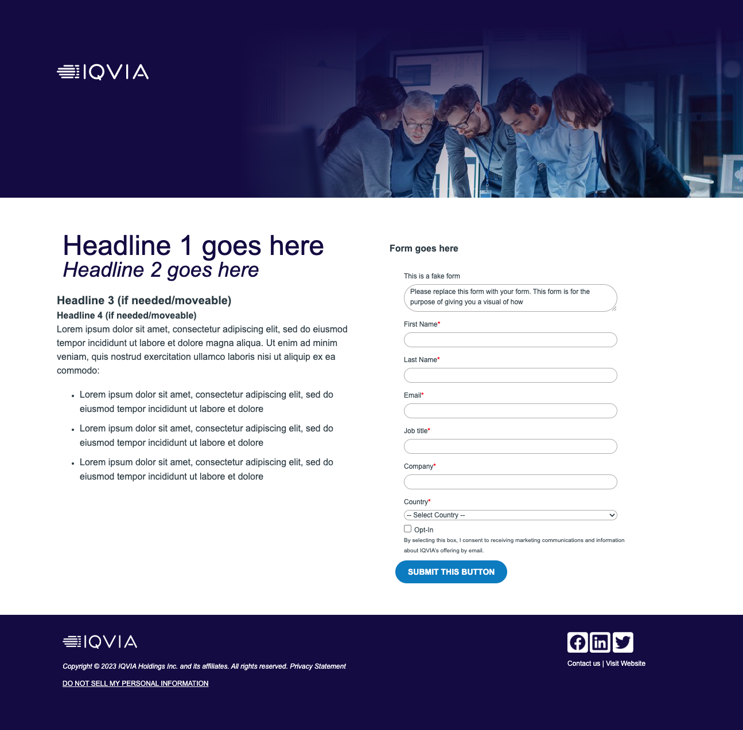
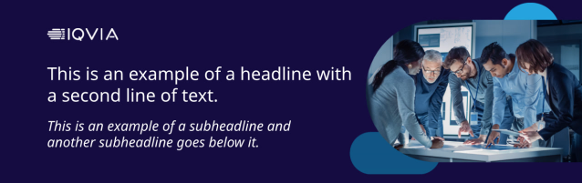

Updates to Eloqua landing page templates
Landing page layouts
2 x New BYO hero banners
Logo, Copy and Image
Logo and Image with blue tint

Slide 11
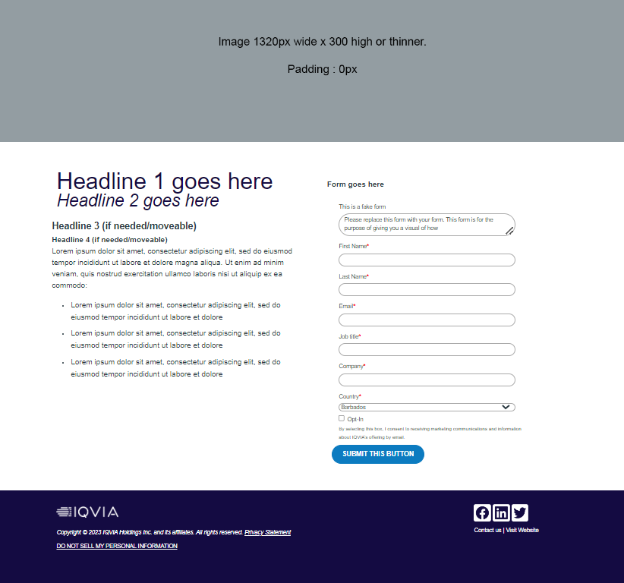
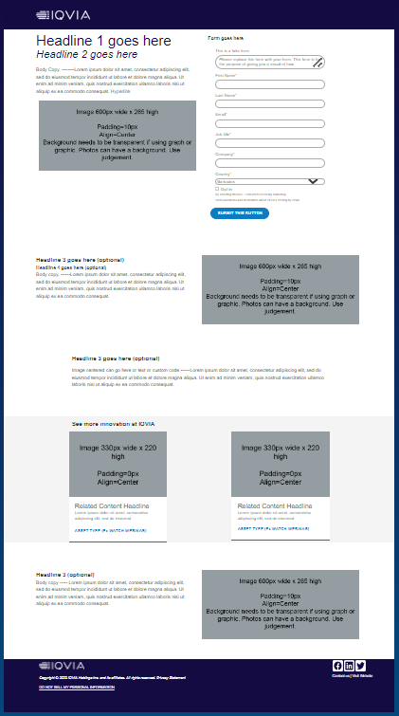
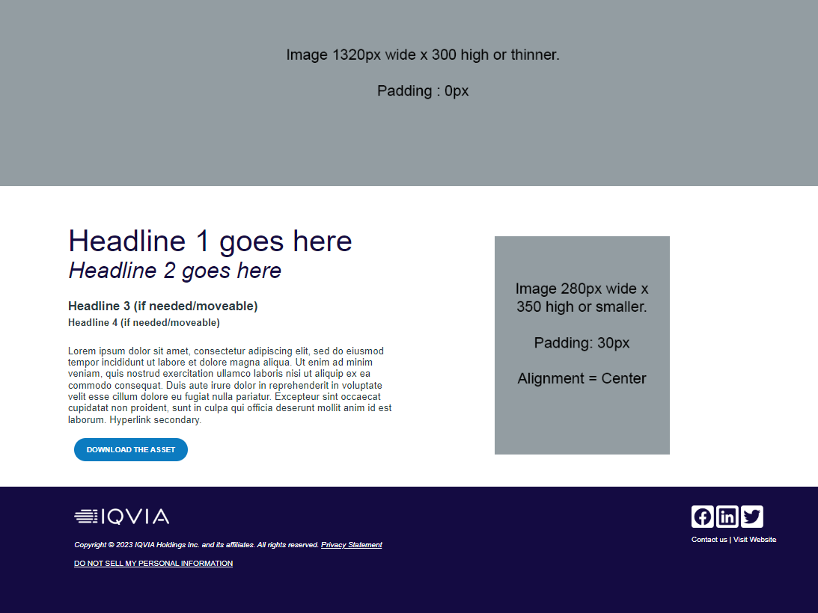
New Landing Page Templates
Updated Landing Pages
New 2023 Template Gated Asset
New 2023 Template Ful Content
New 2023 Template Ungated Asset

Slide 12
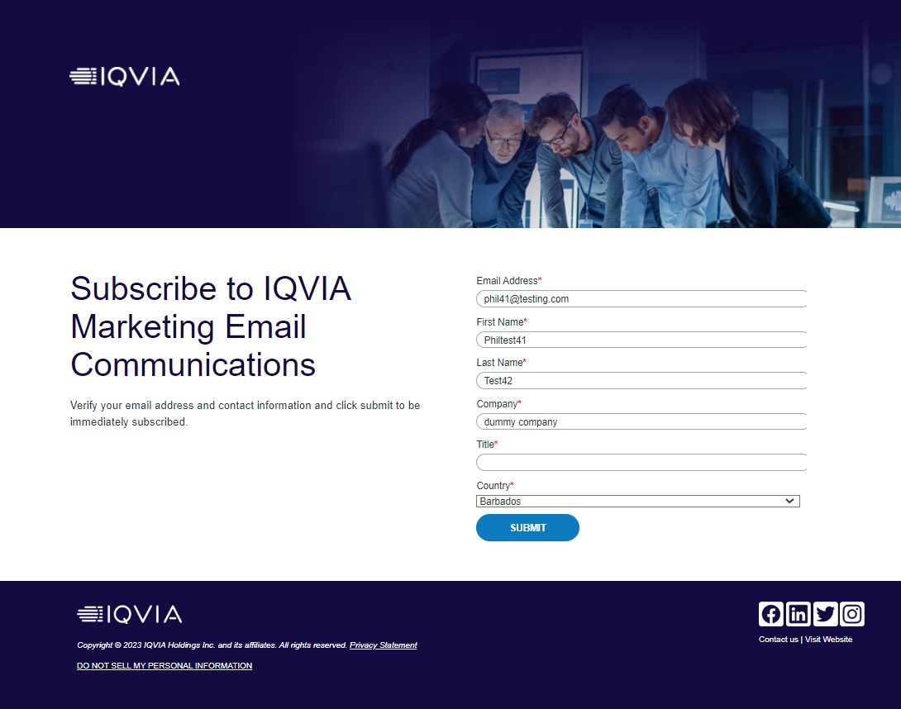
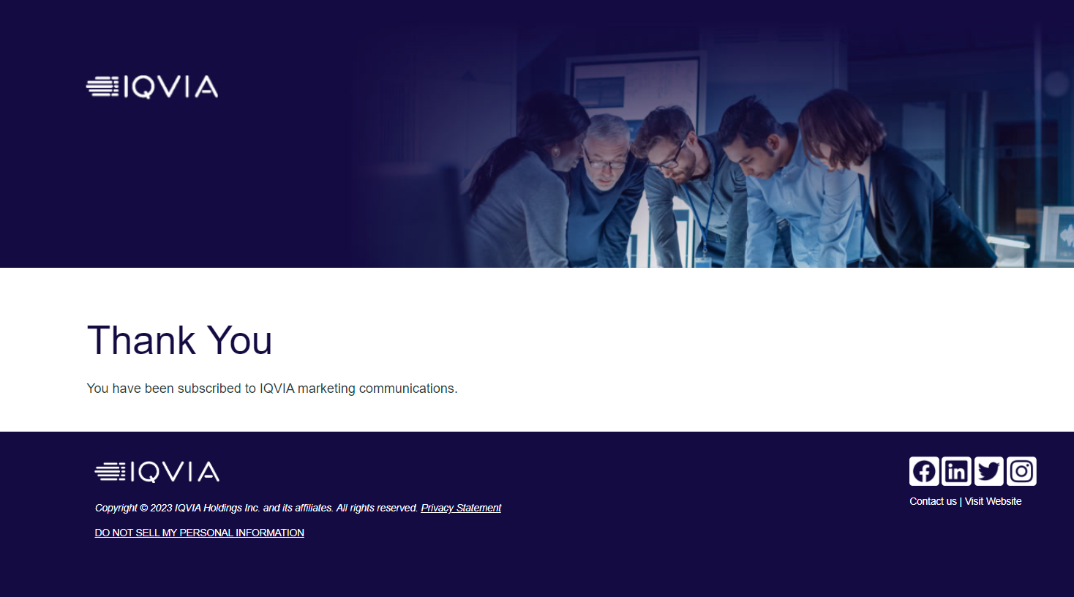
Opt In Page
New Designs
https://secure.constellation.iqvia.com/iqviaoptin

Slide 13
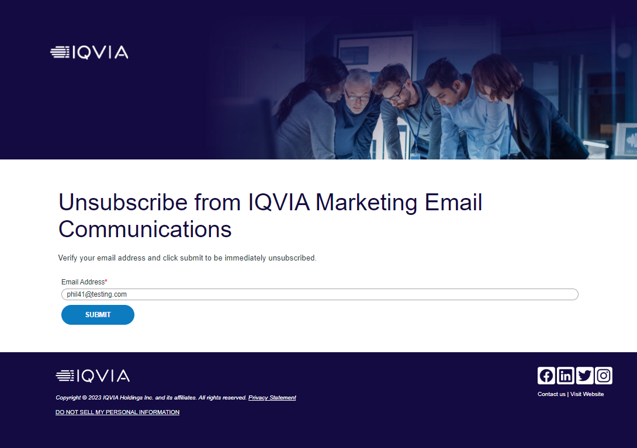
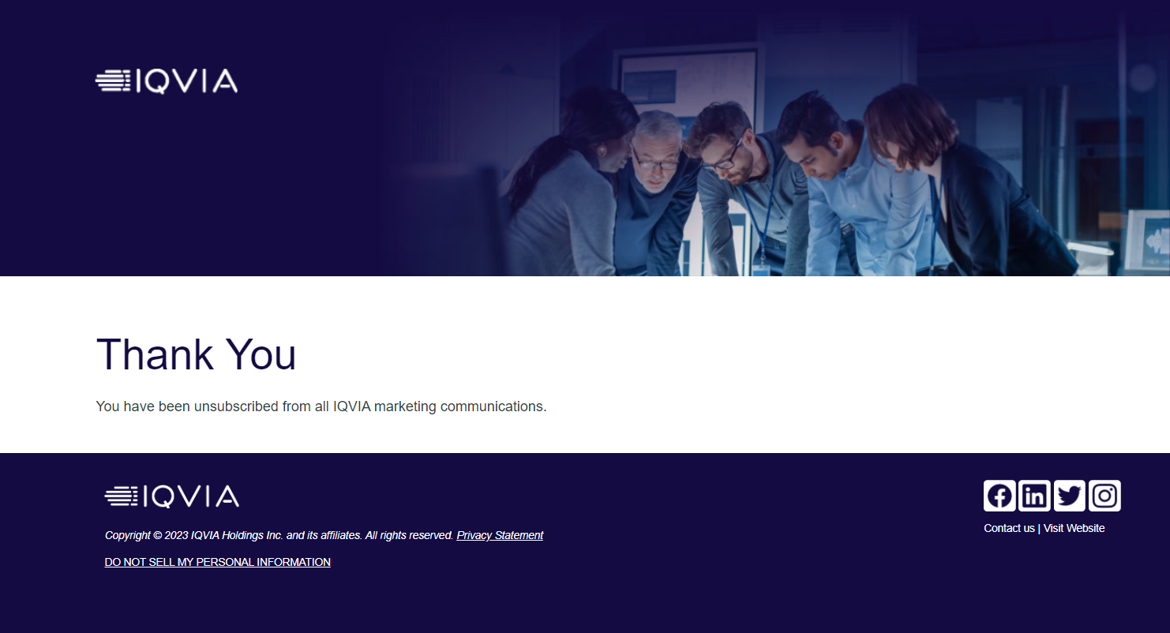
Opt Out Page
New Designs

Slide 14
Sub-brands

Slide 15
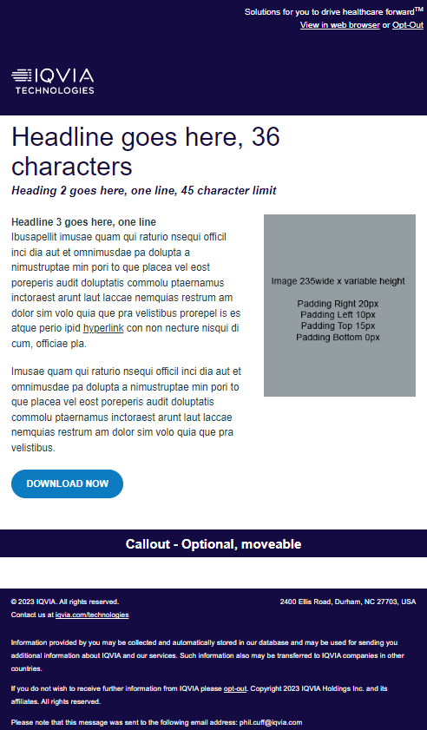
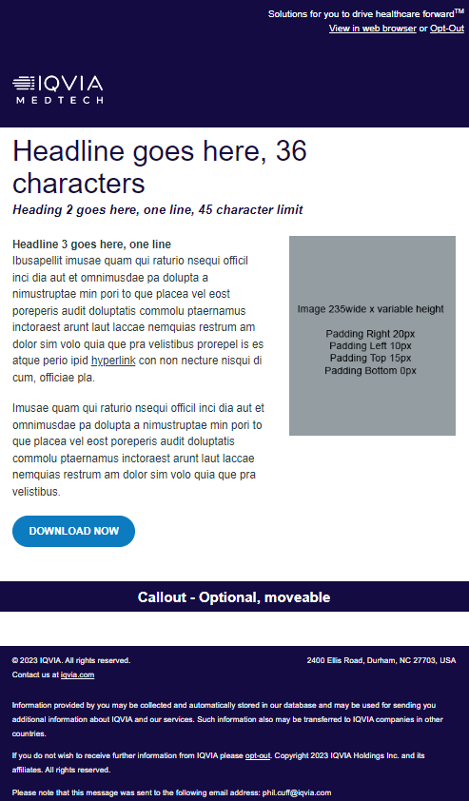

Sub brands
Technologies
Medtech
Consumer Health

Slide 16
Toolbox

Slide 17
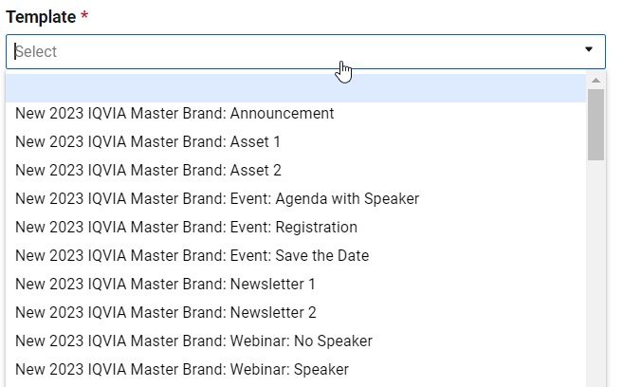
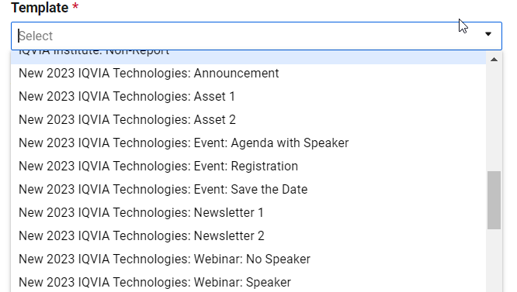
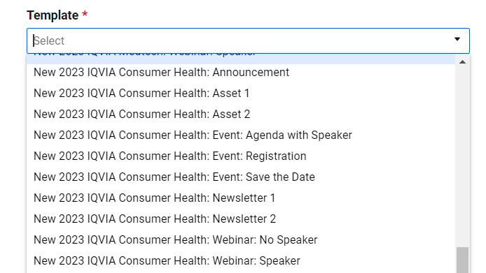
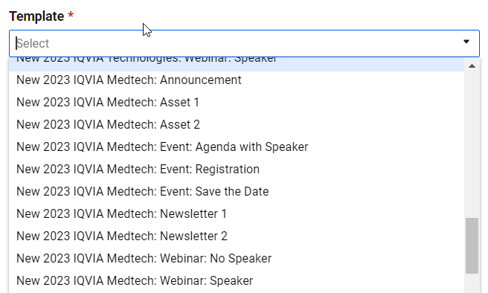
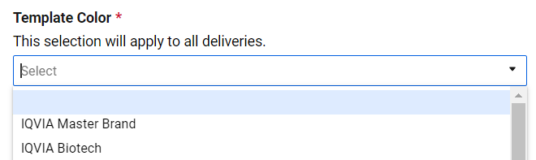
Outreach Request Forms
The request forms have been updated
All templates are available to select from the picklist on the outreach request forms
There are no longer different color variations

Slide 18
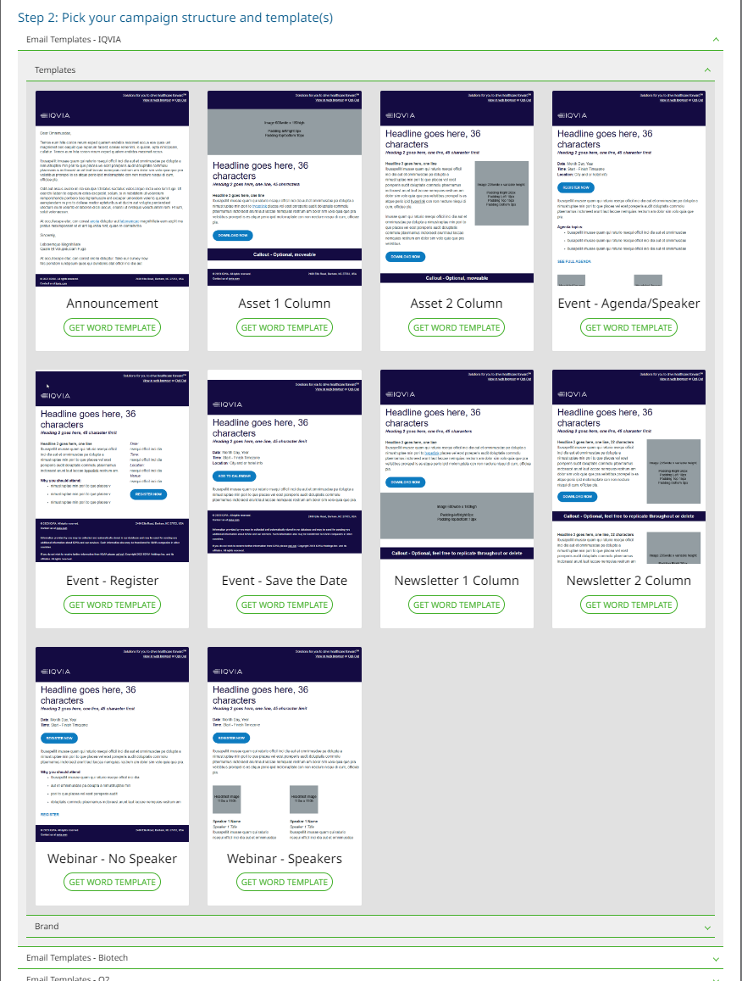
Help Section
Templates have been updated in the help section

Slide 19
BYO Tools

Slide 20
BYO Tools available on Brandworld
BYO Tool resources
Video Walkthrough
New BYO Studio Tools
Biotech Landing Page
Biotech Email Banner

