Slide 1
Eloqua Profiler
Quick Start Guide
David LeBouef
Notes:
lugfgfgkfkgh

Slide 2
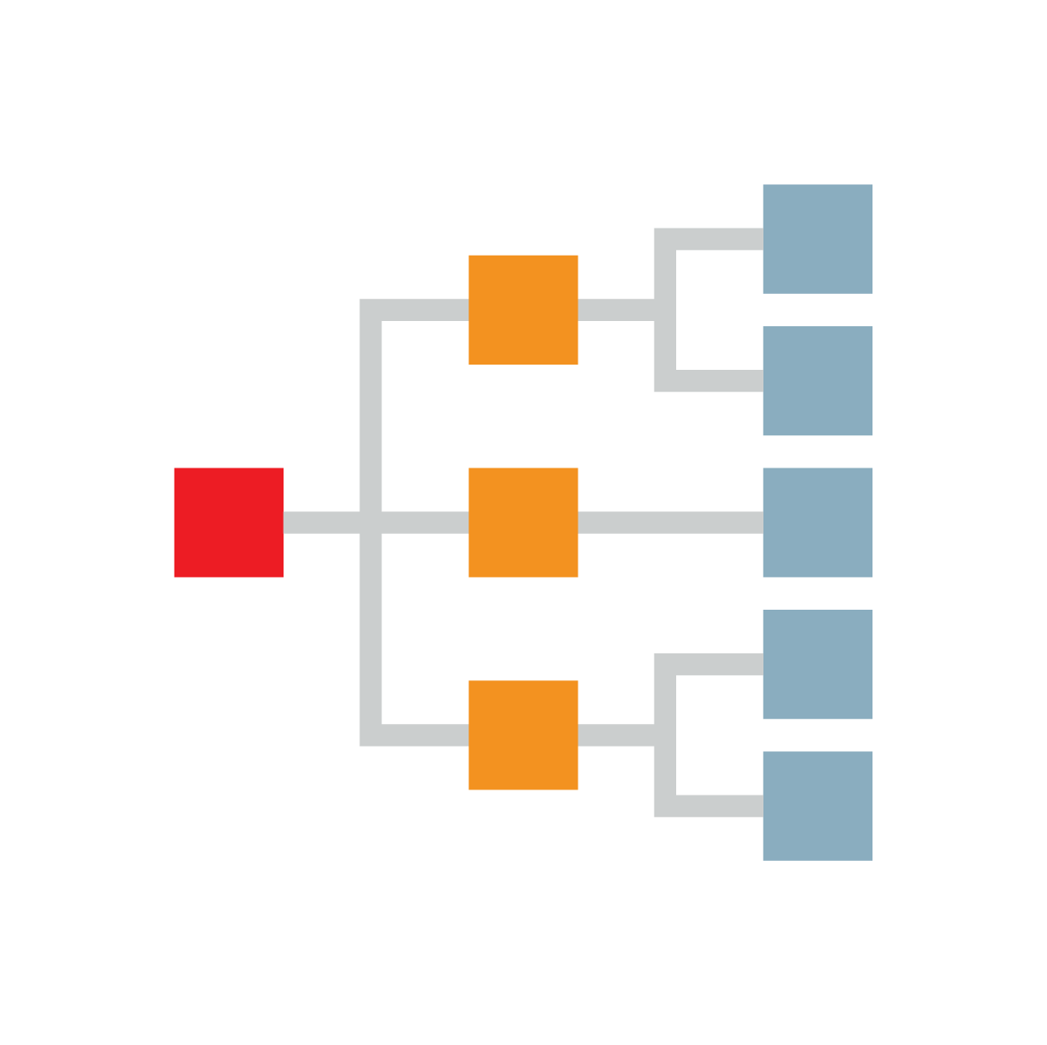

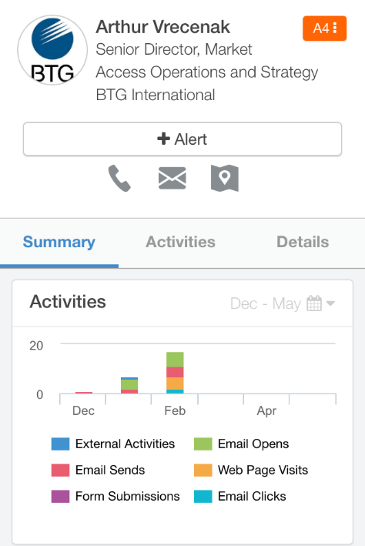
Eloqua Profiler Summary
360 Views of Customer Engagement and Demand Generation Capabilities
Key benefits:
Best in Class Lead Generation : Multiple lead score models based on customer profiles, and engagement over a period of time
360 View of Lead Engagement: Holistic view of marketing engagement w/ IQVIA to improve targeting and customer experience
Easy to Use Interface - Feature rich campaign development with functionality to support nurture campaigns and dynamic content
11
Notes:
Dadfat cleansung

Slide 3
Accessing Profiler and Engage through Salesforce

Slide 4
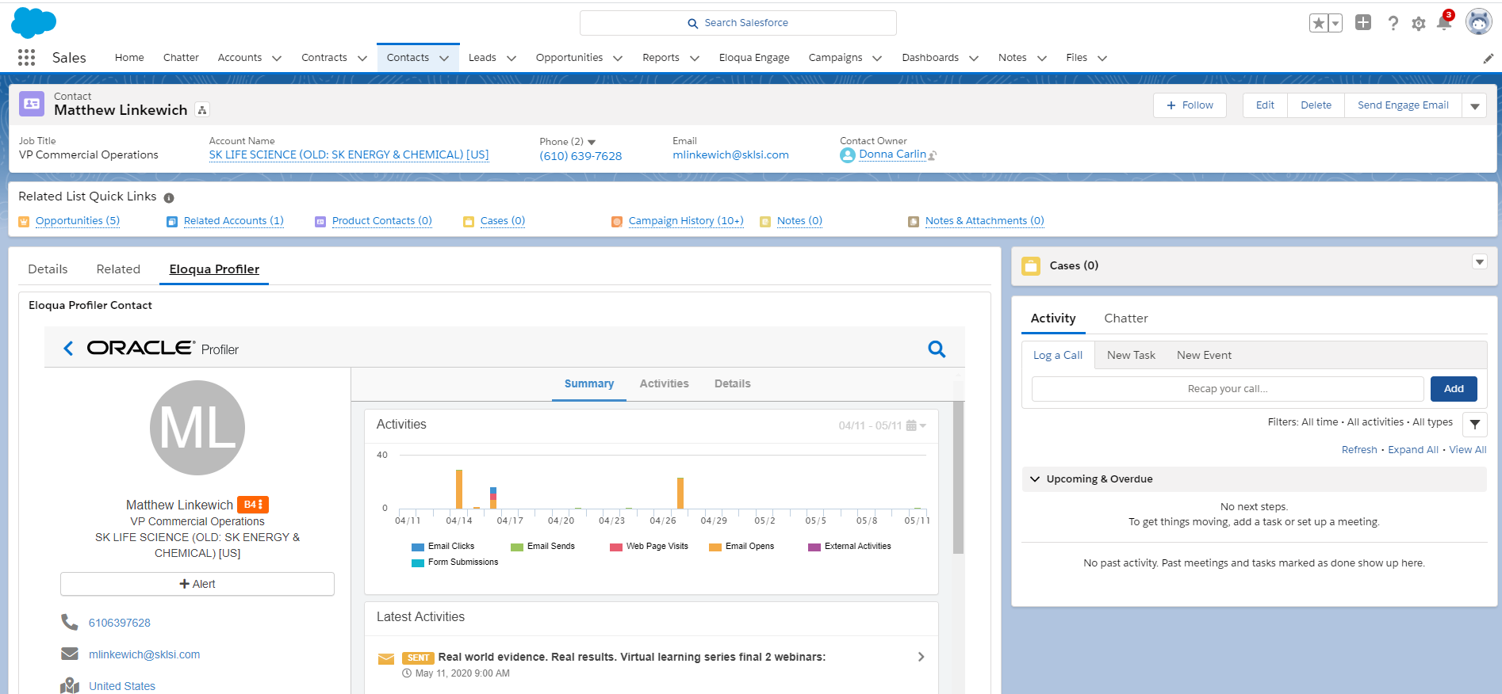
Profiler is Located on Salesforce Lead and Contact Records
Select this tab on the lead/contact layout to see this specific view

Slide 5
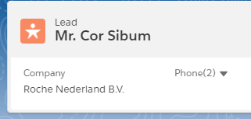
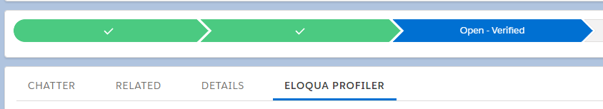
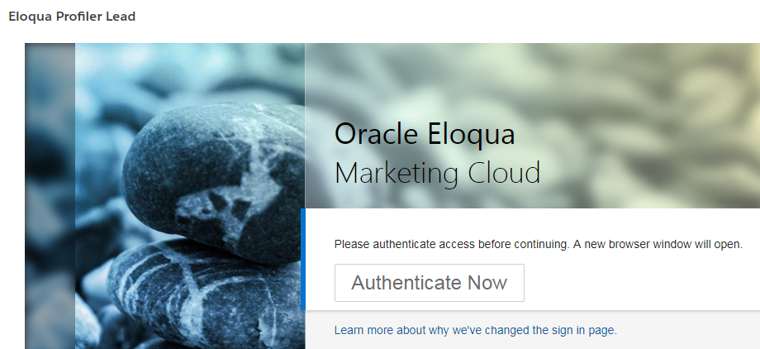
Authenticate Access to Profiler in IQVIA Salesforce
You must have an active Salesforce account and an active Eloqua account to access
Request a Salesforce account
Request an Eloqua account
If you do not have access or Single Sign On does not authenticate you can enter a ticket through VIA.
Your Salesforce password must match your email listed in the IQVIA active directory for SSO to work properly.
Users will be prompted to authenticate before being allowed access.

Slide 6
Reviewing client email activity in Eloqua Profiler

Slide 7
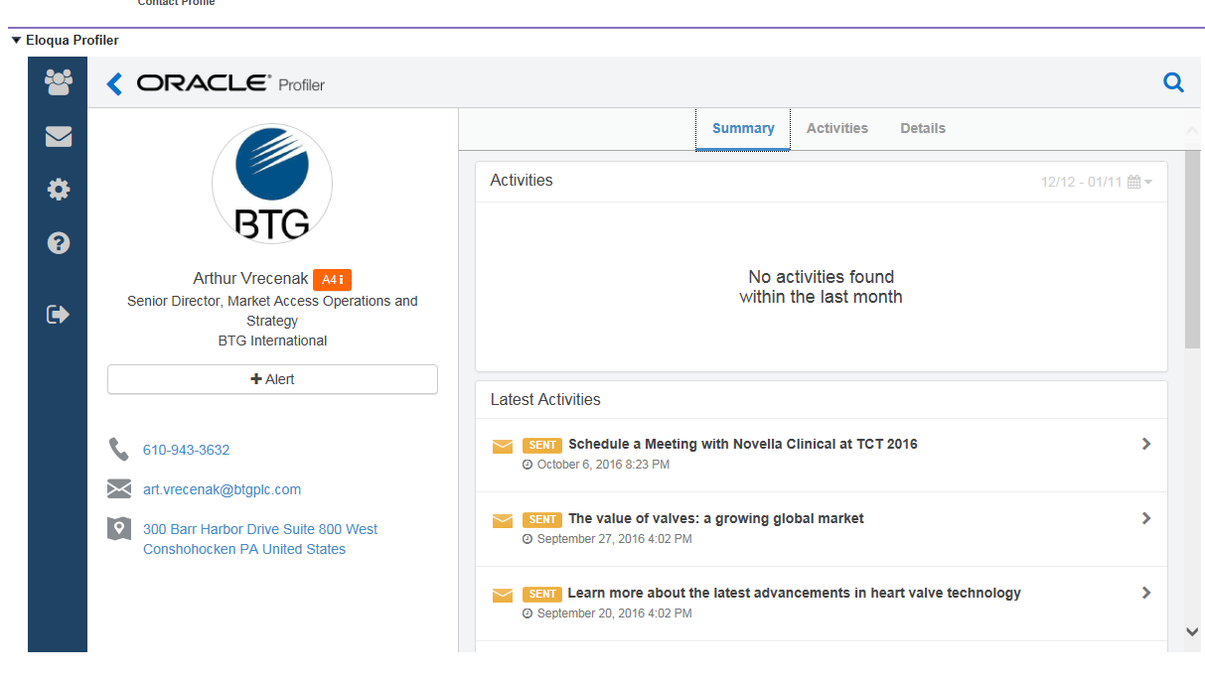
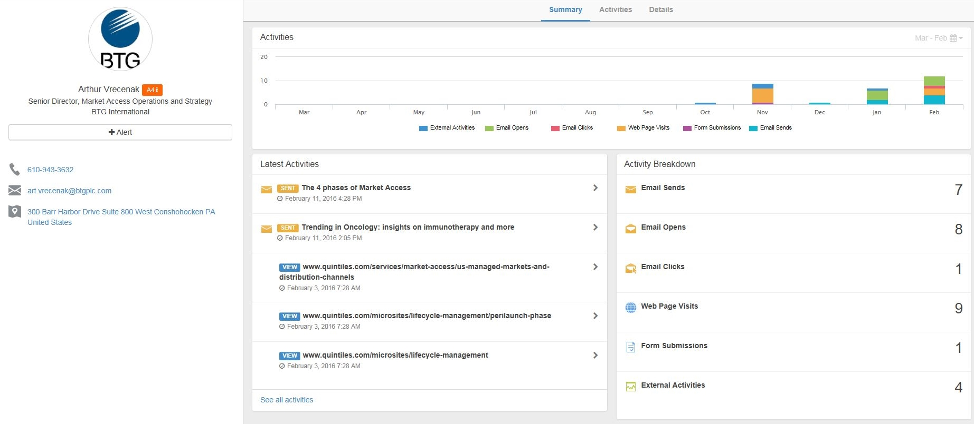
Scroll down on summary tab to view latest activities
You can view what emails a contact has received/opened, which web pages they have visited and any webinars or events they have attended. To amend the time period use the calendar icon (last 30/60 days, or 1 year)

Slide 8
Scroll down on summary tab to view latest activities
You can view what emails a contact has received/opened, which web pages they have visited and any webinars or events they have attended. To amend the time period use the calendar icon (last 30/60 days, or 1 year)

Slide 9
Click “+Alert” in Profiler To Alert for the Company or the Contact
Click on the Alert button

Slide 10
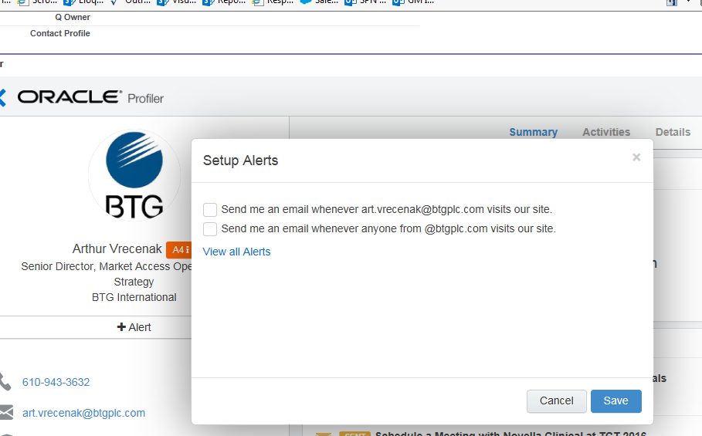
Set the Alert Type at the Contact or Company Level
You can click to have an alert on the Contact or the Company Domain. (For large companies, try not to select company as this will fill up your mailbox!)

Slide 11
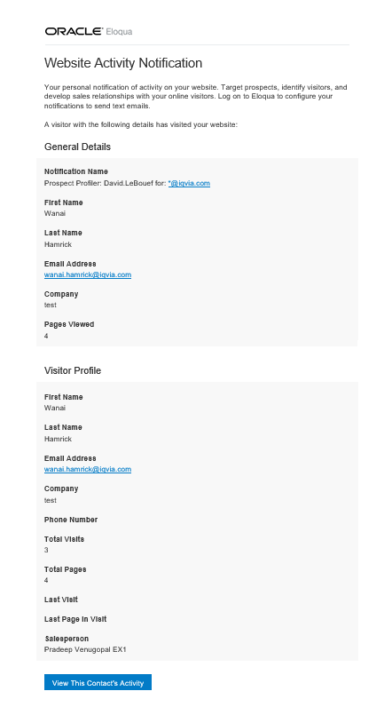
Example of Alert Notification
Alerts are delivered from from Eloqua Notifications <eloquanotifications@eloqua.com>
Suggest setting up an Outlook rule to deliver alerts to a separate folder in Outlook.
To view the contacts complete activity profiler you can view the record in Salesforce or select the call to action located at the bottom of the email to open Profiler.

