Slide 1
Marketing Operations
Open Office Hours
SEO Best Practices Part 2
7-MAR-2024
Sathya N, Senior Web Strategy Coord

Slide 2
SEO Best Practices Agenda: Part 2
Why is SEO important for you?
Search intent
Google’s keyword research tools
Keyword.io tool
Ahref keyword generator, rank & difficulty checker
Google Keyword planner
WordStream
KW Finder
Answer Socrates
SEO Do’s & Don’ts and Action plan

Slide 3

Marketing Automation Open Office Hours
Have your questions answered by the marketing automation team. MA Open Office Hours are held monthly with the following agenda:
  Learn about a tip or best practice
  Ask a question – Pre-submit your questions here or ask during the office hours
  Learn how to leverage IQVIA’s marketing systems and processes most effectively
Action: Sign up here, if you need to be added to the outlook invite
Next Open Office Hours: March 6th @ 9:00am EST, Sathya will present SEO best practices

Slide 4
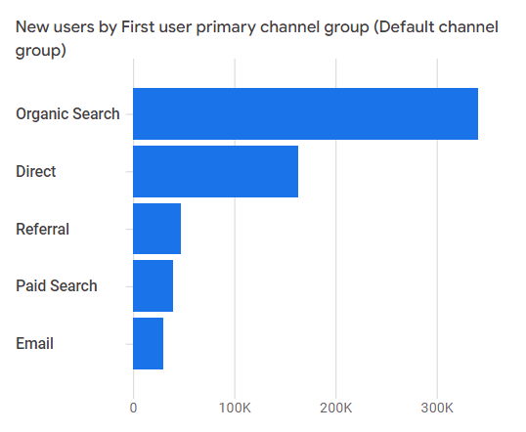
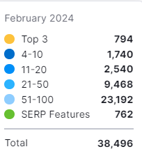
Why is SEO important for you?

Slide 5

Search Intent
The main goal a user has when typing a query into a search engine
Informational Intent
Users want to learn more about something
1
Commercial Intent
Users want to do research before making a purchase decision
2
Navigational Intent
Users want to find a specific page
3
Transactional Intent
Users want to complete a specific action, usually a purchase
4

Slide 6
Search Intent Examples
Informational
Commercial
Navigational
Transactional
These searches are often phrased as questions and use words like who, what, where, why, and how.
What is SEO
North Carolina time now
How to clean a dishwasher
The user is looking for information, but the information is closely connected to the action.
Best indoor plants for low light
Apple watch ultra review
best quality management software
Unlike with other intent types, searchers already know what they’re trying to find.
Starbucks
IQVIA technologies
SEMrush keyword magic tool
Amazon refund policy
This isn’t restricted just to purchases. Users might want to complete a newsletter signup or download software.
iPhone 13 pro max price
SEMrush trial
IQVIA pharmaceutical sales
01
02
03
04

Slide 7
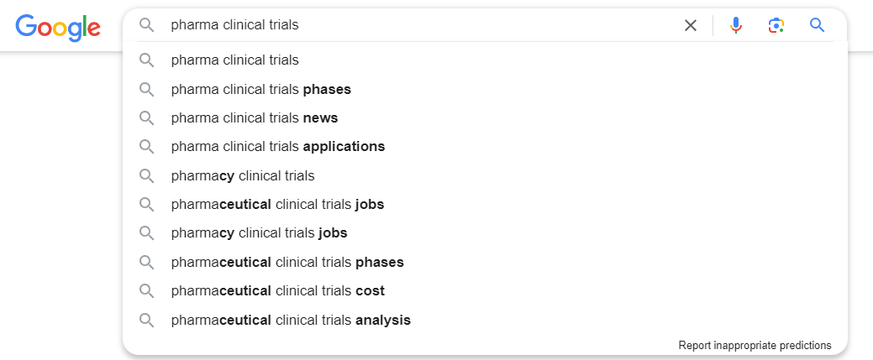
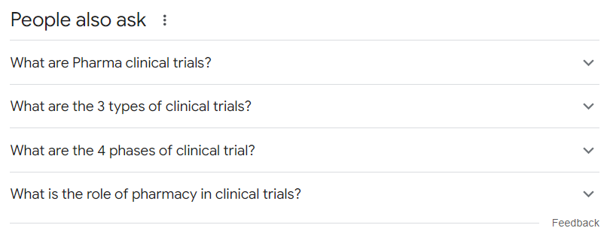
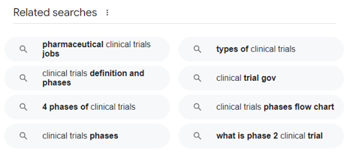
Google’s Keyword Research Tools
Auto suggest, People also ask and Related searches

Slide 8
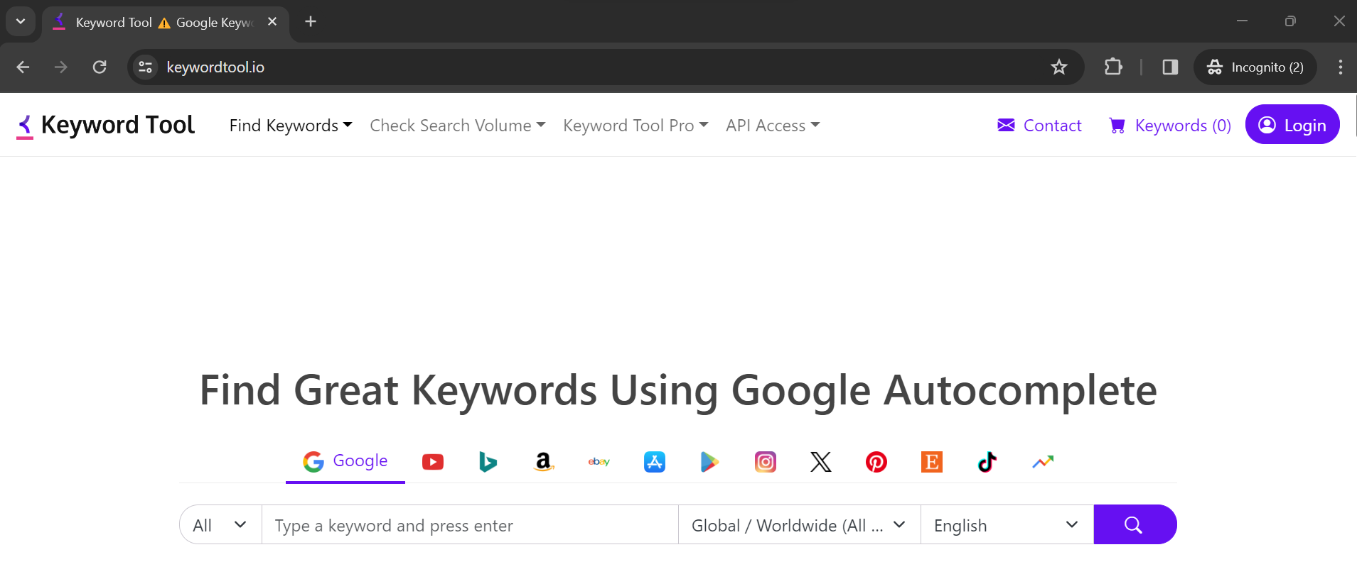
Keyword.io (Sign in not required)
This tool will help you with a comprehensive list of highly relevant keyword suggestions to create and improve your message and connect with your audience better. It helps you find actual phrases people use to find information, products and services.

Slide 9
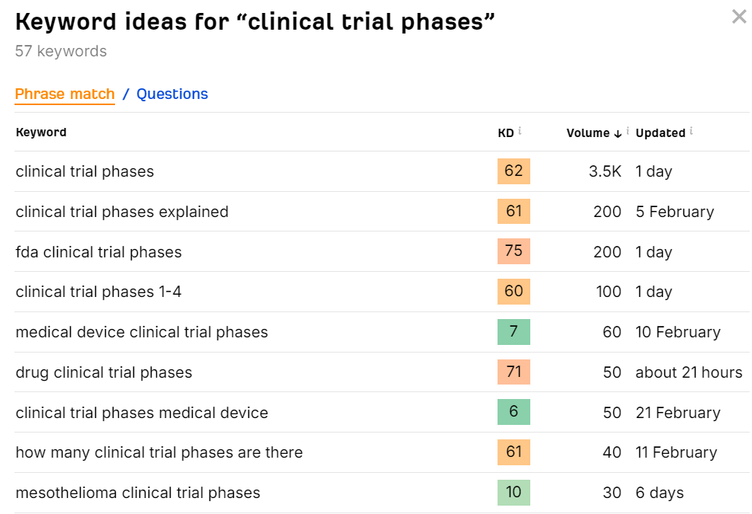
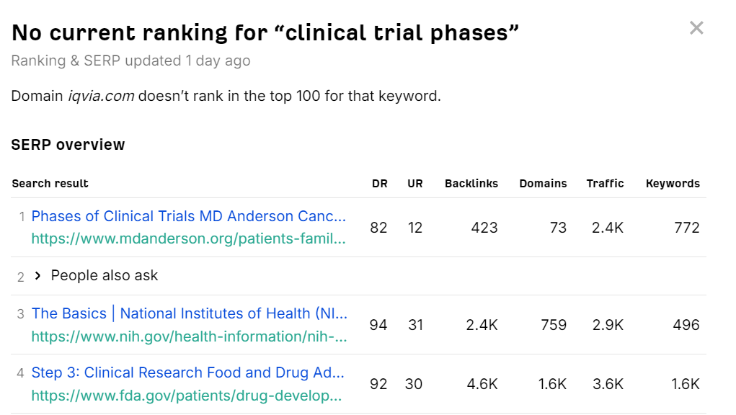
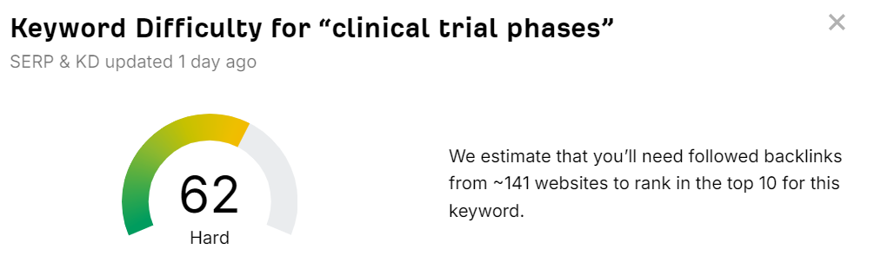
Ahref Keyword Generator, Rank Checker & Difficulty Checker

Slide 10
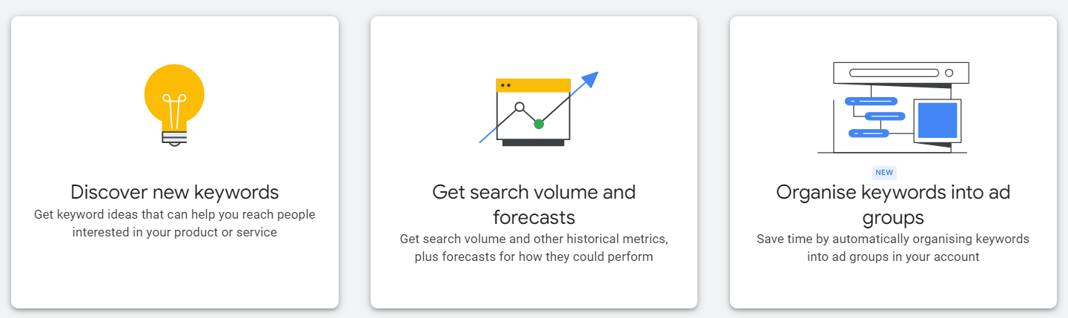
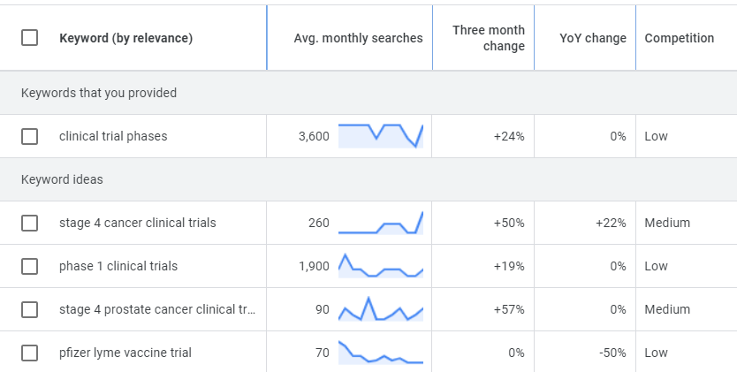
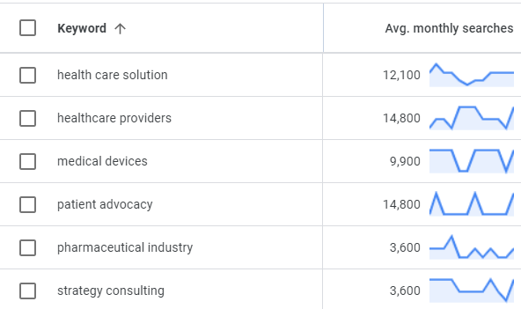
Google Keyword Planner (Create an account and Sign up)

Slide 11
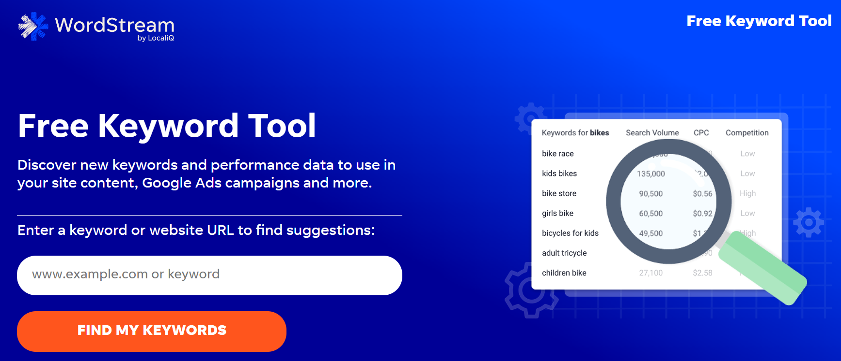
WordStream
One tool to discover and prioritize the best keywords to target.

Slide 12
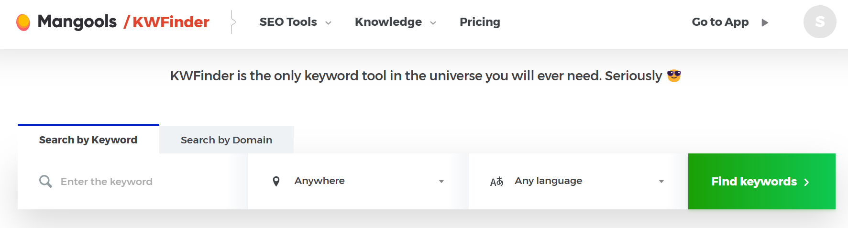
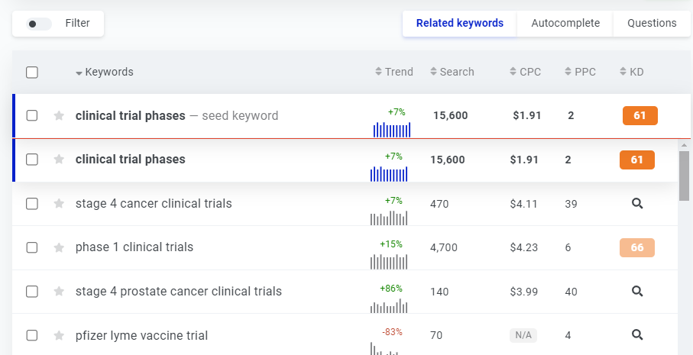
KW Finder
Find long tail keywords with low SEO difficulty

Slide 13
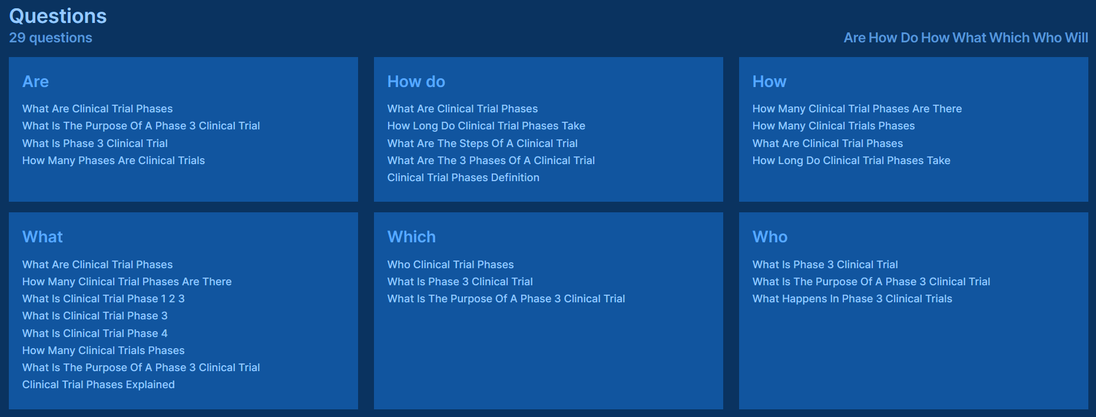
Answer Socrates
Discover the questions people are asking on Google about almost any topic, for free.

Slide 14
SEO Action Plan
Find the list of keywords ranking in the bottom of page 1 and on page 2 (Positions #7 through #19)
Use the targeted keywords as secondary keywords in sub-headings and a couple of times in the body of the page with supporting relevant content (The easiest and simplest way to improve positions fast)
Update the title of the page to include primary keyword satisfying user intent
Add key summary on asset landing pages to inform users about the content embedded in PDF
Inter-link related pages (Assets, Blogs, Events, Webinars, News and Solution pages)
Include keyword in the CTA button instead of ‘Learn more’
Check for duplicate titles/content within iqvia.com and fix it immediately
If your page is not ranking for the desired keyword, perform keyword research to find better keywords that satisfies intent of the page

Slide 15
Do’s Don’ts
Choose only 1 primary keyword
Pick 4-5 secondary keywords around the core topic of the page
Provide ‘Alternate text’ for images
Find internal and backlinking opportunities
Write short sentences and paragraphs that an 8th grader can understand
Write unique page titles
Write unique content better than the competitors
Don’t force keywords into your copy
Avoid gating PDF if the content is not highly valuable
Do not choose broad keywords (Ex: health, analytics)
Avoid using acronyms
(ex. Pull Aim Squeeze Sweep vs. Post Authorization Safety Study)
Don’t write pages with less than 100 words
Don’t cram too many topics into one page
Don’t leave your content stale, update as much as you can

Slide 16
Resources
Access Google Keyword Planner
How to use Keyword Planner?
SEO FAQs
Video: SEO Basics Part 1
Video: SEO Basics Part 2
Introduction to Search Engine Optimization
SEO Keyword Tips
SEO Brand World Guidelines

Slide 17
Thank You

