Slide 1
Marketing Automation & Operations
Improved Tagging for Thought Leadership
Ben Sieve, Web Strategy Manager
June 1, 2022

Slide 2
Agenda
Welcome
Best Practice: Improved Tagging for Thought Leadership
Open Q&A/Discussion

Slide 3

Marketing Automation Open Office Hours
Get your questions answered by the marketing automation team. MA Open Office Hours are held monthly with the following agenda:
  Learn about a tip or best practice
  Ask a question – Pre-submit your questions here or ask during the office hours
  Learn how to leverage IQVIA’s marketing systems and processes most effectively
Action: Sign up here, if you need to be added to the outlook invite
Reminder: Save your questions for the end or enter in the chat. We will address as many as we can!

Slide 4




A new and improved way to tag content, based on Solutions.
Establish Relationship between Solutions and Thought Leadership Content
Allow content authors to select “related solution(s)” for blog, asset landing pages, and event/webinar pages.
Unlocks these features
Links back to Solutions
Improved Reporting
Solutions Filters
Dynamic Modules

Slide 5
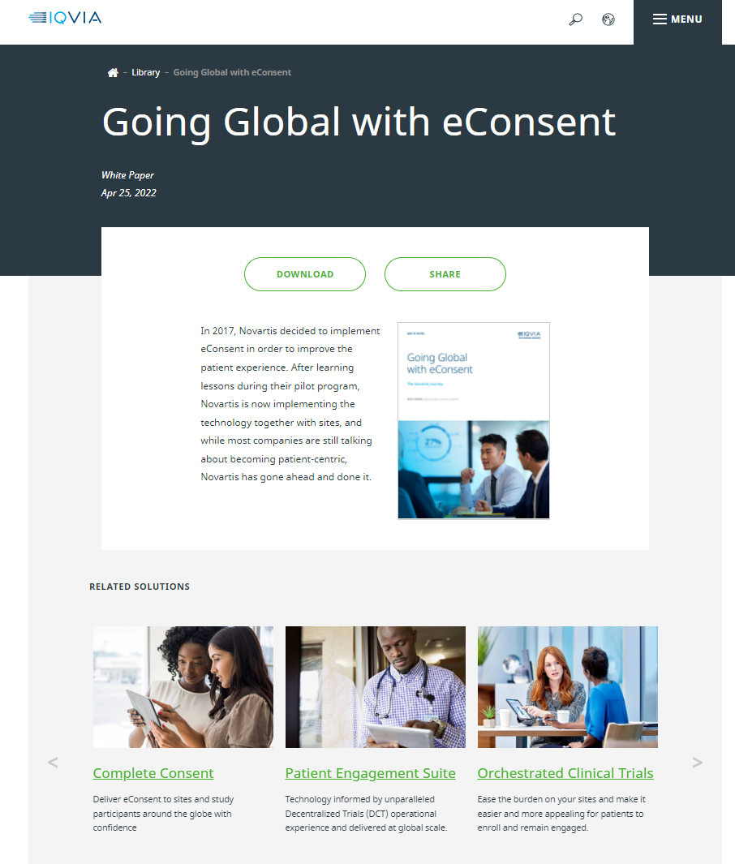
Links back to Solutions
Once tag is added to page, the Related Solutions module automatically appears on the page.
Improved User Experience
Allows users to quickly find related solutions
Reduces dead-ends
Increases page depth and avg. time on site
Search Engine Optimization
Increases internal links to Solution pages
Allows Google bots to crawl the site easier
Increases page authority to solution pages

Slide 6

Improved Reporting
The tag passes to Google Analytics through a custom dimension in code.
Allows for reports for thought leadership pages based on solutions.
The data only captures once the tag has been set up and does not capture historical data.

Slide 7
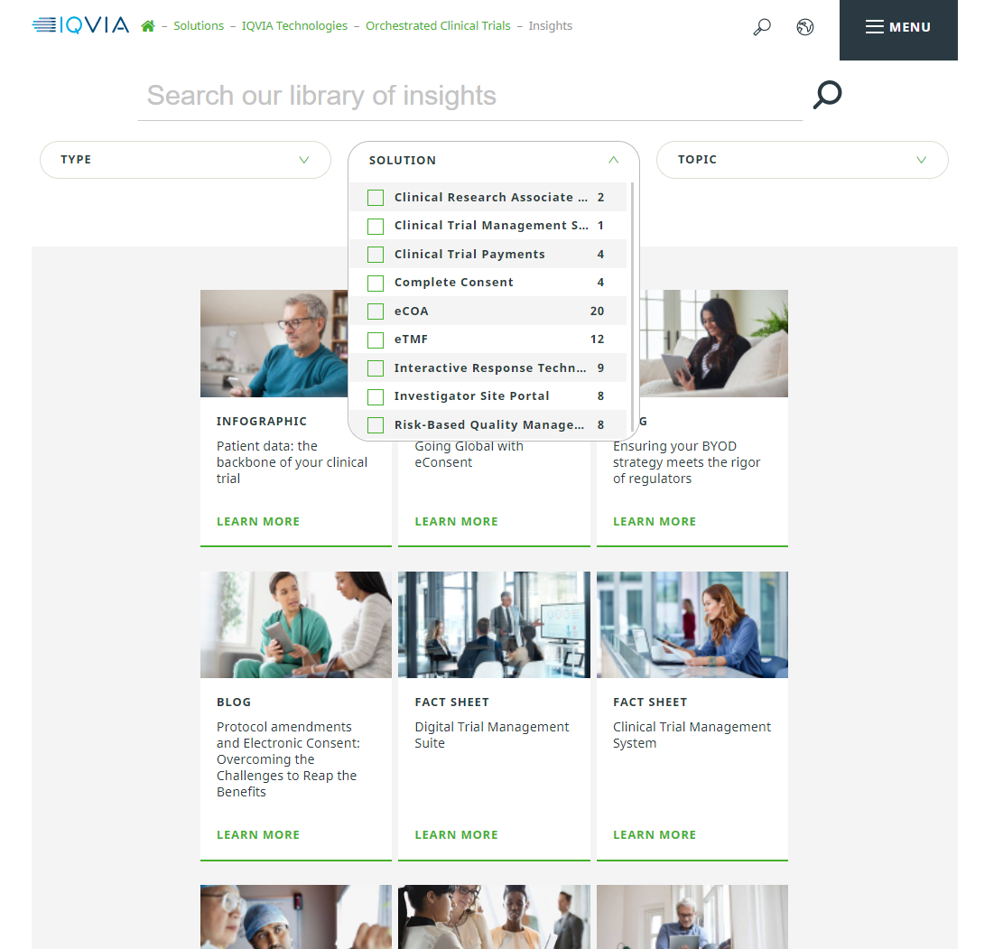
Solution Filters
Filters based on solutions can now be added to Insight listing pages
Allows users to find all the relevant content based on each solution.
Each listing page can be configured with a different filterable list of solutions.
To use the Solutions Filters for listing pages, please submit an “Update an Existing IQVIA.com page” with your request.

Slide 8
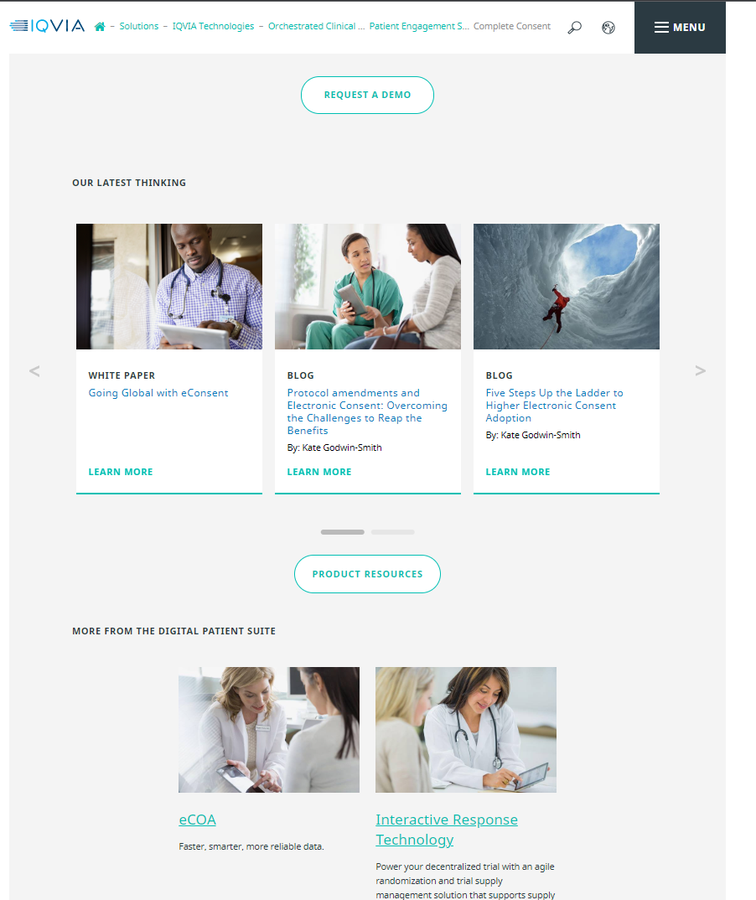
Dynamic Multi Card Modules
Coming soon! Estimated week of 6/6.
Multi cards that automatically update with the newest content based on Solution
Up to 9 of the latest thought leadership items can display
Once an asset is uploaded with the proper tagging, the module updates automatically.
Less requests to update the page.
To use the Dynamic Multi Cards, please submit an “Update an Existing IQVIA.com page” with your request.

Slide 9
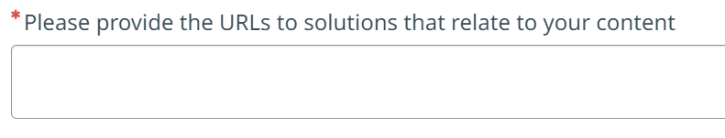
How to utilize the new features
Existing Thought Leadership
Content will need to be properly tagged with its related solution.
Audit your content.
Fill out the spreadsheet template specifying what solution each asset/blog post/event is associated to
Upload your spreadsheet to VIA ticket “Provide Digital Feedback”
New Thought Leadership
Provide your related solution URL(s) when submitting your VIA ticket
A new question for “related solutions” has been added to each VIA request for Web Ops
When submitting your ticket please specify your related solution URL(s)
When Web Ops creates the page, the tags will be applied to your asset/blog post/event

Slide 10
Thank You

