Slide 1
Marketing Operations
2022 Top Rankings
Kristen Powell
March 1, 2023

Slide 2
Agenda
Welcome
2022 Top Rankings
Open Q&A/Discussion

Slide 3

Marketing Operations Open Office Hours
Get your questions answered by the marketing operations team. Open Office Hours are held monthly with the following agenda:
Learn about a tip or best practice
Ask a question – Pre-submit your questions here or ask during the office hours
Learn how to leverage IQVIA’s marketing systems and processes most effectively
Action: Sign up here, if you need to be added to the outlook invite
Reminder: Save your questions for the end or enter in the chat. We will address as many as we can!

Slide 4
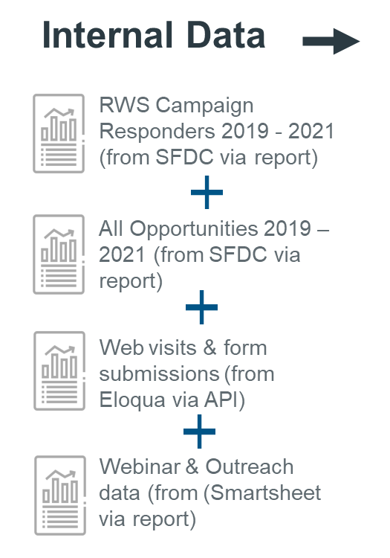
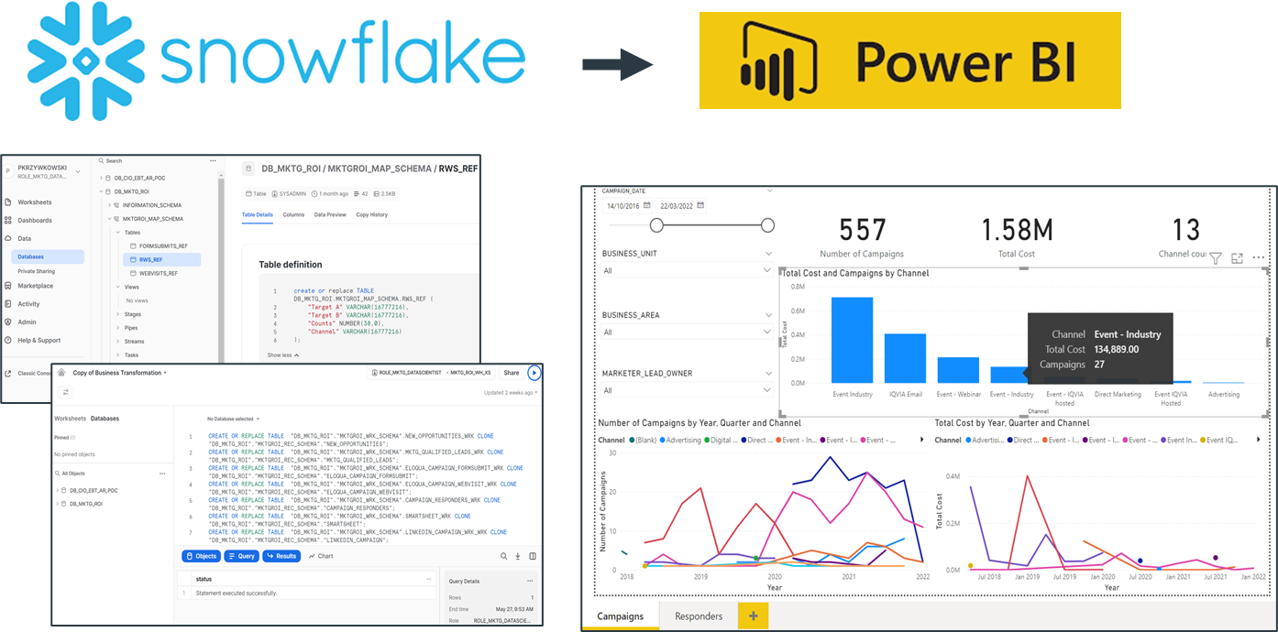
2022 Marketing Analytics & Decision Support Toolkit POC
Taking steps toward targeted, accessible, and timely campaign measurement tools
Partnered with Real World Solutions as Proof of Concept
Phase 1: Proof of Concept (ongoing pilot)
“Beta” version of what a Channel Analytics & Decision Support toolkit could look like
Built on top of the data science platform (Cloudera) and piloted with the RWS Marketing team
Phase 2: Tool build-out partnering with CIO (in progress)
Define business requirements for the Enterprise data lake & analytics layer
Prioritized POC for Marketing ROI within new platform

Slide 5
Top Channels

Slide 6

Top sources bringing in contacts into the database in 2022
NNCs

Slide 7

Events had the highest MQL acceptance rate in 2022
MQL task to accepted MQL
Notes:
Events may be particularly effective at generating leads hand raisers and becoming potential customers. This could be due to the fact that events provide a high level of engagement and interaction with prospects, which can help to build relationships and establish trust. Show that events in 2022 were effective in generating handraisers

Slide 8

Organic and paid search had the highest conversion rate in 2022
MQL to SQL conversion
Notes:
The fact that both organic and paid search had high MQL conversion rates suggests that SEM may be particularly effective at converting leads into customers. This could be due to the fact that prospects who come to a website through a search engine are actively looking for information related to the product or service being offered, making them more likely to convert into customers.

Slide 9

Top channels by SQL Amount
SQL Amount
Notes:
# of sqls

Slide 10
Top Campaigns

Slide 11
Top campaigns bringing in contacts into the database in 2022
NNCs

Slide 12

Top campaigns bringing in MQLs in 2022 were all US RBU campaigns
Marketing Qualified Leads

Slide 13
Top 10 campaigns generating MQLs by business area
US RBU:
OneKey
1,235
Analytic Solutions:
PromoMix
353
TCS:
CPhiWW
322
RWS:
RWELeadGEnAds
290
RWTP:
iqvia_rwtp
237
SRQ:
RegJulyWebinar
182
EMEA RBU: EU4UKCOVID19Septweb
139
RDS:
SCOPERDSClinTech
119
Biotech:
CNSLetsTalkLI
115
Comm Tech:
OCELinkedInAdsDemoRequest
108

Slide 14
Top campaign by channel
Campaign | Channel | # of MQLs
2022_CSMALibrariesMadLog_USCAusa_RL | Display | 965
2022_CPhIWW_GBU_TCS_SD | Event | 322
2021_iqvia_brand | Paid Search | 319
2022_RWELeadGenAds_GBU_RWS_PF | Paid Social | 290
2022_RWHealthEconomicsWbnrMay_USCAusa_RL | Webinar | 203
2022_AIMLinfograpBioPharma_GBU_RWS_JM | Third Party Provider | 155
2022_Q1Nurture_GBU_RWS_CA | Email | 138

Slide 15
Top campaigns bringing in the most SQLs in 2022
Sales Qualified Leads

Slide 16
Top campaigns bringing in the SQLs with the highest amount
SQL Amount

Slide 17
Top Content

Slide 18

Top iqvia.com pages driving MQLs in 2022
Marketing Qualified Leads

Slide 19
Top iqvia.com pages driving # of SQLs in 2022
Sales Qualified Leads

Slide 20
Top iqvia.com pages driving SQL Amount in 2022
Sales Qualified Leads

Slide 21
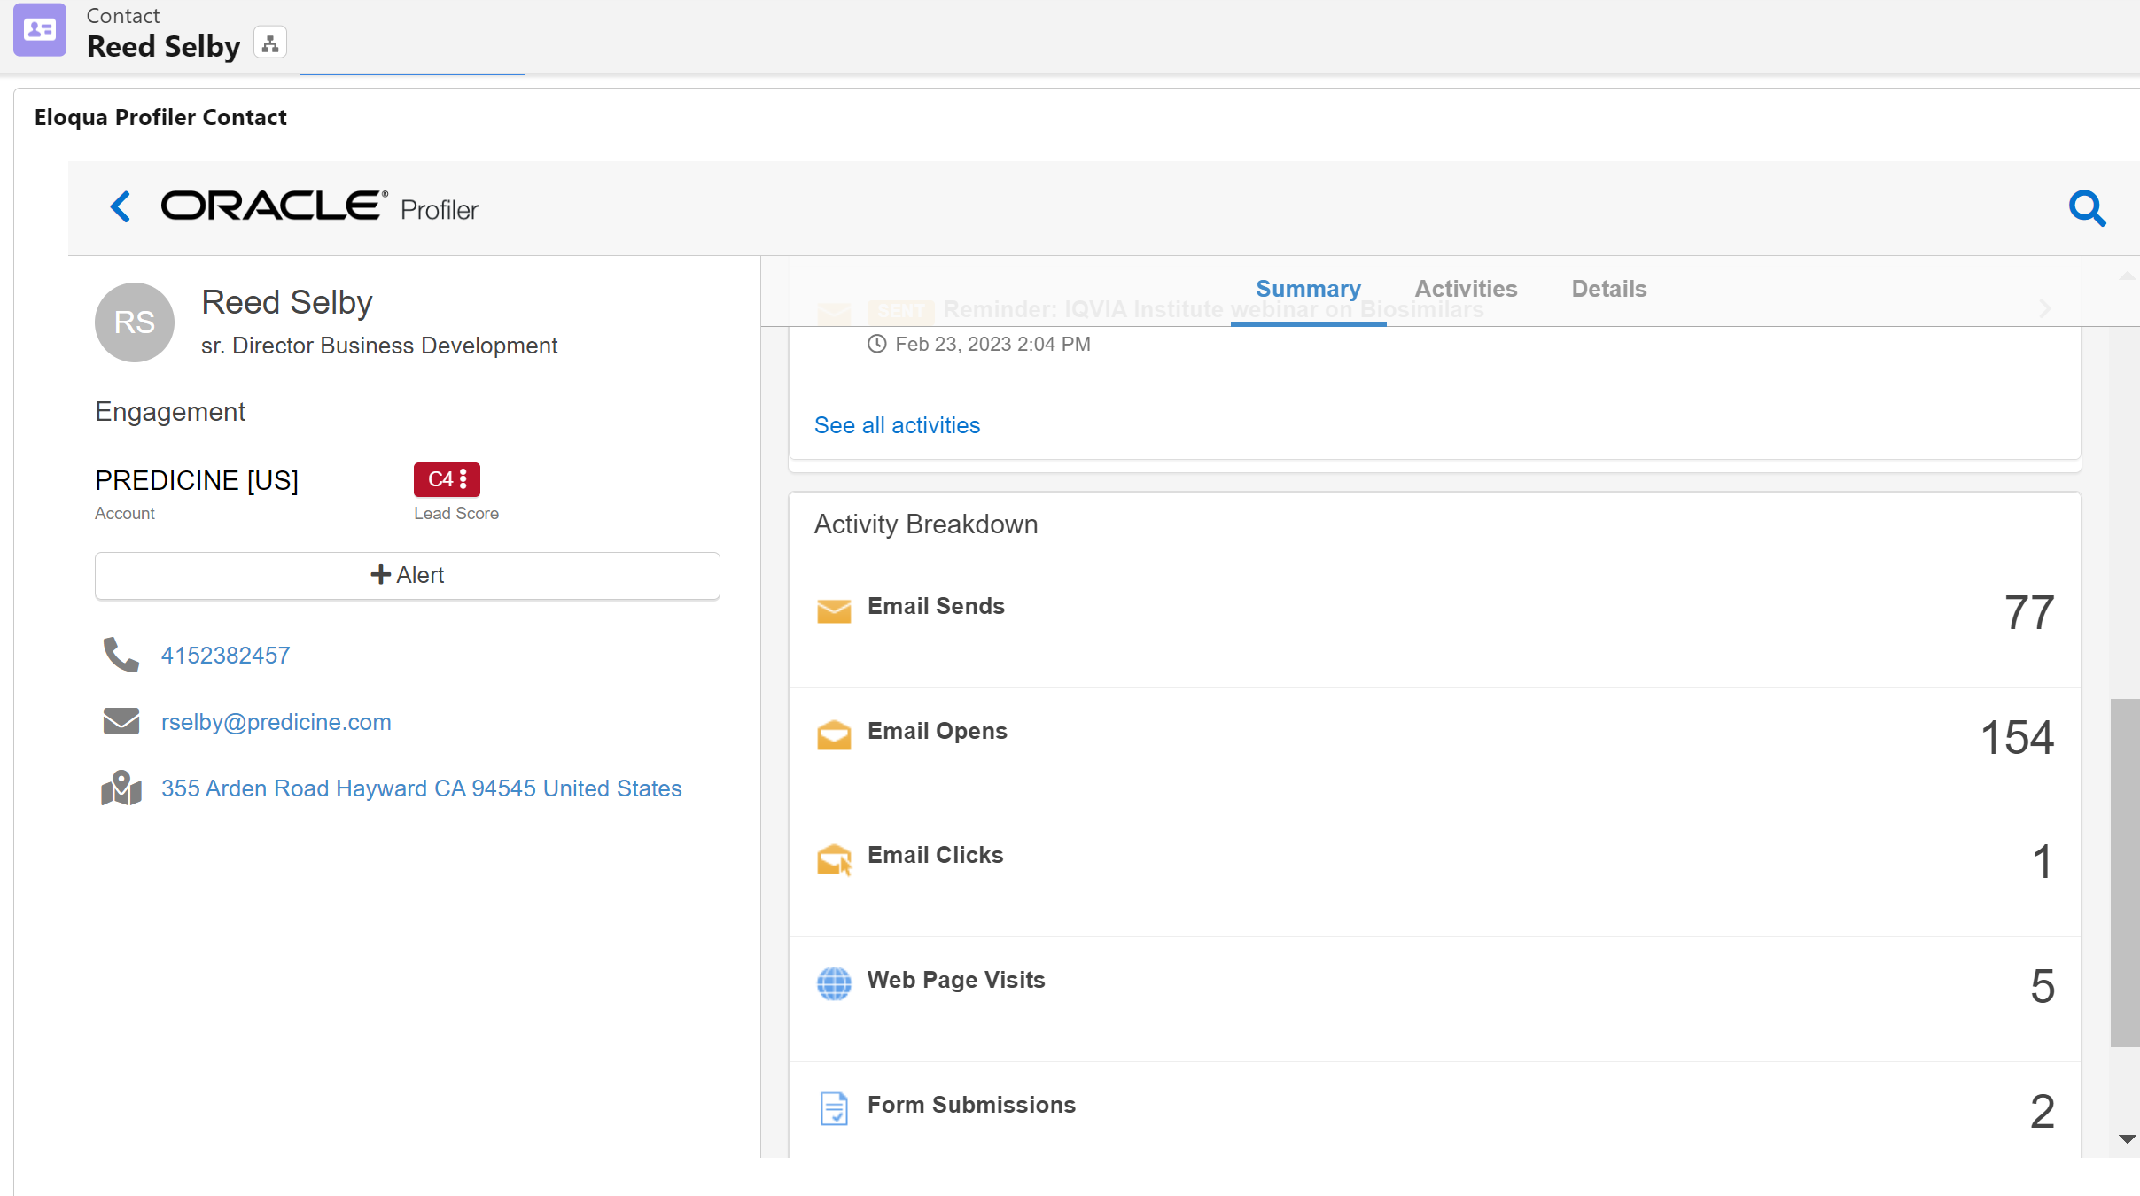
All channels play a part in different user journeys
This contact interacted with different channels and ended up becoming an MQL through the RWTP Paid Search campaign.
Resulted in won opportunity

Slide 22
Thank You

